Slide 1
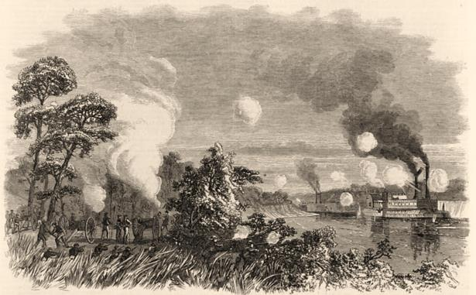
Bailey’s Dam 1864
Learn about Louisiana’s Past through Archaeology
Notes:
Bailey’s Dam 1864
Image credit: Library of Congress, LC-USZ62-117667

Slide 2
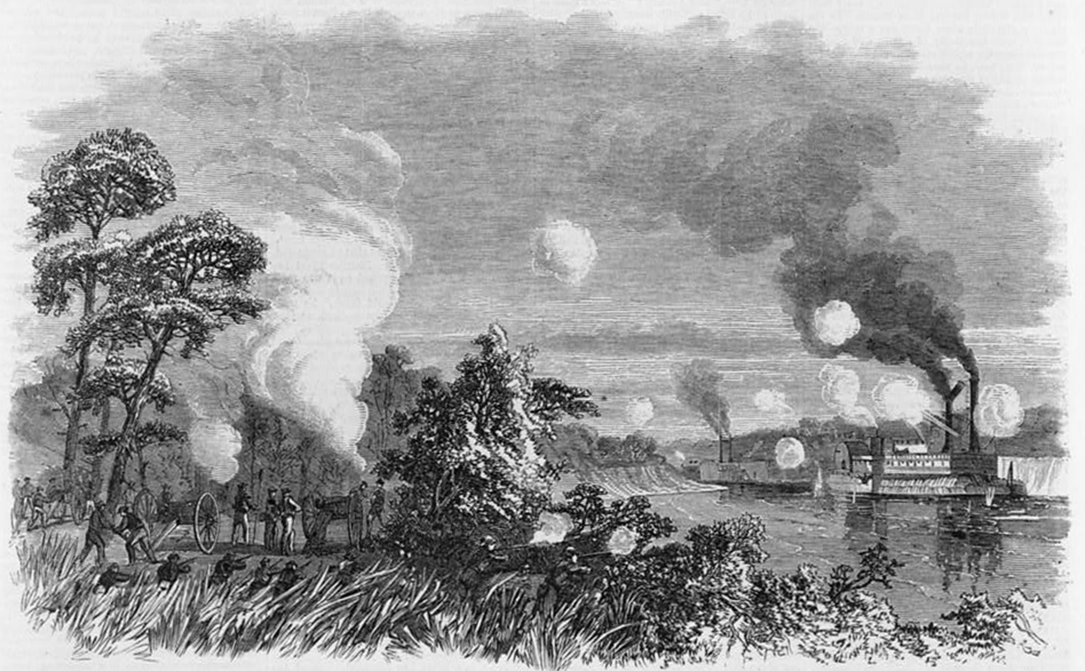
Bailey’s Dam
Library of Congress LC-USZ62-117667
Destruction of the Union transport John Warner, Red River 1864
Notes:
Bailey’s Dam 1864
It is hard to imagine an event could change your life, and the lives of everyone you know, forever. That is what happened in Louisiana during the Civil War. From 1861 to 1865, the people of Louisiana saw everything change. Louisiana split from the Union in January 1861, and joined the Confederate States of America. Soon after, over 25,000 Louisiana men went away to fight. Union forces invaded and controlled parts of Louisiana, such as Baton Rouge, New Orleans, and Opelousas. The Emancipation Proclamation of 1863 freed over 300,000 slaves. All of these events had a huge effect on the society and economy of Louisiana. Few people living in the state at this time escaped the effects of the Civil War.
This is an 1864 drawing from Frank Leslie’s Illustrated Newspaper. It is of an event related to the Civil War in Louisiana. Frank Leslie’s Illustrated Newspaper was in print from 1855 to 1891. It reported weekly on the events of the Civil War.
Image credit: Frank Leslie’s Illustrated Newspaper, June 18, 1864, page 197; Library of Congress, LC-USZ62-117667

Slide 3
Bailey’s Dam
Library of Congress LC-DIG-ppmsca-34042
Building Bailey’s Dam, Alexandria, 1864
Notes:
Civil War Louisiana 1861-1865
Bailey’s Dam is the subject of this presentation. This site was the result of a Civil War event in Louisiana. Bailey’s Dam is also important because of the vision of one man, and the effort of many. This site is a tribute to human ingenuity, teamwork and courage.
Bailey’s Dam is in Rapides Parish, near the city of Alexandria. The Union army built a series of dams here during the Red River Campaign. A campaign is a military plan with a specific goal. It can include more than one battle, and take place in more than one location. This is a photograph of the construction of Bailey’s Dam in 1864.
Image credit: Library of Congress, LC-DIG-ppmsca-34042

Slide 4
Bailey’s Dam
Last Confederate army surrenders June 1865
Louisiana secedes
Jan 1861
Port Hudson surrenders
July 1863
Louisiana joins Confederacy
March 1861
Lee surrenders April 1865
Abraham Lincoln elected president Nov 1860
Emancipation
Proclamation
Jan 1863
Red River Campaign
March 1864
Civil Rights Act of 1866
A.D. 1860 | A.D. 1861 | A.D. 1862 | A.D. 1863 | A.D. 1864 | A.D. 1865 | A.D. 1866
Union occupies
New Orleans
April 1862
Reconstruction in Louisiana
March 1865
Tennessee 1st Confederate State readmitted to Union
July 1866
Union uses
African-American troops
at Port Hudson
Ft. Sumter attacked
April 1861
Civil War!
Union takes
Baton Rouge
May 1862
Union takes Alexandria March1864
Black = Louisiana
Red = Other Events
Timeline of events in Louisiana and the United States 1860-1867
Notes:
Civil War Louisiana 1861-1865
First, let’s put the Civil War in Louisiana in context. Here is a timeline of events in Louisiana and other areas of the U.S. during the war.

Slide 5
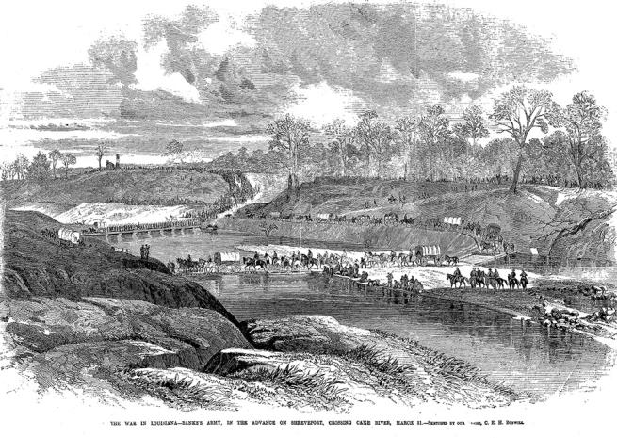
Bailey’s Dam
The Red River Campaign – March 10 to May 22, 1864
Library of Congress LC-USZ62-111176
Union forces cross the Cane River, March 1864
Notes:
The Red River Campaign – March 10 to May 22, 1864
To understand more about Bailey’s Dam, we’ll need to talk a little about the Red River Campaign. This was the Union’s last campaign in Louisiana. Why was this campaign important? President Lincoln was worried that Emperor Maximillian I of Mexico would join the war on the side of the Confederates. Lincoln decided that a Union presence in Texas would prevent Mexico from entering the conflict. Lincoln’s goal for the Red River Campaign was to capture the city of Shreveport, and then move into Texas. At this time, Shreveport was the Confederate capital of Louisiana. It was also the headquarters of the Confederate command west of the Mississippi. The Union would score big if this campaign was successful.
Success for the Union would mean control of Shreveport and control of the Red River. This was the only major river in Louisiana still in Confederate hands. This is a drawing of the Union forces crossing the Cane River on their way to Shreveport.
Image credit: Frank Leslie’s Illustrated Newspaper, May 7, 1864, page 108; Library of Congress, LC-USZ62-111176

Slide 6
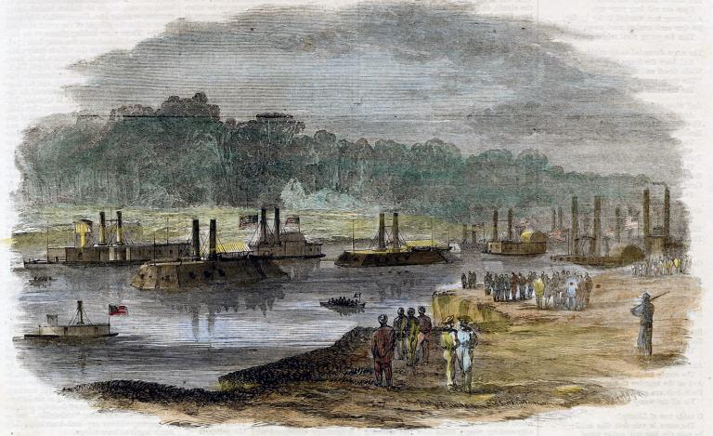
Bailey’s Dam
The Red River Campaign – March 10 to May 22, 1864
Transport
Ironclad
Steamer converted
to transport
Harper’s Weekly, April 30, 1864
Union boats on the Red River at Alexandria, 1864
Notes:
The Red River Campaign – March 10 to May 22, 1864
This is a drawing from Harper’s Weekly of Union boats on the Red River. There were a variety of boats in the Red River Campaign. Ironclads were the armed boats. Transport boats carried troops. Riverboats and ferries transported people, and sometimes served as hospitals. Barges carried materials and supplies. These boats play an important role in the story of Bailey’s Dam.
Image credit: Harper's Weekly, April 30, 1864, courtesy of Louisiana State Library

Slide 7
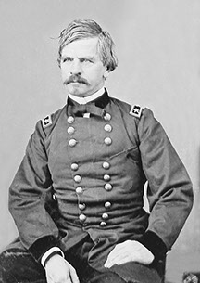
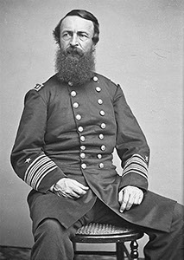
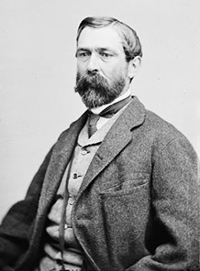
Bailey’s Dam
The Red River Campaign – March 10 to May 22, 1864
Union Officers
Major General Nathaniel Banks - Army
Rear Admiral David Porter - Navy
Lt. Colonel Joseph Bailey - Army Engineer
Banks
Confederate Officer
Major General Richard Taylor
Porter
Bailey
Taylor
Notes:
The Red River Campaign – March 10 to May 22, 1864
These are the Union and Confederate officers of the Red River Campaign. Colonel Bailey was an engineer in the Union army, and came up with the idea and design for the dams. Admiral Porter was in charge of the Union navy, and General Banks was in charge of the Union army. The Union navy and army worked together in this campaign. General Taylor was in charge of the Confederate forces in Louisiana. His headquarters, and a number of soldiers, were in Shreveport. But, his forces were much smaller in number than those of General Banks and Admiral Porter.
Image credits:
Bailey – National Archives 111-BA-188
Banks – National Archives 111-B-3753
Porter – National Archives 111-B-1889
Taylor – Library of Congress LC-B813-2113 B [P&P]
Confederate flag – Wikipedia, in public domain http://en.wikipedia.org/wiki/Flags_of_the_Confederate_States_of_America#mediaviewer/File:CSA_FLAG_28.11.1861-1.5.1863.svg
Union flag – Wikipedia, in public domain http://en.wikipedia.org/wiki/Union_(American_Civil_War)#mediaviewer/File:US_flag_34_stars.svg

Slide 8
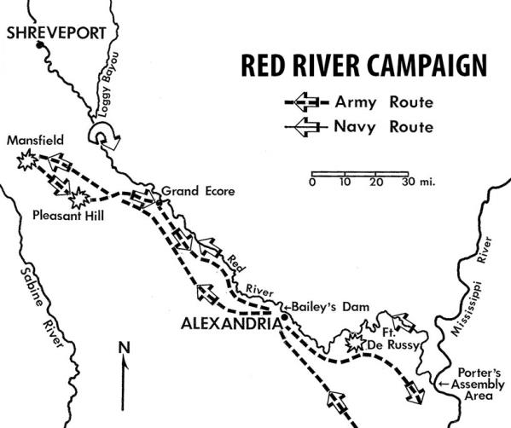
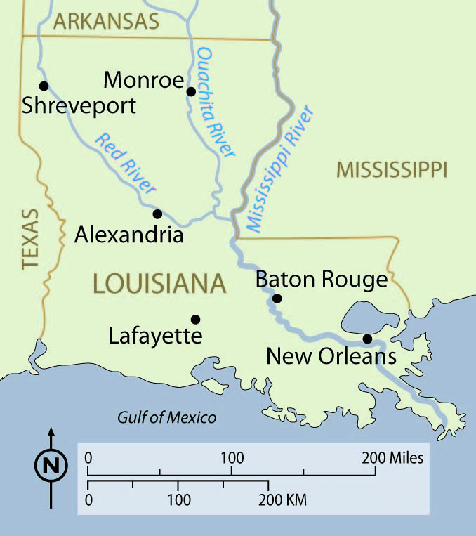
Bailey’s Dam
Bailey’s Dam
Map of the Red River Campaign, 1864
Notes:
The Red River Campaign – March 10 to May 22, 1864
Here is a map of the Red River Campaign. There were battles at Ft. DeRussy, Grand Ecore, Pleasant Hill and Mansfield. Skirmishes took place in several areas along the Red River. A “skirmish” is a brief fight between two forces. Although the plan for the Union forces was to reach and take Shreveport, they never made it. They turned around after the battle of Mansfield, and headed back toward the Mississippi River. It was on this return trip down the Red River that the real trouble began for the Union boats.
Image credits:
Red River Campaign map – Louisiana Division of Archaeology
Map of Louisiana – Station Archaeology Program

Slide 9
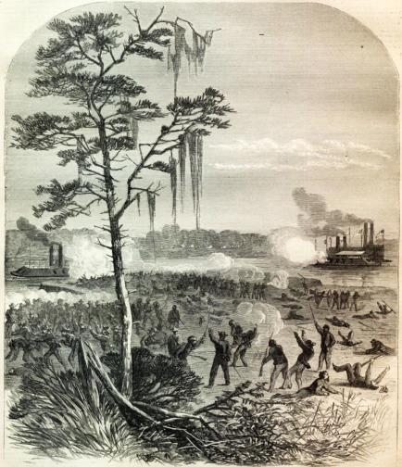
Bailey’s Dam
Harper’s Weekly 1864, Library of Congress LC-USZ62-117668
Confederate attack on Union boats in Red River, 1864
Notes:
The Red River Campaign – March 10 to May 22, 1864
During the retreat from Mansfield, the water in the Red River was very low. The Union fleet was stuck in the river near Alexandria. The river had big stone outcrops in that area, and the boats could not float over them. The boats were easy targets for Confederate attacks. This is a drawing of a Confederate attack on Union boats in the Red River. It appeared in Harper’s Weekly on May 14, 1864.
Image credit: Harper’s Weekly May 14, 1864, Library of Congress LC-USZ62-117668

Slide 10
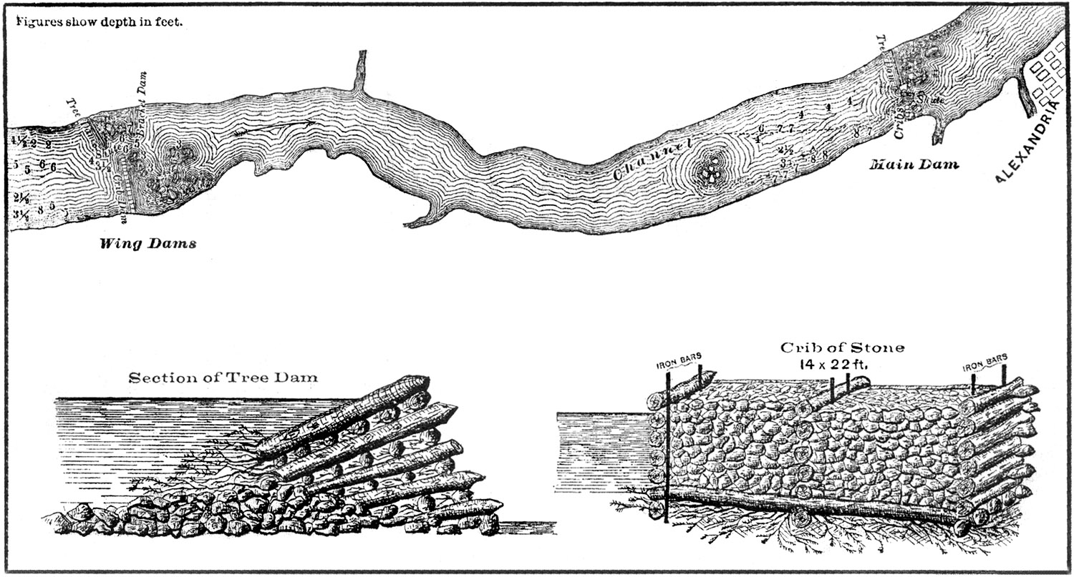
Bailey’s Dam
Tree Dam
Crib Dam
A.T. Mahan, US Navy, 1883
Sketch of the Red River and Dams, 1864
Notes:
Bailey’s Dam 1864
Bailey’s Dam was a way to free the Union boats. Colonel Bailey was an experienced lumberman before the war. He used dams to float timber down a river to a sawmill. He suggested a series of dams would raise the water level, which would help free the stranded Union boats. Once the water levels were high enough, the dams would be broken, and the fast-moving current would push the boats over the shallow areas.
The type of dam and choice of construction materials for each structure depended on the geography and materials available in the area. Here is a sketch of the river where dams were located, and two types of dams built. A wedge-shaped tree dam on one side of the river, and rectangular crib dam on the other side made up the main dam. Barges, which are flat boats, closed up the gap in the middle.
Image credit: The Navy in the Civil War, Volume III – The Gulf and Inland Waters, by Commander A.T. Mahan, U.S. Navy, 1883. Gutenberg Files http://www.gutenberg.org/files/21562/21562-h/21562-h.htm#imagep208

Slide 11
Bailey’s Dam
LC-DIG-ppmsca-34042
Building Bailey’s Dam, Alexandria, 1864
Notes:
Bailey’s Dam 1864
Many Union military units built the dam. But, the majority of the project fell to three crews: the 29th Maine Volunteer Infantry Regiment, and former slaves in the 97th and 99th Regiments of the United States Colored Troops Infantry. These men braved not only the Louisiana rivers, woods and swamps, but the threat of sniper attack while they worked on the dam. This is a photograph of the construction of Bailey’s Dam in 1864.
While this was the best idea at the time to free the Union boats, few actually believed it would work.
Image credit: Library of Congress LC-DIG-ppmsca-34042

Slide 12
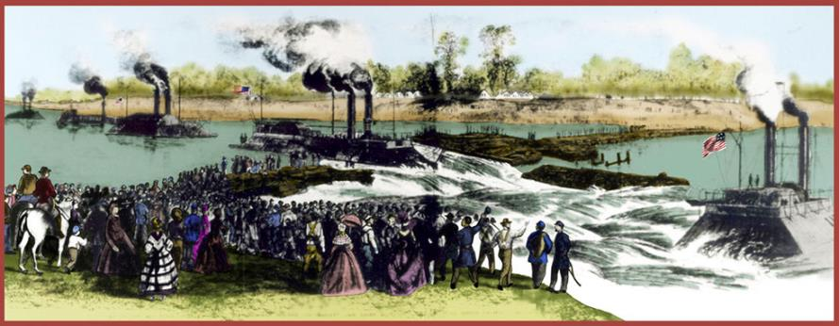
Bailey’s Dam
Colorized version of image from Frank Leslie’s Illustrated Newspaper, July 16, 1864
Union fleet passing through Bailey’s Dam, May 1864
Notes:
Bailey’s Dam 1864
But, it did work! The dam project was a great success for Colonel Bailey. The water level rose, and the Union boats were freed. They continued on their way to the Mississippi River, and the Confederates did not destroy the fleet. Bailey’s Dam played a key role in the outcome of the Red River Campaign. If the Confederates had destroyed the Union fleet, the Civil War would have continued longer.
This is a drawing of the Union boats passing through Bailey’s Dam in May 1864.
Image credit: colorized version of image from Frank Leslie’s Illustrated Newspaper, July 16, 1864. Courtesy of the Louisiana State Library.

Slide 13
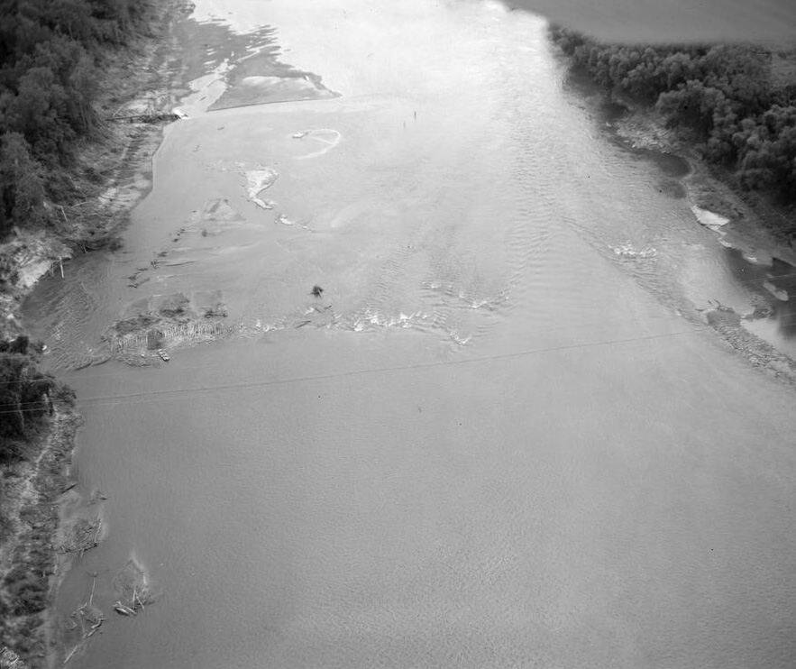
Bailey’s Dam
Bailey’s Dam
Library of Congress HAER LA,40-ALEX.V,2-1; CEI
Aerial view of Bailey’s Dam at low water, 1984
Notes:
Bailey’s Dam 1984
The remains of Bailey’s Dam were visible during low water in the river. Low water was a problem in the Red River because it restricted boat traffic. The U.S. Army Corps of Engineers wanted to build a modern dam just downstream from Bailey’s Dam as part of their Red River Waterway Project. You can learn more about this project at http://www.redriverwaterway.com/ind-locks.asp. This construction project would allow more boat traffic in the Red River. It would also affect Bailey’s Dam. The lock and dam would cause the site to be underwater permanently. Because Bailey’s Dam was an important part of our history, the U. S. Army Corps of Engineers wanted archaeologists to investigate the site.
Image credits:
Library of Congress HAER LA,40-ALEX.V,2-1
Coastal Environments, Inc.

Slide 14
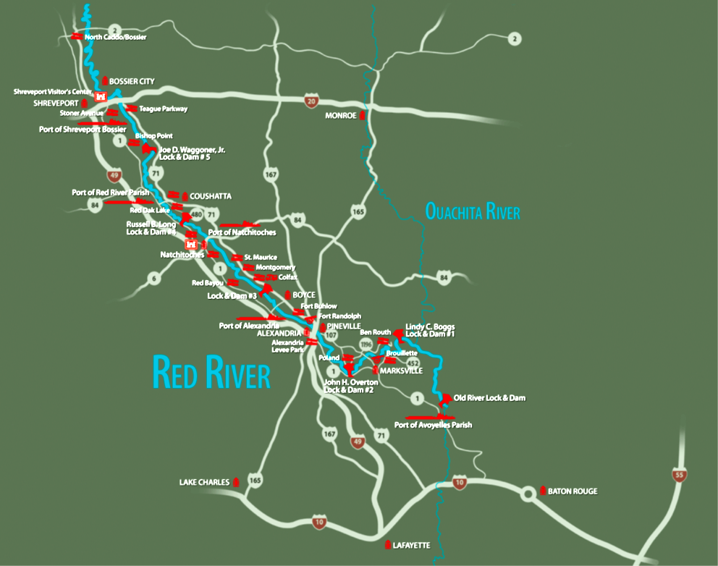
Bailey’s Dam
Bailey’s Dam
Red River Waterway Commission
U.S. Army Corps of Engineers’ Red River Waterway Project and Bailey’s Dam
Notes:
Bailey’s Dam Fieldwork 1984
This is a map of the U.S. Army Corps of Engineers’ Red River Waterway Project. Let’s talk a little about dams and locks. Dams and locks are used on shallow rivers. They work by maintaining the same water level all of the time. Dams hold water, and locks raise or lower the water level. Locks open and close to adjust the water level in each dam section, and are large enough for a boat to pass through. Dams and locks help boats travel through the shallow areas of a river.
Image credit: Red River Waterway Commission http://www.redriverwaterway.com/forms/Full-Map.pdf

Slide 15
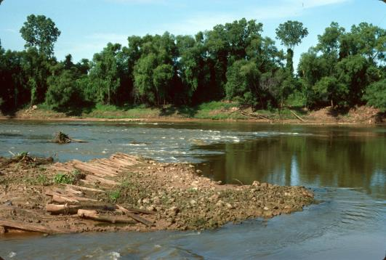
Bailey’s Dam
Photographs by Coastal Environments, Inc.
Bailey’s Dam at low water in the Red River, 1984
Notes:
Bailey’s Dam Fieldwork 1984
Archaeologists started work at Bailey’s Dam in the summer of 1984. These are photographs of Bailey’s Dam taken at low water. The image on the left is an overview of an area of the Red River where part of a dam was exposed. Notice the people in the photograph, just to the right of the red box. Archaeologists sometimes use people in photographs to show the size of an object that may not be easy to measure. The photograph on the right is a close-up of the exposed dam.
Image credit: Coastal Environments, Inc.

Slide 16
Bailey’s Dam
A.T. Mahan, US Navy, 1883
Photograph by Coastal Environments, Inc.
Section of a tree dam from Bailey’s Dam site, 1984
Notes:
Bailey’s Dam Fieldwork 1984
Archaeologists started first on the tree dam. It was on the east side of the Red River, where Pineville is today. The image on the left is a sketch of the tree dam from 1864. This drawing is from an 1883 report on the Civil War. The photograph on the right is an archaeologist recording a section of the dam in 1984.
Archaeologists wanted to know if the remains of the tree dam and the crib dam would confirm the information in the historical drawings.
Image credits:
Sketch of tree dam – The Navy in the Civil War, Volume III – The Gulf and Inland Waters, by Commander A.T. Mahan, U.S. Navy, 1883. Gutenberg Files http://www.gutenberg.org/files/21562/21562-h/21562-h.htm#imagep208
Archaeologists recording exposed dam structure – Coastal Environments, Inc.

Slide 17
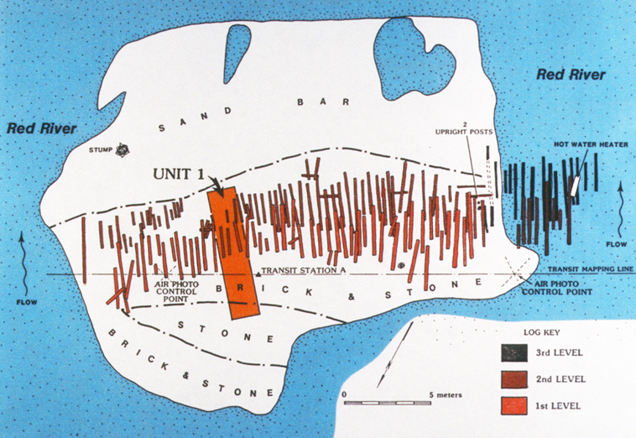
Bailey’s Dam
Coastal Environments, Inc.
Map of tree dam excavation, Unit 1 Trench, 1984
Notes:
Bailey’s Dam Fieldwork 1984
Archaeologists dug a trench to study the tree dam. This map shows the location of the trench. This drawing includes geographical structures in the area, such as a sand bar and areas where archaeologists found brick and stone. There is a color coded “log key” showing levels where features were found.
Archaeologists chose a trench to get a long profile of the structure to see how it was constructed. The trench was 5 feet wide by 22 feet long, and was parallel to the river current. Archaeologists had to use a water pump in this unit because rising water seeped into the trench. Originally, the plan was to get to the base of the tree dam, but the water pump could not match the pace of rising water levels. Archaeologists recorded and photographed each detail of the tree dam construction, and compared their notes with historical records.
Image credit: Coastal Environments, Inc.

Slide 18
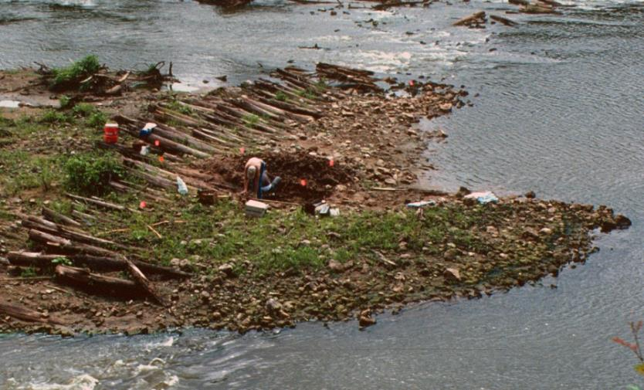
Bailey’s Dam
Archaeologists
Photograph by Coastal Environments, Inc.
Archaeologists excavating trench unit at Bailey’s Dam, 1984
Notes:
Bailey’s Dam Fieldwork 1984
This is a photograph of archaeologists digging the trench. It’s easy to see from this photograph how the rising water could affect their work.
Image credit: Coastal Environments, Inc.

Slide 19
Bailey’s Dam
Photograph by Coastal Environments, Inc.
Close-up of Unit 1 Trench, 1984
Notes:
Bailey’s Dam Fieldwork 1984
Here is a close-up of part of the Unit 1 trench. Historical records showed that the material used to build the tree dam came from the surrounding forest. Archaeologists confirmed this from their excavations, and by recording the types of trees in the nearby forest. Historical drawings showed the timbers with their tops pointed upstream. Archaeologists found the tree tops pointed downstream. They also discovered the timbers didn’t have limbs, and the tree tops were made pointed by an axe. Archaeologists found brick and stone on top of the dam, and sand and mud in the spaces between the logs.
Image credit: Coastal Environments, Inc.

Slide 20
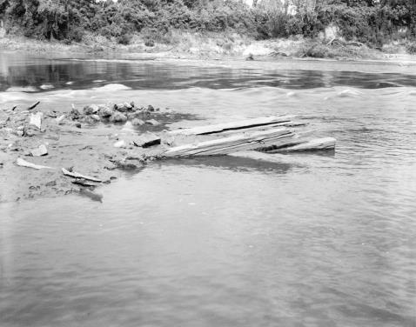
Bailey’s Dam
A.T. Mahan, US Navy, 1883
Library of Congress HAER LA,40-ALEX.V,2—16; CEI
Section of a crib dam from Bailey’s Dam site
Notes:
Bailey’s Dam Fieldwork 1984
Next, archaeologists worked on the crib dam. According to historical records, the frame for the crib dam was timber taken from buildings on the Alexandria side of the river. Stone, brick and other materials filled the dam to weigh it down. The image on the left is a sketch of the crib dam from 1864. This drawing is from an 1883 report on the Civil War. The photograph on the right is exposed timbers of the crib dam, taken in 1984.
Image credits:
Sketch of crib dam – The Navy in the Civil War, Volume III – The Gulf and Inland Waters, by Commander A.T. Mahan, U.S. Navy, 1883. Gutenberg Files http://www.gutenberg.org/files/21562/21562-h/21562-h.htm#imagep208
Photograph of crib dam – Library of Congress HAER LA,40-ALEX.V,2—16 http://www.loc.gov/pictures/item/la0217.photos.073301p/resource
Coastal Environments, Inc.

Slide 21
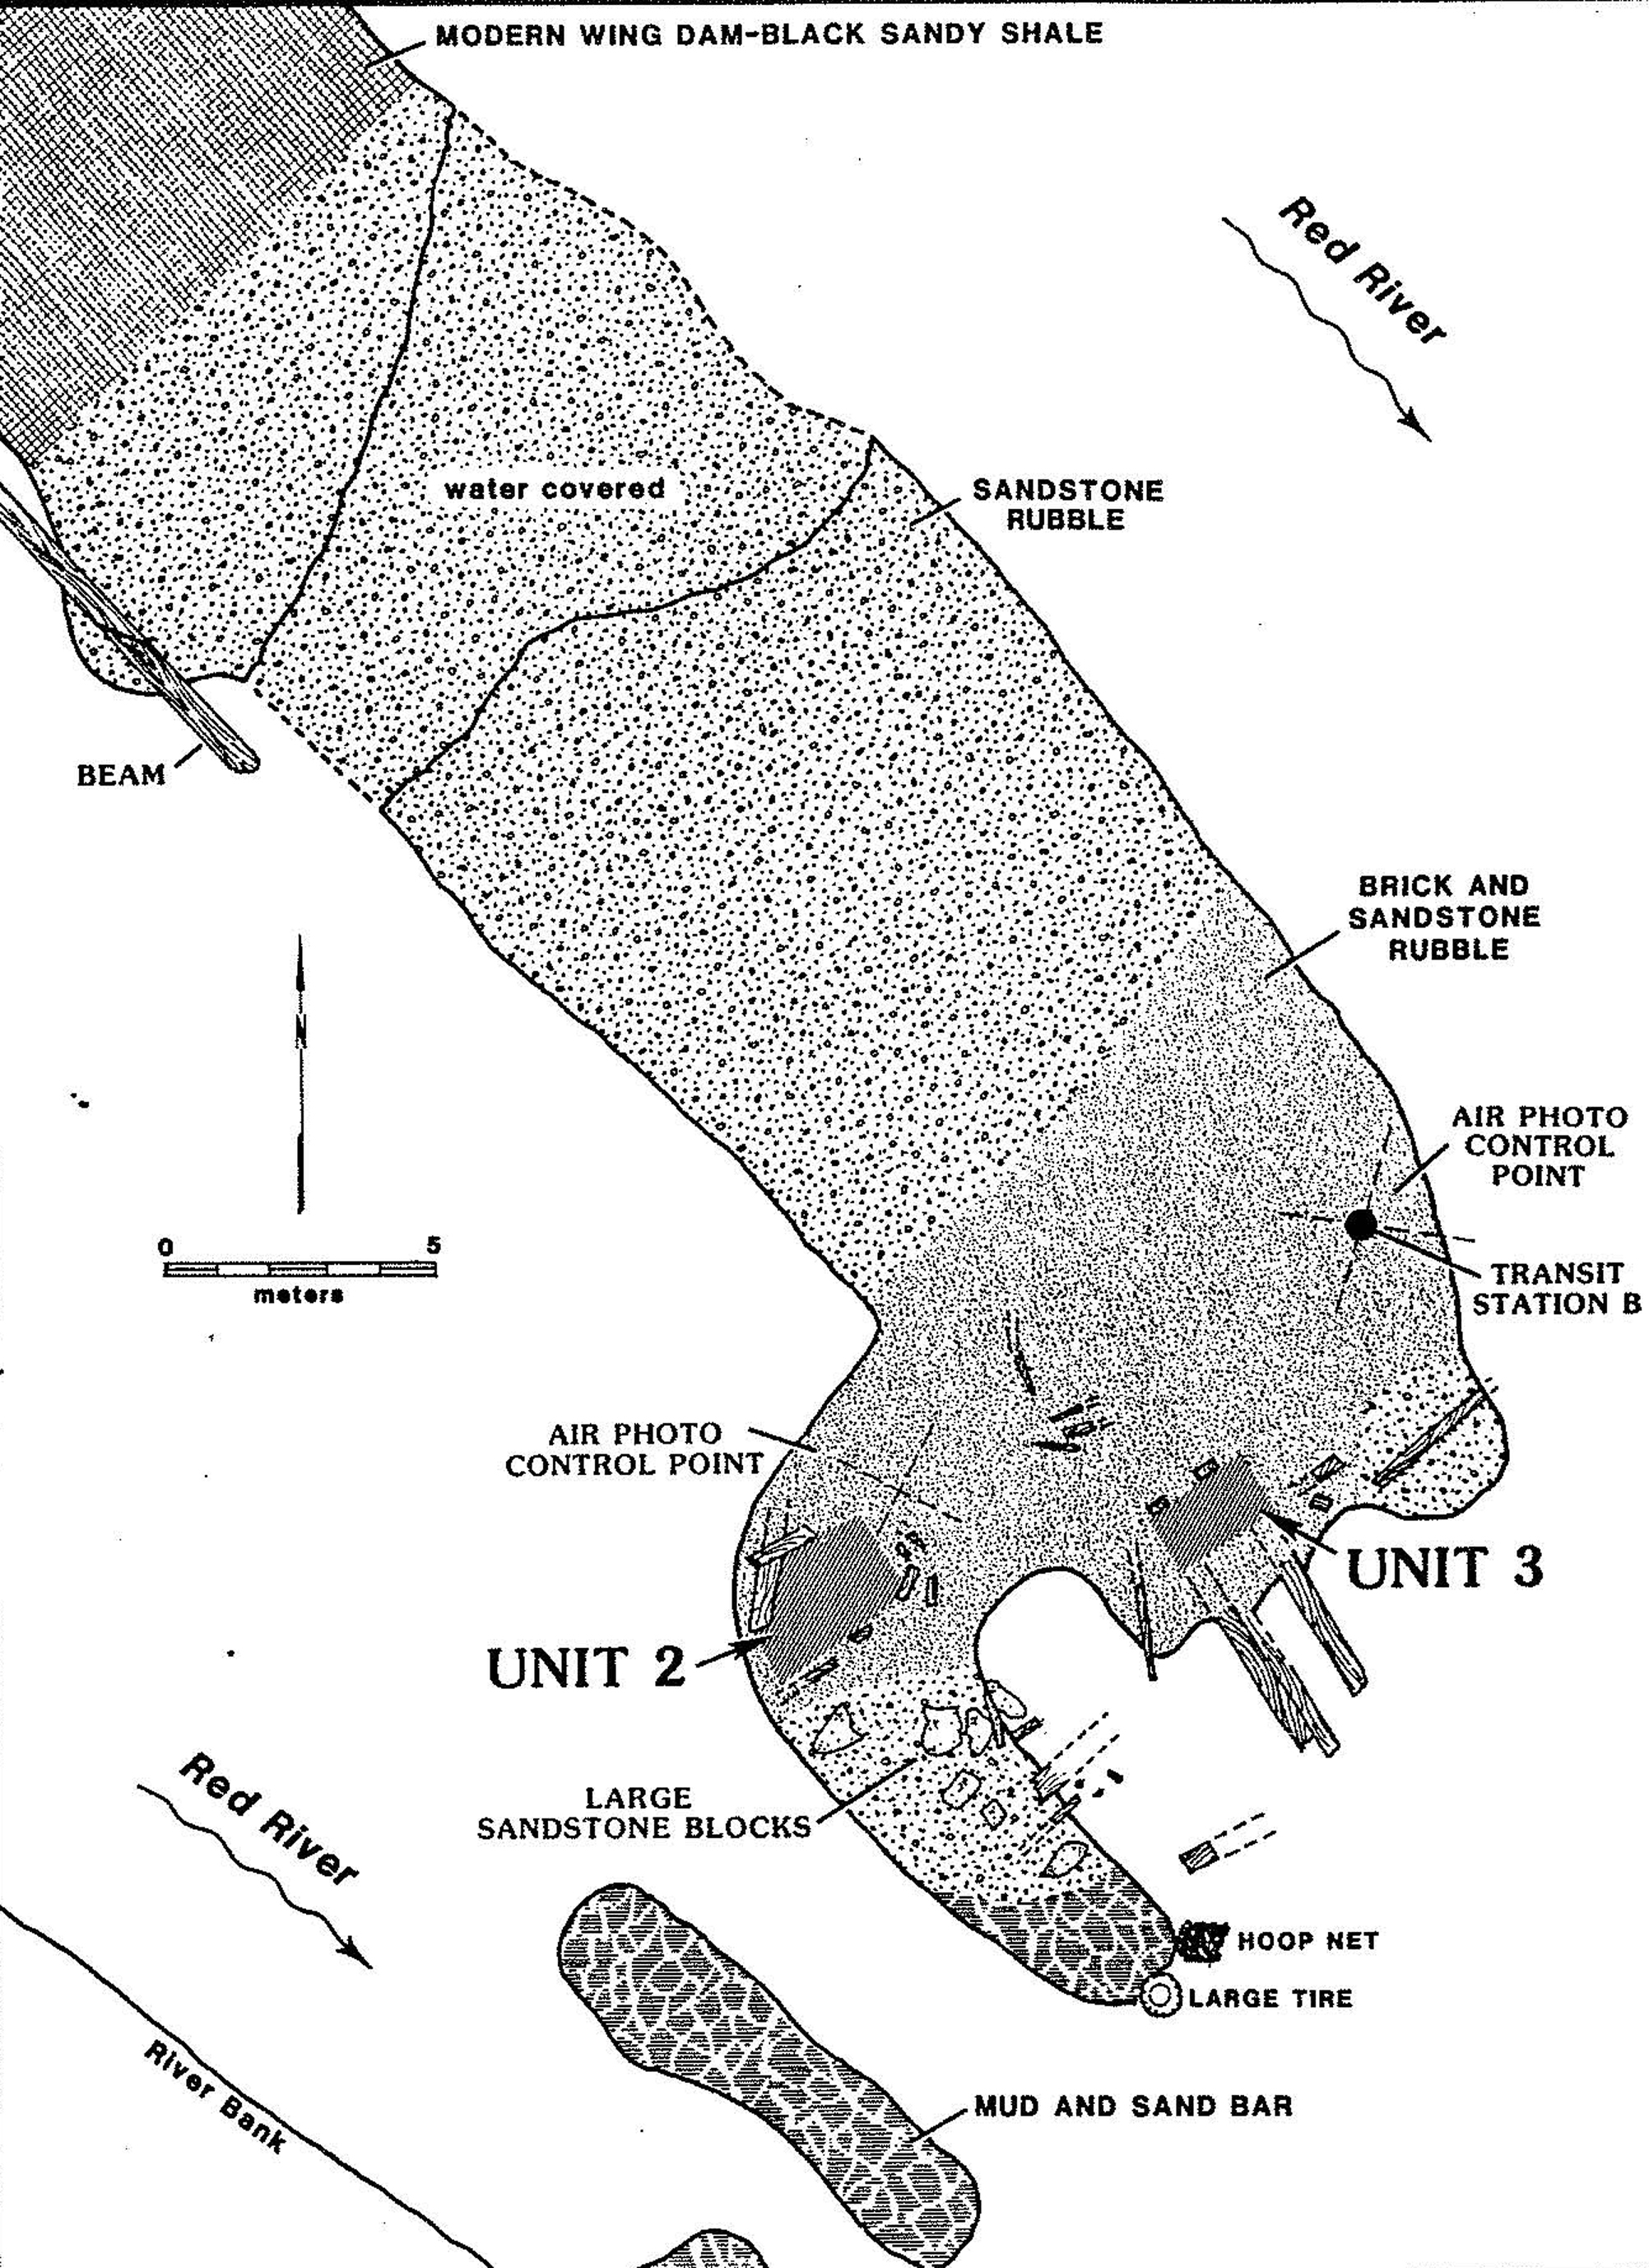
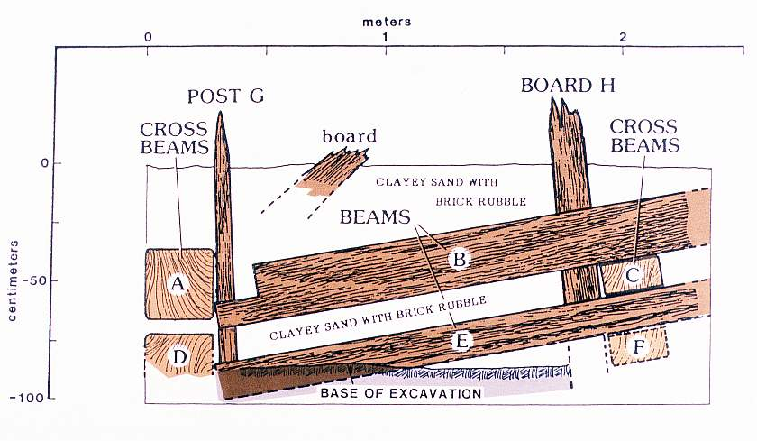
Bailey’s Dam
Images by Coastal Environments, Inc.
Wall profile of Unit 3
Map of Units 2 and 3
Notes:
Bailey’s Dam Fieldwork 1984
Archaeologists dug two units around the crib dam, Unit 2 and Unit 3. The image on the left is a map of the location of the units. The image on the right is a wall profile from Unit 3. Each unit measured 4 feet wide by 8 feet long. Archaeologists removed mud and dirt from these units to reveal the construction of the crib dam. They recorded and photographed the position of each timber and beam.
Image credit: Coastal Environments, Inc.

Slide 22
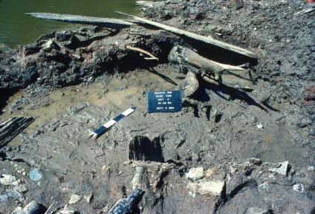
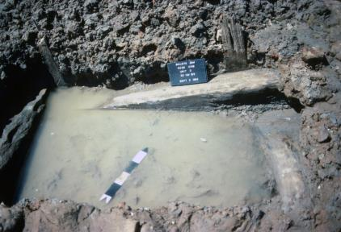
Bailey’s Dam
Photographic Board
Photographs by Coastal Environments, Inc.
Unit 2 Crib Dam
North Arrows
Unit 3 Crib Dam
Notes:
Bailey’s Dam Fieldwork 1984
Here are close-up photographs of the crib dam units. There is an arrow pointing to north, which also serves as a scale. The scale is in 10 centimeter increments. Notice the photographic boards with information about the unit, depth and level. These boards also contain the date and site number. The arrows and boards are standard archaeological methods and techniques when excavating and recording a site.
Archaeologists confirmed many historical accounts of how the crib dams were constructed. However, they discovered that the documents were not always accurate. Historical documents indicated that the fill for the crib dam was brick, stone, and machine parts. Archaeologists found some of the crib fill was sand and mud, with a layer of loose bricks and stone on top. This differed from the historical accounts.
Image credit: Coastal Environments, Inc.

Slide 23
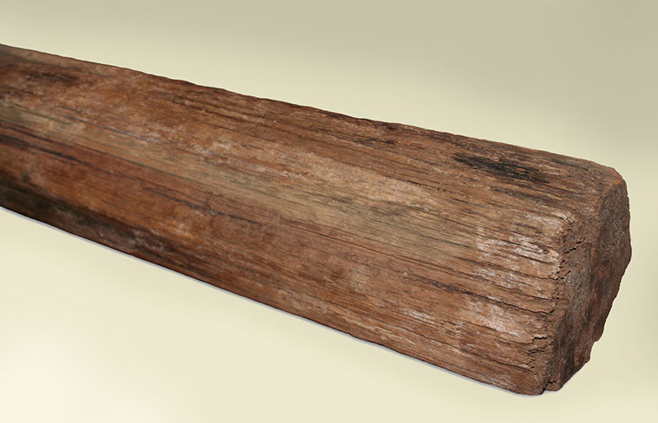
Bailey’s Dam
Wood from Bailey’s Dam
Notes:
Bailey’s Dam Artifacts 1984
This is a piece of wood from the tree dam. It might have come from a building in Alexandria, or it might be the mast of a river boat. Union soldiers took wood from just about anywhere to build the dams.
The next several slides feature other artifacts from Bailey’s Dam. Archaeologists recovered these artifacts from the east and west banks of the Red River near the dams.
Image credit: Louisiana Division of Archaeology

Slide 24
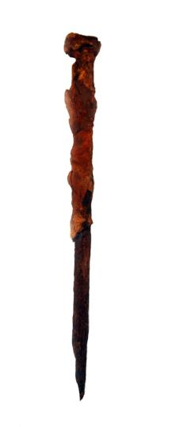
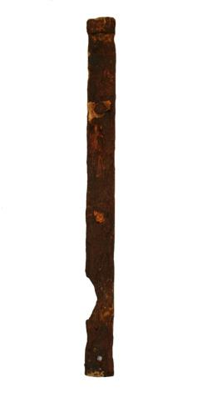
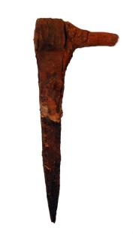
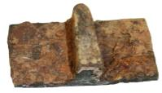
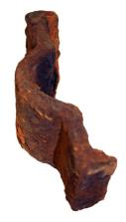
Bailey’s Dam
Iron Hinges
Iron Fragment
Iron Spike
Metal artifacts from Bailey’s Dam
Notes:
Bailey’s Dam Artifacts 1984
Here are some of the metal artifacts found at Bailey’s Dam. Items like these might have been fill for the dams.
Image credit: Louisiana Division of Archaeology

Slide 25
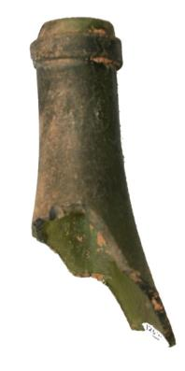
Bailey’s Dam
Wine bottle piece from Bailey’s Dam
Notes:
Bailey’s Dam Artifacts 1984
This is part of a wine bottle from the time of Bailey’s Dam.
Image credit: Louisiana Division of Archaeology

Slide 26
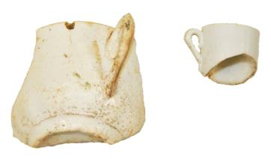
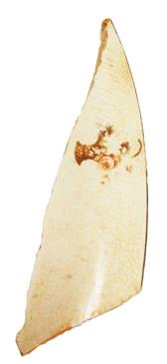
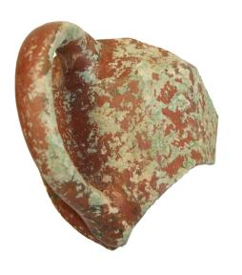
Bailey’s Dam
Plate Design
Cup Fragments
Plate Fragment
Ceramic artifacts from Bailey’s Dam
Notes:
Bailey’s Dam Artifacts 1984
These are ceramic artifacts recovered from Bailey’s Dam. Notice the design on the plate fragment. It is a maker’s mark, put there by the company that made the plate. This information helps archaeologists identify and tell the age of an artifact.
Image credit: Louisiana Division of Archaeology

Slide 27
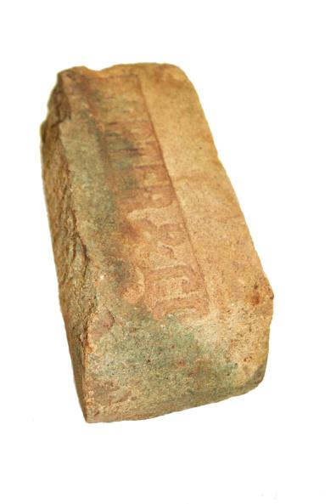
Bailey’s Dam
Maker’s Mark
Brick artifact from Bailey’s Dam
Notes:
Bailey’s Dam Artifacts 1984
Here is part of a brick from Bailey’s Dam. Archaeologists recovered brick and stone from the river banks, and from inside the crib and tree dams.
Notice the mark on this brick. This is a maker’s mark from the company that manufactured the item. This mark can help archaeologists identify, and tell the age of this artifact. The mark on this brick is “Porter & Co.” This is the name of an Ohio company that was in business during the 1800s.
Image credit: Louisiana Division of Archaeology

Slide 28
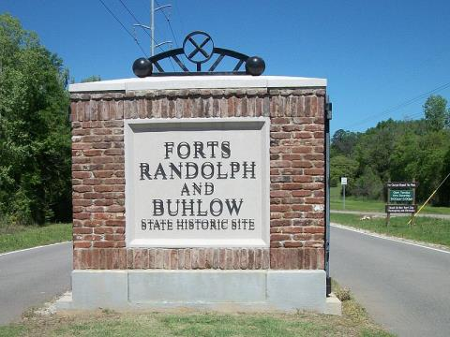
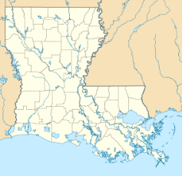
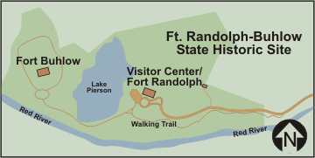
Bailey’s Dam
Forts Randolph and Buhlow State Historic Site, Pineville
Notes:
Bailey’s Dam
Archaeologists worked at the site during August and September of 1984. Then the U.S. Army Corps of Engineers built their dam project downstream from Bailey’s Dam. You can still see the general area of Bailey’s Dam from Forts Randolph and Buhlow State Historic Site. Confederates built these forts after the Red River Campaign to guard against future Union attacks. You can read more about Forts Randolph and Buhlow at http://www.crt.state.la.us/louisiana-state-parks/historic-sites/forts-randolph-buhlow-state-historic-site/index. There is an exhibit on Bailey’s Dam at the Visitor’s Center at the State Historic Site.
Image credits:
Site Marker – By Herodotus2go (Own work) [CC BY-SA 3.0 (http://creativecommons.org/licenses/by-sa/3.0)], via Wikimedia Commons
http://commons.wikimedia.org/wiki/File:Forts_Randolph_and_Buhlow_State_Historic_Site_Entrance,_March_2012.JPG
State map – By Alexrk2 (Own work) [GFDL (http://www.gnu.org/copyleft/fdl.html) or CC BY 3.0 (http://creativecommons.org/licenses/by/3.0)], via Wikimedia Commons
http://en.wikipedia.org/wiki/Forts_Randolph_and_Buhlow_State_Historic_Site
Historic Site Map – Louisiana Office of State Parks

Slide 29
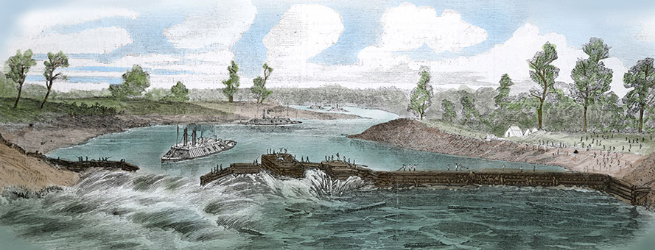
Bailey’s Dam
Colorized version of image from Harper’s Pictorial History of the Civil War, c1894. Courtesy of the Library of Congress LC-USZ62-39604
Porter’s fleet passing the dam at Alexandria, 1864
Notes:
Bailey’s Dam and Archaeology
Bailey’s Dam was an important moment in Louisiana history. Archaeologists gathered and preserved information on Bailey’s Dam for future generations to appreciate. Human creativity was at the heart of the dam project. The effort and skill it took to build Bailey’s Dam serves to remind us of the very human players in this historical event.
Image credit: colorized version of image from Harper’s Pictorial History of the Civil War, c1894. Courtesy of the Library of Congress LC-USZ62-39604 http://www.loc.gov/resource/cph.3a39951

Slide 30
Bailey’s Dam
Information on Bailey’s Dam
Bailey’s Dam Interactive Website and Virtual Book http://www.crt.la.gov/DiscoverArchaeology
War in Louisiana http://www.knowla.org/entry/536/&view=summary
Harper’s Weekly Civil War Papers http://www.sonofthesouth.net/leefoundation/civil-war-1865.htm
The Red River Campaign
http://www.civilwar.org/battlefields/mansfield/mansfield-history-articles/redriverjoiner.html
Red River Campaign http://www.knowla.org/entry/777/&view=summary
Notes:
Bailey’s Dam Wrap Up
There are many sources available on Bailey’s Dam and the Red River Campaign. The following is a list of sources if you are interested in knowing more about this important event in Louisiana history.
Bailey’s Dam Interactive Website and Virtual Book http://www.crt.la.gov/DiscoverArchaeology
Civil War in Louisiana http://www.knowla.org/entry/536/&view=summary
Harper’s Weekly Civil War Papers http://www.sonofthesouth.net/leefoundation/civil-war-1865.htm
The Red River Campaign http://www.civilwar.org/battlefields/mansfield/mansfield-history-articles/redriverjoiner.html and http://www.knowla.org/entry/777/&view=summary

Slide 31
Bailey’s Dam 1864
This presentation is one in a series of modules about Louisiana archaeology. Each module has a PowerPoint presentation and associated student activities. The series is called “Learn about Louisiana’s Past through Archaeology.”
This presentation is intended for educational use. Please use image credits where provided.
Please visit the Division of Archaeology website for additional teaching materials and educational resources at: www.crt.la.gov/DiscoverArchaeology
Presented by:
Louisiana Division of Archaeology
Office of Cultural Development
Department of Culture, Recreation and Tourism
Office of the Lieutenant Governor
Baton Rouge, Louisiana
This project was made possible through the Governor's Office of Homeland Security and Emergency Preparedness (GOHSEP) and the Federal Emergency Management Agency (FEMA) as part of implementing the Louisiana Hazard Mitigation Grant Program for Hurricane Katrina recovery.
© Louisiana Division of Archaeology 2016

