Slide 1
ARCHAEOLOGY AT THE GUSTE HOUSING DEVELOPMENT
New Orleans, Louisiana
AN EDUCATIONAL MODULE ON URBAN HISTORICAL ARCHAEOLOGY
D. Ryan Gray
University of New Orleans
Department of Anthropology and Sociology
Unless otherwise noted, all images by earth search, inc., courtesy of the housing authority of new orleans, or by the uno department of anthropology’s archaeology and curation lab

Slide 2
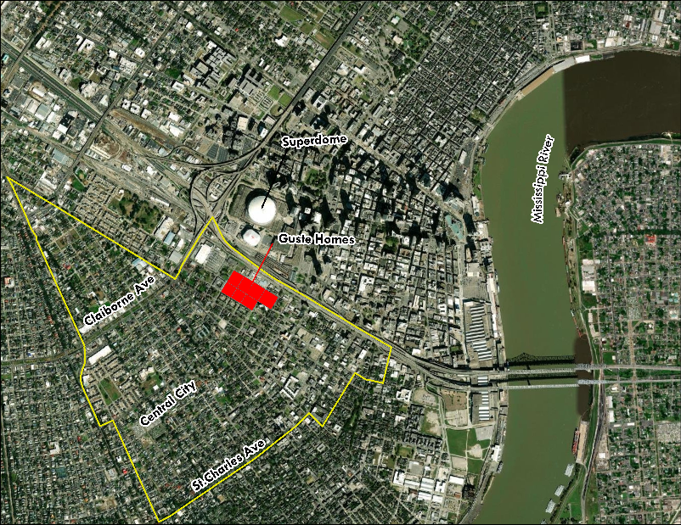
DURING 2012 AND 2013, ARCHAEOLOGISTS EXCAVATED THE LOCATION OF THE WILLIAM J. GUSTE HOMES, A PUBLIC HOUSING DEVELOPMENT IN THE CENTRAL CITY NEIGHBORHOOD OF NEW ORLEANS, PRIOR TO CONSTRUCTION AT THE SITE.

Slide 3
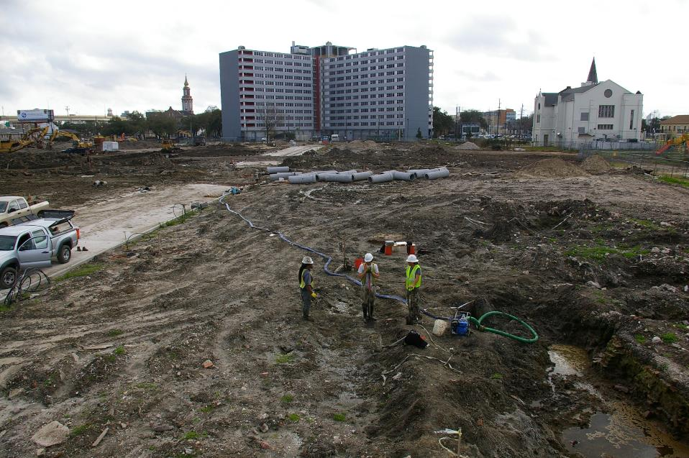
WHY DID ARCHAEOLOGISTS DIG HERE? WHAT WERE THEY LOOKING FOR, AND WHAT DID THEY FIND? WHY DOES IT MATTER?

Slide 4
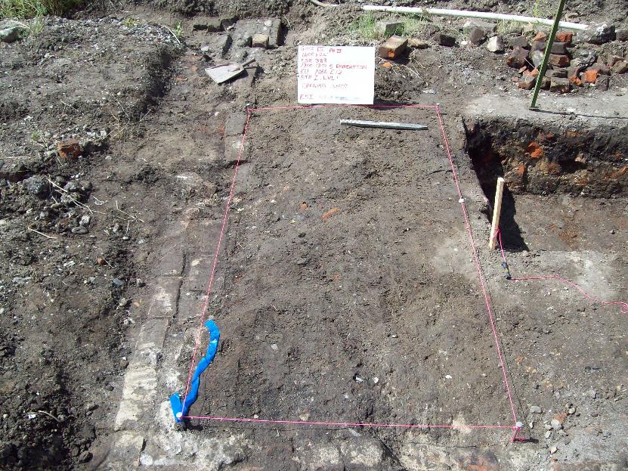
Part I: DEFINING TERMS

Slide 5
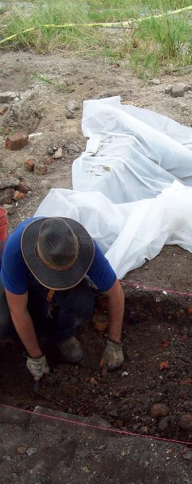
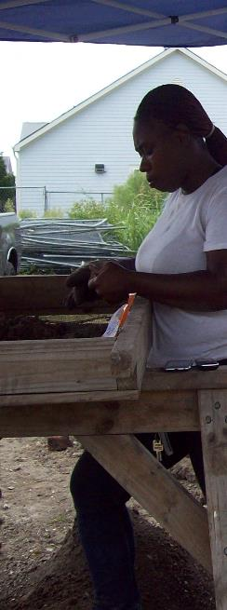
What is
Archaeology?
archaeology is a subfield of anthropology
Archaeologists use material remains to study human cultures in the past
Material remains include artifacts, buildings, landscapes, and the human body itself

Slide 6
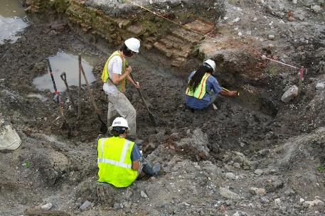
What is URBAN historical archaeology?
Historical archaeologists focus on the recent past
Historical archaeologists use documents, maps, and oral history to understand sites
Urban historical archaeologists study the growth and development of cities in the modern world

Slide 7
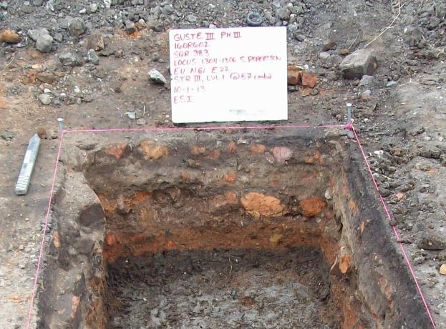
STRATIGRAPHY
archaeologists use stratigraphy, or layers of soil in the ground, to understand sites. when you excavate, you go backwards in time. each layer is older than the one above it.

Slide 8
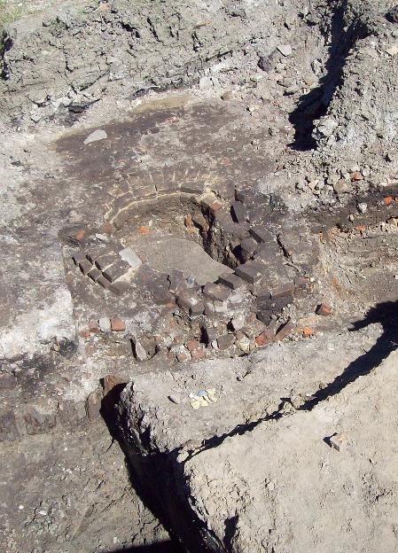
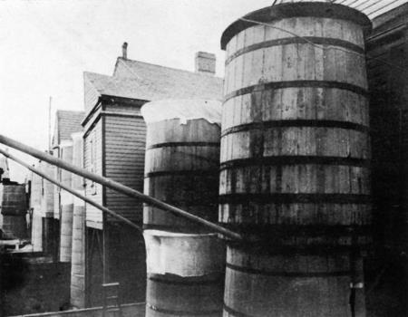
FEATURES
A Feature is a part of an archaeological site. The most common urban features are the remains of buildings, walkways, and patios.
Other features are related to sanitation, like the brick foundation on the left. What do you think it is?
A CIRCULAR BRICK FOUNDATION FOR A RAINWATER CISTERN
Description: New Orleans, 1905. Cisterns screened with cheesecloth, part of massive mosquito control program initiated after outbreak of Yellow Fever. |Source= 'Yellow Fever Prophylaxis in New Orleans 1905,' by Robert Boyce

Slide 9
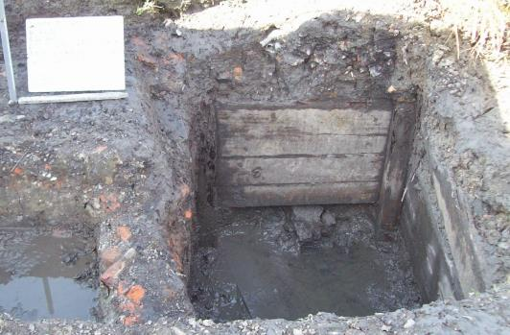
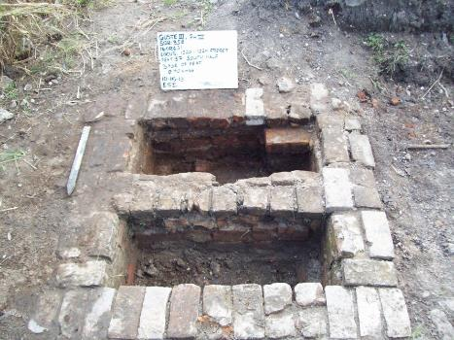
BEFORE HOUSES had indoor plumbing, toilets were usually outside, in a separate building (the outhouse or PRIVY), with the toilet EMPTYING INTO a hole in the ground beneath it. These pits, lined with wood, brick, or nothing at all, are called privy shafts, and they are another important feature used by urban archaeologists.
PRIVY SHAFTS

Slide 10
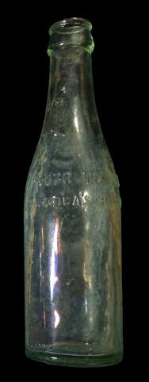
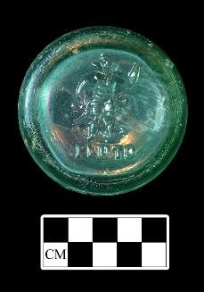
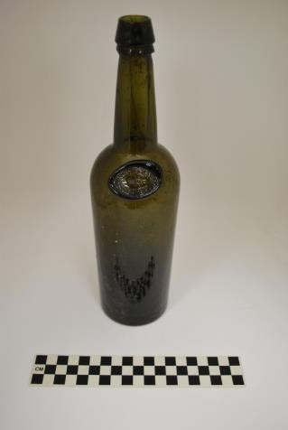
Archaeologists use artifacts to learn about the past. they study and classify artifacts to learn about how they were made, used, marketed, and discarded.
COMPARE THESE BOTTLES. WHAT KINDS OF DIFFERENCES DO YOU SEE? WHAT DO YOU THINK THEY WERE USED FOR?

Slide 11
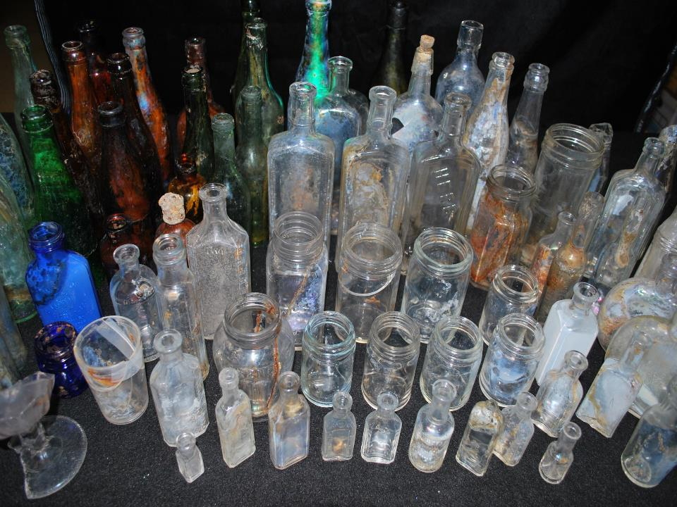
PRIVY PITS OFTEN FILLED RAPIDLY with artifacts WHEN no longer in use. As a result, THEIR CONTENTS may SERVE AS historical TIME CAPSULES to study people in the past.

Slide 12
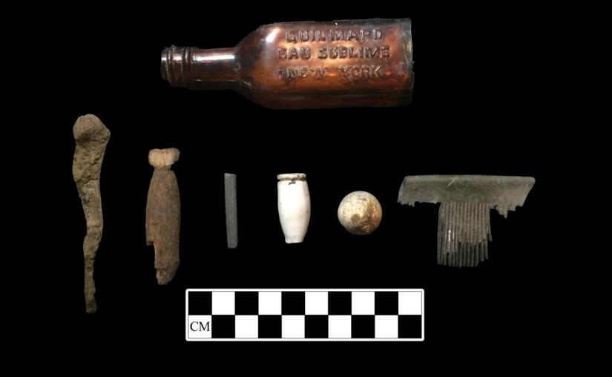
EXAMPLES OF ARTIFACTS
These are some examples of artifacts recovered at the guste homes. What sort of items can you identify here?

Slide 13
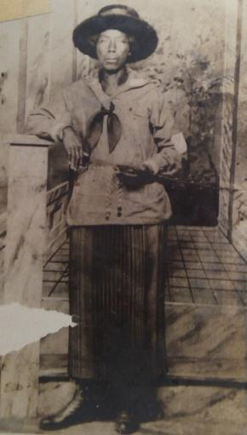
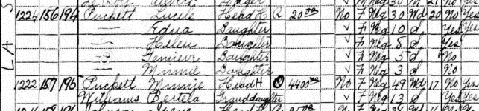
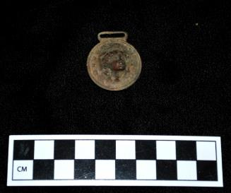
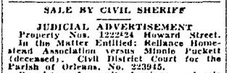
Archaeologists try to LINK ITEMS TO THE PEOPLE WHO USED THEM, AND TO THE OTHER ARTIFACTS RECOVERED with them, AS PART OF AN ASSEMBLAGE.
The large collection of bottles in the earlier slide were thrown away when a woman named minnie puckett owned 1222 LaSalle. Descendants of Puckett shared a family photograph of minnie and recollections of the family’s loss of the house on LaSalle.

Slide 14
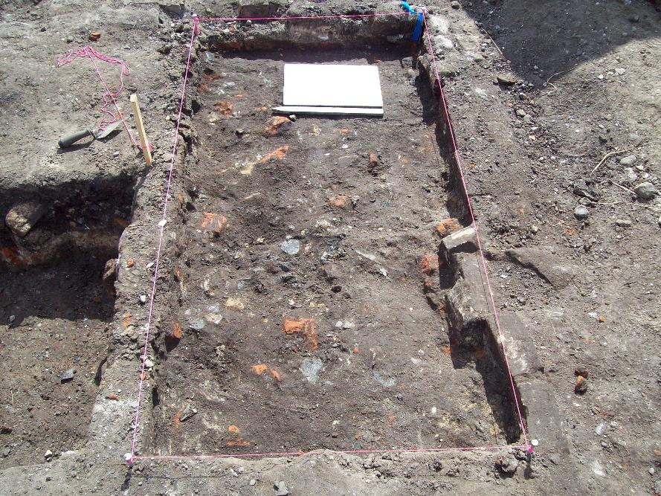
Part 2: why dig at the guste homes?

Slide 15
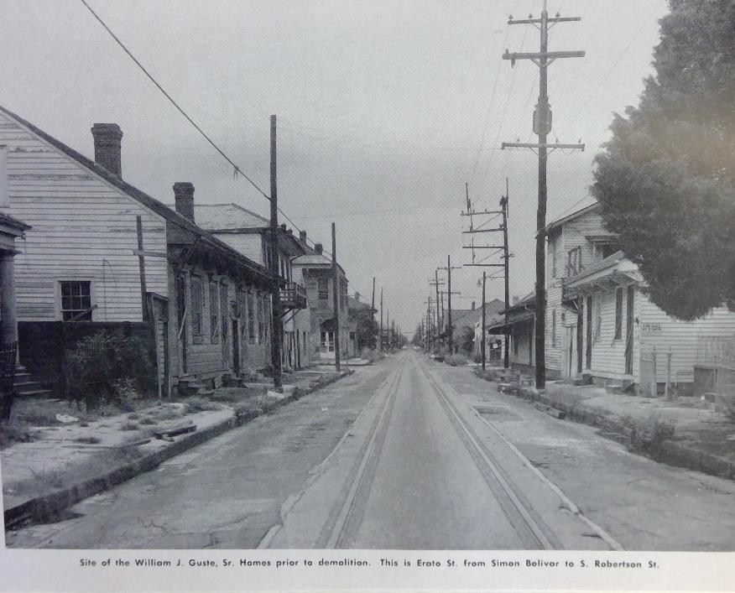
THE SHORT ANSWER: It’s required by law…

Slide 16
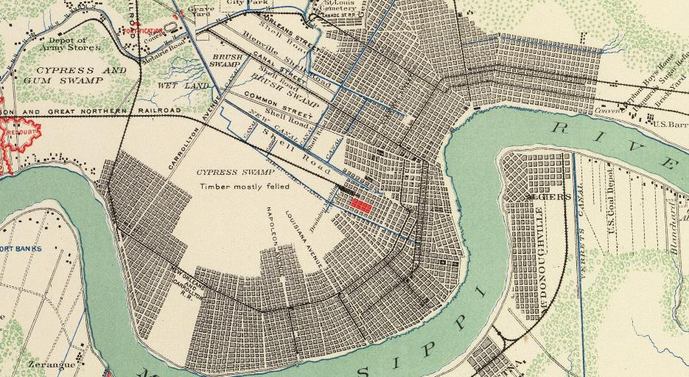
The long answer: there was good reason to expect significant archaeological remains at guste
Abbot, Henry L.
1863 Approaches to New Orleans, prepared by order of Maj. Gen. N.P. Banks (by) Henry L. Abbot, Capt. and Chief Top Engrs., Feb. 14th, 1863. In Atlas to Accompany the Official Records of the Union and Confederate Armies, Plate XC. U.S. Government Printing Office, Washington, D.C.
The Guste neighborhood was occupied before the Civil War. Even though it was a low-lying area, the nearby rail line and Canal encouraged development. The highlighted part of this 1863 map indicates the project area.
Excerpt from Abbot, Henry L., Approaches to New Orleans, prepared by order of Maj. Gen. N.P. Banks (by) Henry L. Abbot, Capt. and Chief Top Engrs., Feb. 14th, 1863. In Atlas to Accompany the Official Records of the Union and Confederate Armies, Plate XC. U.S. Government Printing Office, Washington, D.C.

Slide 17
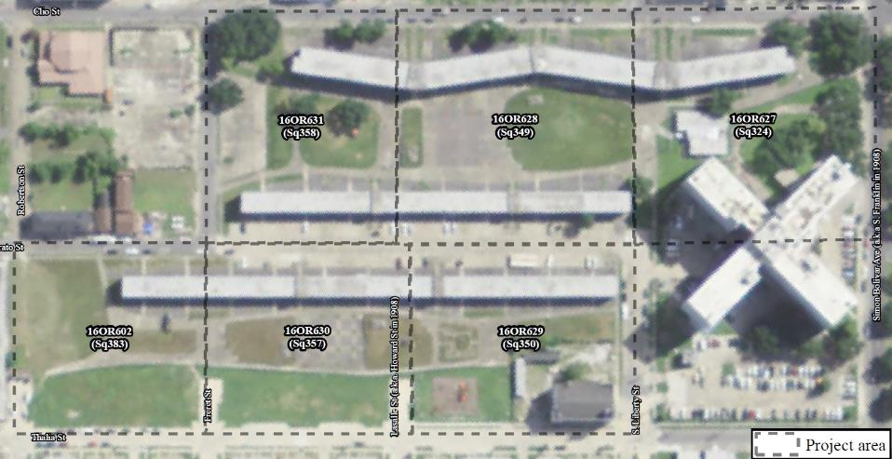
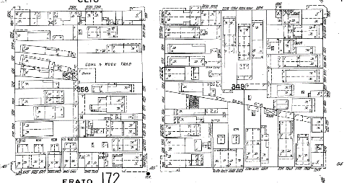
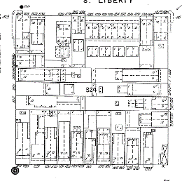
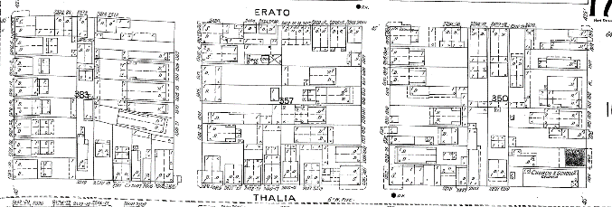
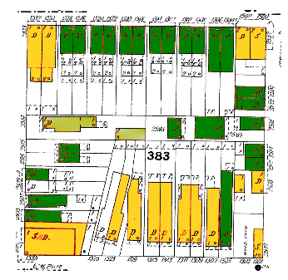
After the Civil War, a multi-racial working-class community gradually developed in the area, and homes and businesses filled the blocks.
Race of Head of Household by 1910 U.S. Census; Green indicates “Black” and Yellow indicates “White”

Slide 18
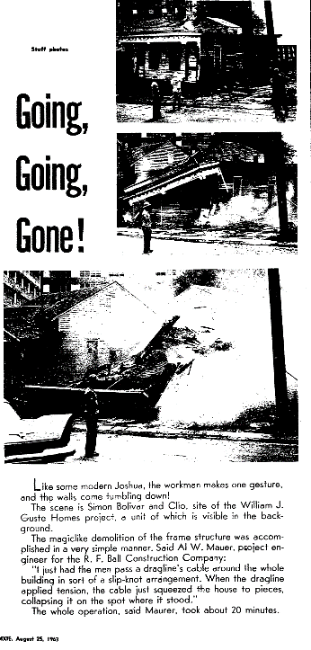
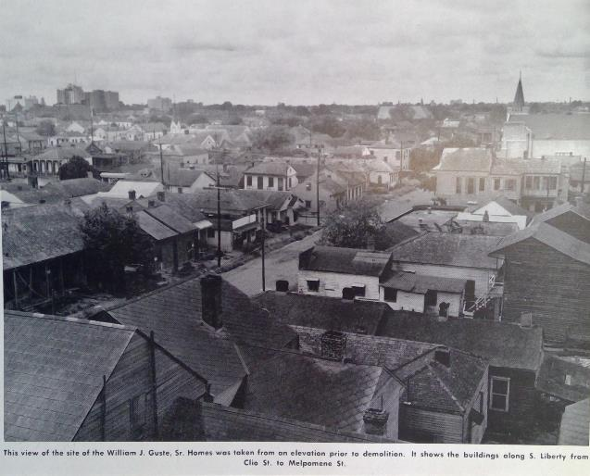
By the time HANO planned the Guste Homes, housing in New Orleans had become very segregated, and the Guste area was a predominantly Black neighborhood.

Slide 19
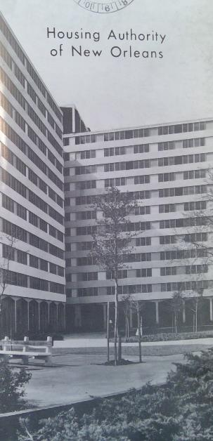
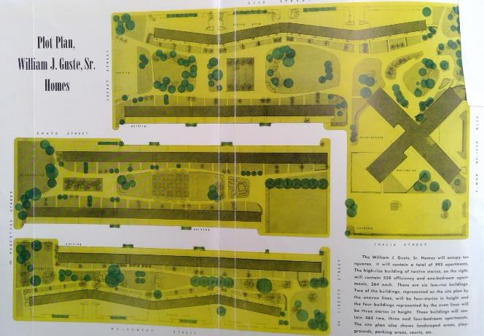
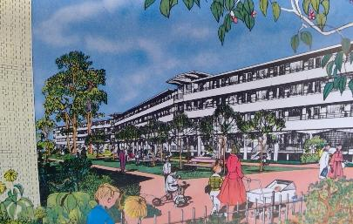
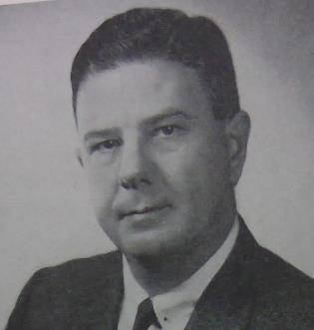
HANO promoted the Guste Homes, named for long-time HANO legal counsel William J. Guste, Sr., as a replacement for what was termed slum housing. Opened in 1964, the complex included a high-rise retirement facility, one of the first of its kind in the city.

Slide 20
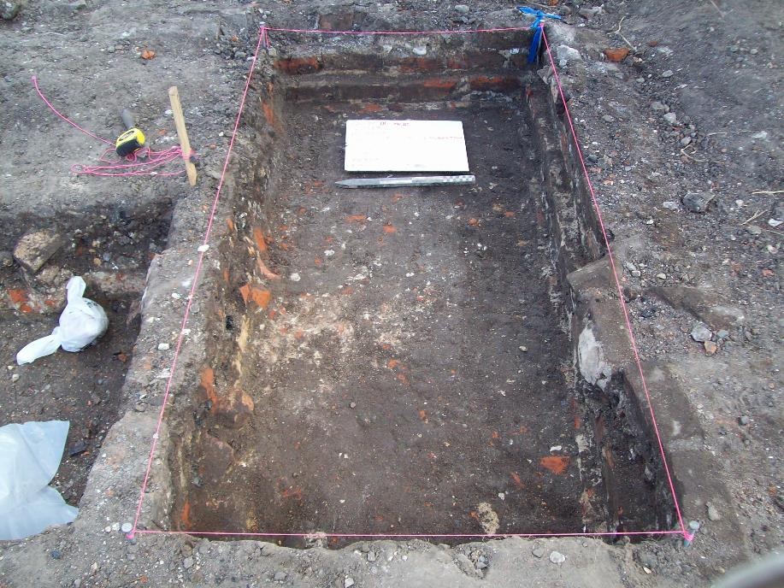
Part 3: What were Archaeologists looking for?

Slide 21
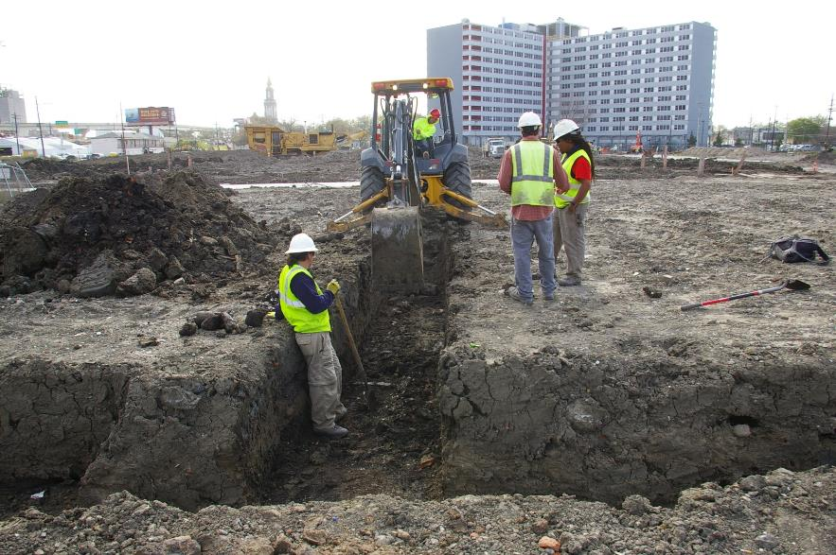
Archaeologists used historical research to plan excavations at Guste. They then used a backhoe to look for areas where remains from the pre-1964 neighborhood were preserved.

Slide 22
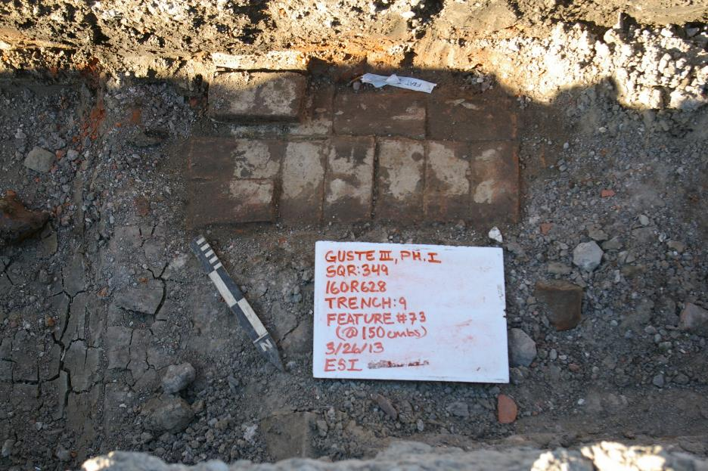
Historians researched individual properties to provide context for archaeological remains. They identified residents and businesses associated with addresses at specific points in the past.

Slide 23
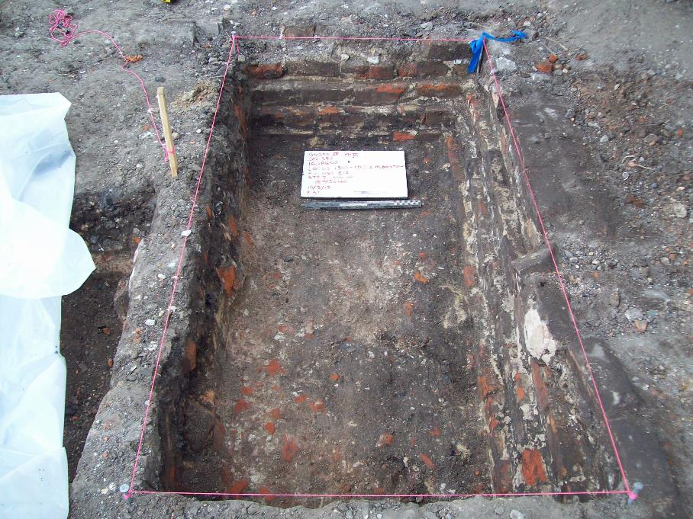
Part 4: what did archaeologists find?

Slide 24
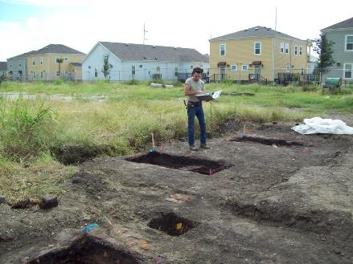
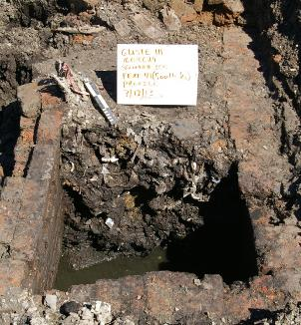
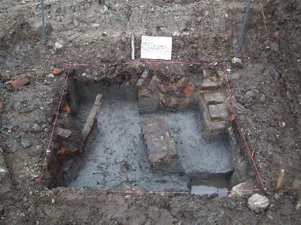
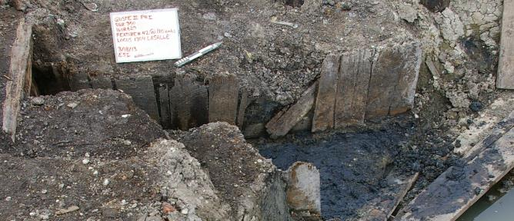
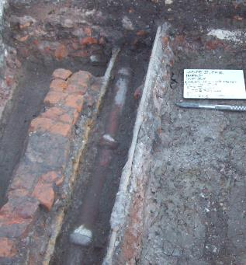
Archaeologists excavated building foundations, cistern bases, privies, and middens (deposits of household trash), spanning the period from 1870 to the 1960s.

Slide 25
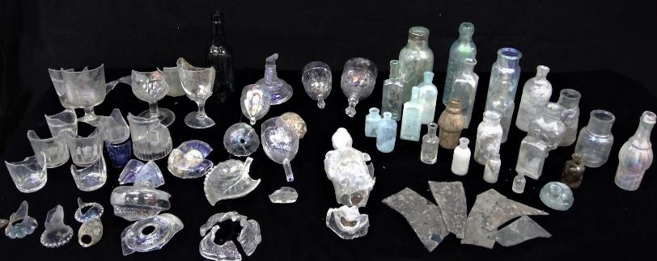
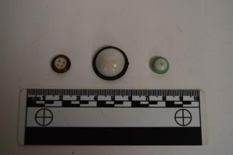
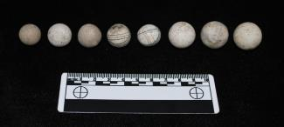
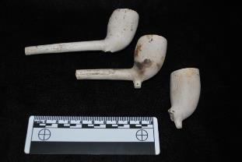
In the process, they recovered thousands of artifacts, including fragments of glass bottles, tableware, ceramic vessels, butchered animal bone, and small, everyday items, like buttons, marbles, and smoking pipes.

Slide 26
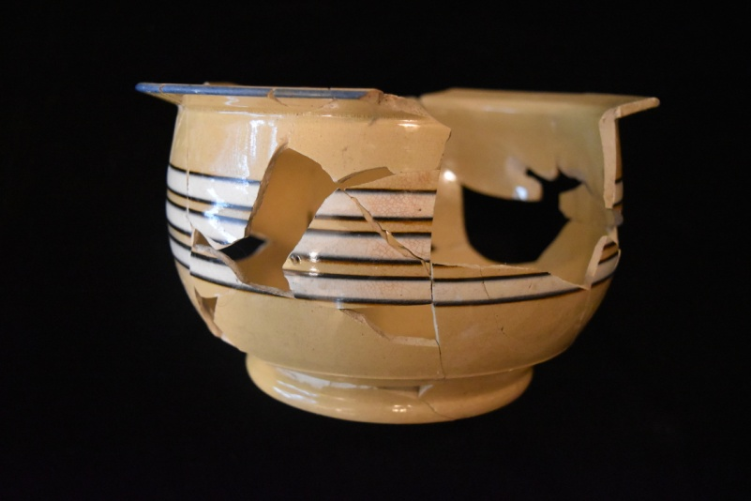
Some objects that were common in the past are unfamiliar today. This is a “chamber pot”. Often stored under the bed, they were used to avoid night-time trips to the outhouse. Indoor plumbing made them unnecessary.

Slide 27
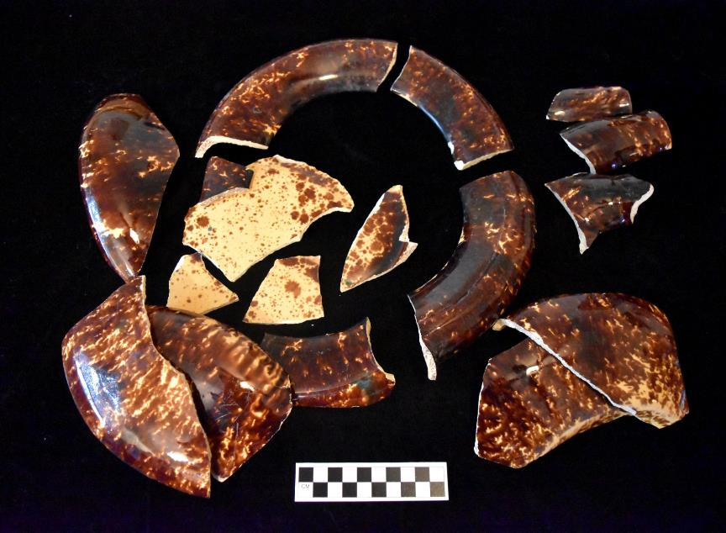
Sometimes items were incomplete but still identifiable, like this unusual vessel. Can you identify any clues as to what its function was? It also relates to sanitation.

Slide 28
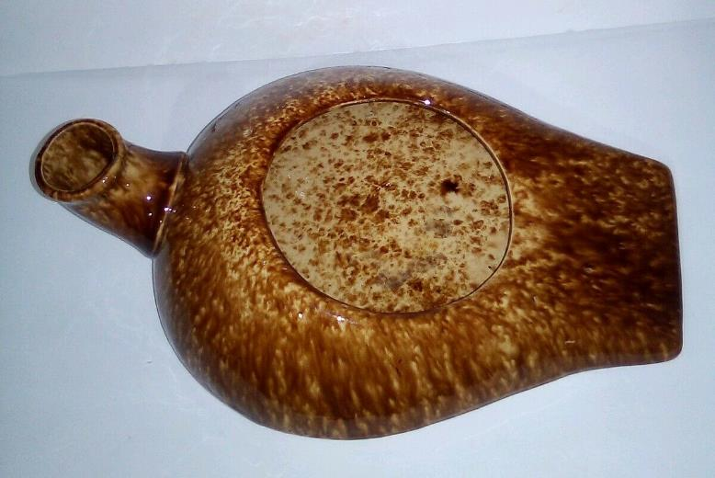
Photo from https://www.ebay.com/itm/Antique-Bennington-Pottery-Bed-Pan-Urinal-Rockingham-Glaze-Tobacco-Spongeware-/153866218803?nma=true&si=wEqWuDspukfxHHL9jKb6DHW1v1U%253D&orig_cvip=true&nordt=true&rt=nc&_trksid=p2047675.l2557
Here is a complete example from an antiques auction: it is a ceramic urinal or bed pan, probably from the 1870s or 1880s. Items like this also give clues as to whom might be associated with a given assemblage.

Slide 29


Sometimes, artifacts could also be connected to specific households —and even to specific individuals— known from documentary sources.
This is a ‘quartee’, a token with a 2 ½ cent value, found at 1300-1302 S. Robertson. Many lunch counters and saloons had ‘2 for a nickel’ specials; when one item was purchased, the ‘quartee’ would be given as change. The initials on one side of the coin would identify the issuing business. The “H.M.N.” on this one refers to Hillary M. Nugent, the one-time owner of the address.

Slide 30

This “Registered Driver” badge, with the license number D-130, almost certainly belonged to John O’Connor, a driver for his family’s bakery at 1304-1306 Freret Street. The bakery was a long-running fixture in the neighborhood, operating from 1886 until around 1926.

Slide 31

Other times artifacts tell us information about people who don’t show up in property records, or they may tell us things we don’t know about them otherwise.
The remainder of this section will focus on the artifacts from a privy from before 1880, pictured at right during excavation.

Slide 32

Try to identify some of the items in this and the next three slides and consider what they might tell you about the residents at the address in the 1870s.

Slide 33





Slide 34






Slide 35









Slide 36

Part 5: why does it matter?

Slide 37




Archaeological sites are a non-renewable resource
They tell information about the lives of people that may not be recorded in books
Archaeology also tells about the present: where we’ve been, what has changed, and how we got here
Clockwise, from upper left: image from HANO yearbook; lusterware dish with butterfly design; red-lining map of New Orleans with Central City area (reproduced from https://dsl.richmond.edu/panorama/redlining/#loc=5/39.1/-94.58); pocket watch case from Puckett family privy.

Slide 38
ACKNOWLEDGEMENTS
Archaeologists from Earth Search, Inc., carried out most large-scale excavations at the Guste site on behalf of hano and hud. ESI prepared a report of investigations for submission to the Louisiana Division of Archaeology; photos and records from this were utilized in the creation of this educational module, as was original research by the University of New Orleans. R.C. Goodwin and Associates undertook initial testing and construction monitoring on two blocks for HANO and HUD.
Funding and support for this project was provided by the Federal Emergency Management Agency through the Louisiana Governor’s Office of Homeland Security and Emergency Preparedness and the Housing Authority of New Orleans

