Slide 1
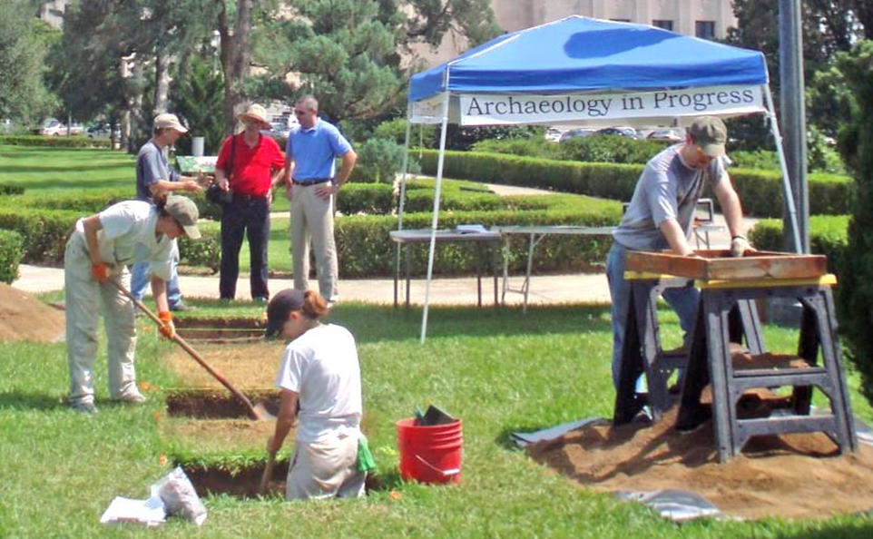
Introduction to
Archaeology
Learn about Louisiana’s Past through Archaeology
Notes:
Title: Introduction to Archaeology
Image Credit:
Louisiana Division of Archaeology

Slide 2
Archaeology
Introduction to the field of archaeology.
Notes:
Archaeology
This presentation introduces the field of archaeology.
Image credit: Louisiana Division of Archaeology

Slide 3
Archaeology
What is archaeology?
  Language of archaeology
Archaeology as a career
The process of archaeology
Why do archaeology?
Notes:
Archaeology
You will learn what archaeology is and who works in this field. You will learn the process of archaeology, and why this field of research is important.

Slide 4
Archaeology
What I know about archaeology
List three things you know about archaeology.
Notes:
Archaeology
Before we begin, list three things you know about archaeology. Hold on to this list, we will look at it again later.

Slide 5

Archaeology
What is archaeology?
Archaeology is the study of people who lived in the past.
Notes:
What is archaeology?
Archaeology is the study of people who lived in the past through the things they left behind. Archaeology is not the study of dinosaurs or fossils.
Image credit:
https://openclipart.org/detail/25741/architetto-dino-04

Slide 6
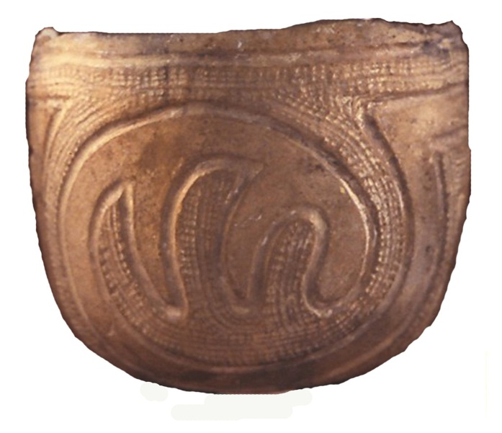
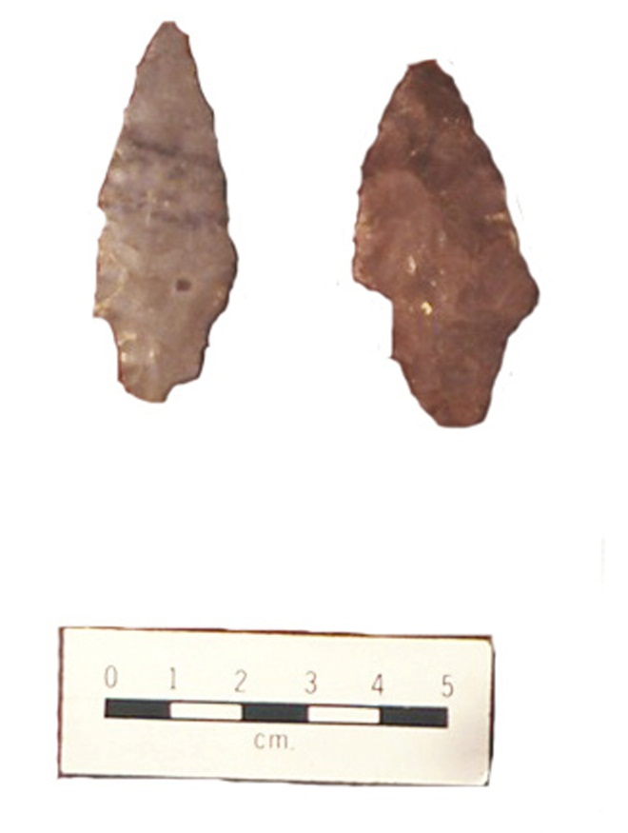
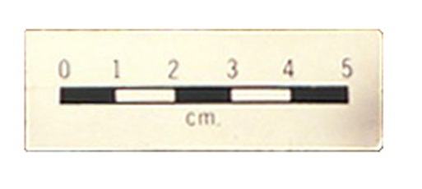
Archaeology
Artifacts
Catalogue Number 369041
Department of Anthropology
Smithsonian Institution
Catalogue Number 364275
Department of Anthropology
Smithsonian Institution
Artifacts are things people leave behind.
Notes:
Artifacts
Artifacts are some of the things people leave behind. Artifacts are portable, like pottery and stone points. These artifacts are from a site in Avoyelles Parish, Louisiana. They are more than 2,000 years old.
Image credit:
Louisiana Division of Archaeology
Catalogue Numbers 364275 and 369041, Department of Anthropology, Smithsonian Institution

Slide 7
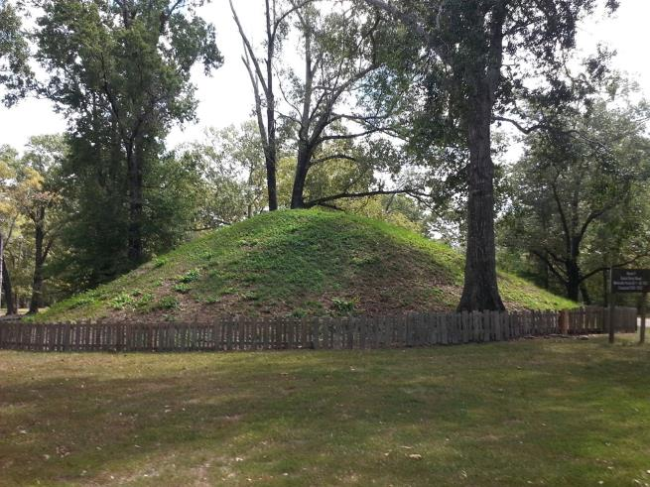
Archaeology
Landscape
People also leave behind changes to the landscape.
Notes:
Landscape
People can also leave behind changes to the landscape. This is an earth mound in Avoyelles Parish, built over 2,000 years ago. A modern fence protects this mound. Archaeologists refer to mounds as features. Features are remains that people leave behind that are not portable. In addition to mounds, features include outlines of buildings, garbage pits, hearths, and graves.
Image credit:
Louisiana Division of Archaeology

Slide 8
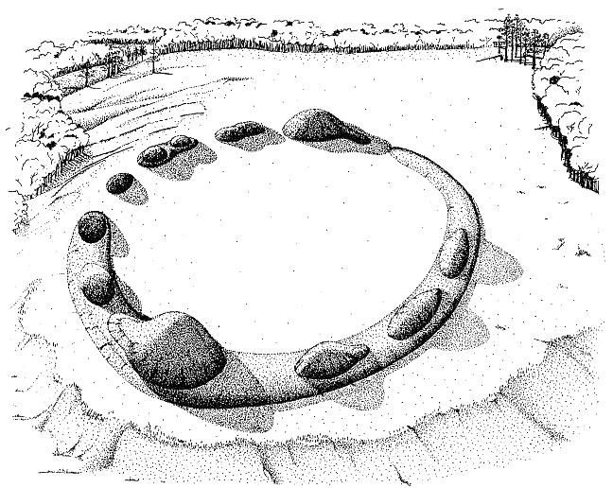
Archaeology
Time Periods of Archaeology
Drawing by Jon Gibson
Prehistoric means a time before writing was invented.
Notes:
Time Periods of Archaeology
Archaeologists divide the field into two major time periods, prehistoric and historic. “Prehistoric” is a time before writing was invented. This is a drawing of Watson Brake in Ouachita Parish. The earth mounds and oval earth ring are more than 5,000 years old.
Image credit:
Jon Gibson

Slide 9
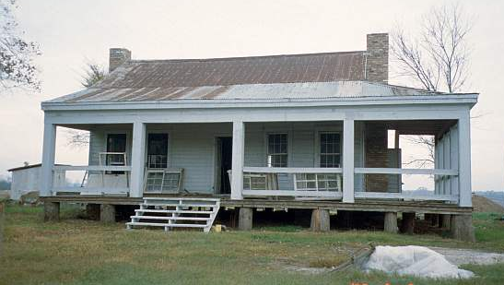
Archaeology
Time Periods of Archaeology
Historic means a time when there was writing.
Notes:
Time Periods of Archaeology
“Historic” is a time when writing was used. This is a picture of the Allen House in Desoto Parish, built in 1848. That makes it more than 160 years old.
Image credit:
Louisiana Division of Archaeology

Slide 10
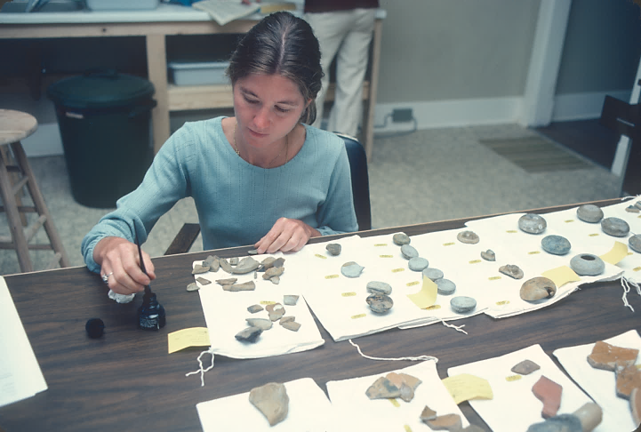
Archaeology
Career in Archaeology
.
An archaeologist is a scientist who works in this field.
Notes:
Career in Archaeology
An archaeologist is a scientist who works in this field. The archaeologist studies people who lived long ago, the things they made, and the changes they made to the land. An archaeologist is like a detective working at a crime scene. Both collect evidence in order to understand the events that occurred in the past.
In this picture an archaeologist is labeling artifacts from El Nuevo Constante, a Spanish shipwreck in the Gulf of Mexico.
Image credit:
Louisiana Office of Tourism and Coastal Environments, Inc.

Slide 11


Archaeology
Career in Archaeology
An archaeologist goes to college.
Notes:
Career in Archaeology
An archaeologist goes to college. Many students interested in archaeology choose to major in anthropology, which is the study of humans.
Image credits:
https://openclipart.org/detail/27076/university-hat (left)
https://openclipart.org/detail/94021/graduation-icon (right)

Slide 12
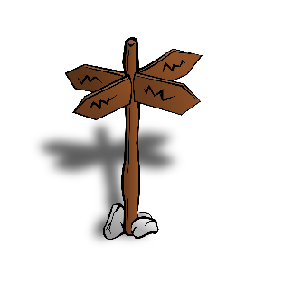
Archaeology
Career in Archaeology
Private Company
Government
Museum
University
An archaeologist has career options and education options.
Notes:
Where do archaeologists work?
An archaeologist can work in government or for a private company. An archaeologist can also work at a museum or a university. An archaeologist often has a higher degree, like a master’s or PhD. A PhD usually is required to teach at a university.
Image credit:
https://openclipart.org/detail/11500/rpg-map-symbols-crossroads-sign

Slide 13
Archaeology
Career in Archaeology
An archaeologist can work on land.
Notes:
Where do archaeologists work?
An archaeologist can work on land. This is a photograph of archaeologists digging at a site. This is the Marksville site in Avoyelles Parish. Archaeologists discovered that it is more than 2,000 years old.
Image credit:
Louisiana Division of Archaeology

Slide 14
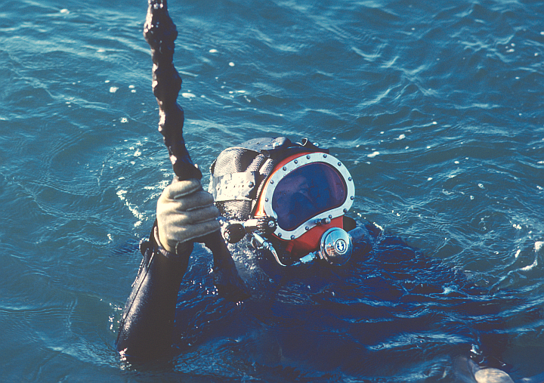
Archaeology
Career in Archaeology
.
An archaeologist can work in the water.
Notes:
Where do archaeologists work?
An archaeologist can work in the water. Here is an archaeologist diving on El Nuevo Constante, a shipwreck in the Gulf of Mexico. This Spanish ship sank in 1766 off the Louisiana coast near Cameron Parish.
Image credit:
Louisiana Office of Tourism

Slide 15
Archaeology
Career in Archaeology
Science:
Chemistry, Physics, Geophysics
Earth Sciences
Biological Sciences
Paleoclimatology
Technology:
Mapping
Remote Sensing
Viewing/Imaging
Computer Science
You can learn more about other fields involved in archaeology by
searching online for “science and technology fields in archaeology.”
Archaeologists are not the only scientists who work in this field.
Notes:
There are other sciences involved in archaeology.
An archaeologist is not the only scientist who works in this field. Other scientists often work with archaeologists. If you want to know more about other fields and archaeology, search online for “science and technology fields in archaeology.”

Slide 16

Archaeology
Process of Archaeology
Analysis
Research
?
?
Publication
Interpretation
?
Site
?
Hypotheses
Excavation
?
?
There are steps to follow in archaeology.
Notes:
Process of Archaeology
There are steps to follow in archaeology. We will use this circle diagram to track the process. The place in the middle of the diagram is for the main topic or theme. The words in blue are not in order now, but they fit somewhere on the arrows of the diagram.
The goal of archaeology is to answer questions about the past. A site is the place that has remains of past human activities. It is the place where archaeologists get evidence about the past. Therefore, “Site” is in the center of the diagram.
The circle diagram shows that the process of archaeology can continue. Science can help answer many questions about the past, but these answers can also create more questions.
Challenge: see if you can order the steps in archaeology.
Image credit:
http://www.clker.com/clipart-six-6-rainbow-circular-arrows.html#

Slide 17
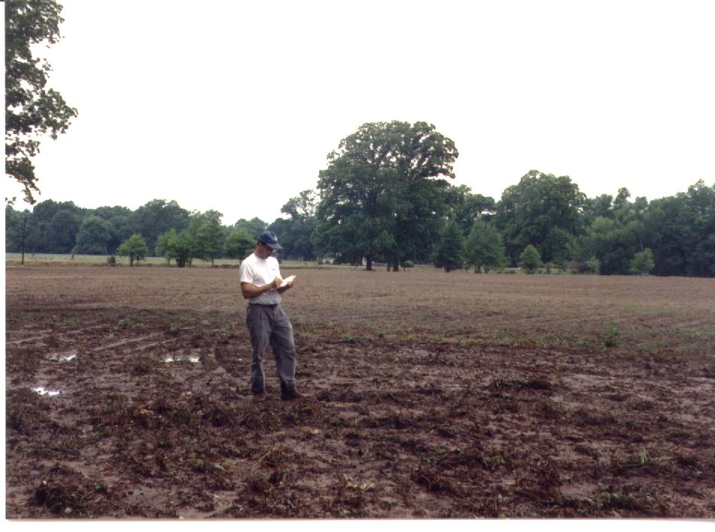
Archaeology
Process of Archaeology
University of Louisiana at Lafayette
This archaeologist is recording details of a site.
Notes:
Process of Archaeology – Recording a Site
Here is an archaeologist recording a site. An archaeologist will carefully record many details during this step. Before doing any real digging at a site, an archaeologist will take other steps.
Image Credit:
University of Louisiana at Lafayette
Department of Sociology, Anthropology, and Child and Family Studies

Slide 18
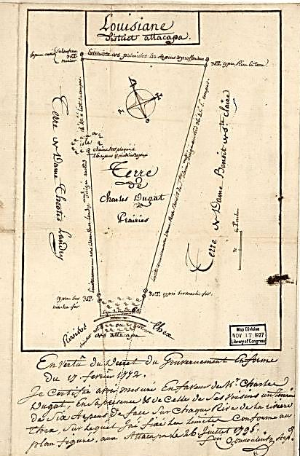
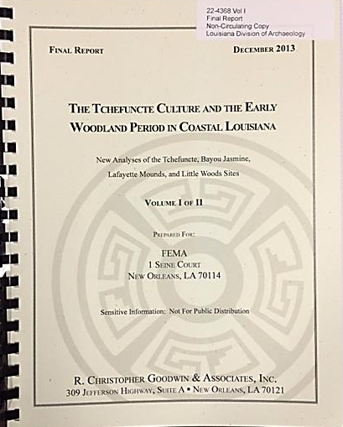
Archaeology
Process of Archaeology
Library of Congress , Geography and Map Division, g4012tm gct00213
Research is the next step in the process.
Notes:
Process of Archaeology – Research
Research is the next step in the process. Research is important because it tells the archaeologist more about the history of the area and about what archaeologists have found out at similar sites. Archaeologists use historical maps, journals, archaeological reports, and site records.
Image credit:
Library of Congress, Geography and Map Division, g4012tm gct00213 (left)
Louisiana Division of Archaeology (right)

Slide 19
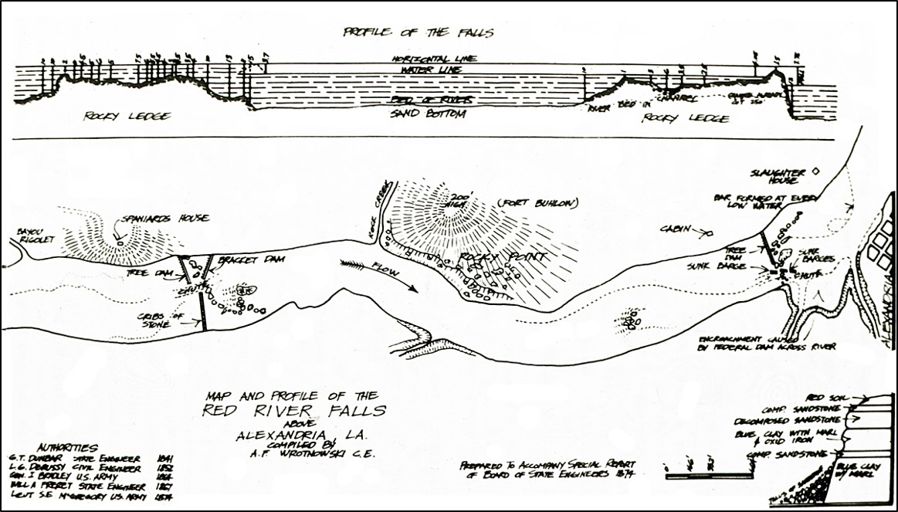
Archaeology
Process of Archaeology
Profile View
Bailey’s Dams
Alexandria
Plan View
Courtesy of the State Library of Louisiana
Maps are an important part of research.
Notes:
Process of Archaeology – Research
Maps are an important part of research. Some maps are old. They hold information already known about a particular area.
This is a historic map of the Red River Falls in Rapides Parish, drawn in 1874. The Union army built a series of dams here. Archaeologists now know this site as Bailey’s Dam. This map shows the location of the structures as well as other information. In this map, we see a “Profile View,” or view from the side, of the falls. There is also a “Plan View,” or view from above, of the structures.
Image credit:
Board of State Engineers, 1874
State Library of Louisiana

Slide 20
Archaeology
Process of Archaeology
Site
Discovery through artifacts or changes to the land.
What kind of people lived here?
How did they live?
Questions
People lived here in the 1800s.
They hunted, fished, and grew crops.
Hypotheses
Like other scientists, an archaeologist forms hypotheses,
Notes:
Process of Archaeology – Hypotheses
Like other scientists, an archaeologist forms hypotheses. “Hypotheses” are the ideas that a scientist has about a particular thing or situation.
This diagram explains the process. Artifacts left behind, or observed changes to the land lead to a potential site. The archaeologist has questions about the site, such as who built it and what was its purpose. These questions lead to possible ideas, or hypotheses, about the site. An archaeologist asks questions and forms hypotheses based on training and research.

Slide 21

Archaeology
Process of Archaeology
Analysis
Research
?
Hypotheses
Publication
Interpretation
Site
?
?
Excavation
?
This shows what we know so far about the process of archaeology.
Notes:
Process of Archaeology
This shows what we know so far about the process of archaeology. Artifacts or changes to the land lead to a site. “Site” is a main topic for archaeology. An archaeologist conducts research about the land. The archaeologist forms hypotheses based on this research, as well as the education and training received in college.
We have more steps to discuss in the process of archaeology. How are you doing so far? Can you guess the next steps?
Image credit:
http://www.clker.com/clipart-six-6-rainbow-circular-arrows.html#

Slide 22
Archaeology
Process of Archaeology
Photograph by Jeff Girard
Excavation is an important step in archaeology.
Notes:
Process of Archaeology – Excavation
Excavation is an important step in the process. “Excavation” means the controlled digging that takes place at a site. This step provides the archaeologist with more information about the site.
Here is a photograph of excavations at the Fredericks Site in Natchitoches Parish. American Indians began living at the site about A.D. 400. Archaeologists discovered that the site was in use over a period of 500 years.
Image credit:
Jeff Girard, Northwestern State University of Louisiana

Slide 23




Archaeology
Process of Archaeology
LAW
Code
Of
Ethics
An archaeologist must obey certain laws.
Notes:
Process of Archaeology – Laws
An archaeologist must obey certain laws. For example, an archaeologist needs permission from the landowner before digging. Sometimes a site is on land owned by the state or federal government. This case requires a special permit.
An archaeologist follows a code of ethics. That is a set of rules to guide their work. For example, did you know that an archaeologist does not keep artifacts from a site? To read more on the code of ethics for archaeology search online for “ethics and archaeology.”
Image credits:
https://openclipart.org/detail/75799/registry-book (top left)
https://openclipart.org/detail/398/old-book (bottom left)
https://openclipart.org/detail/62989/scales-of-justice (center)
https://openclipart.org/detail/193501/rubber-stamp (right)

Slide 24



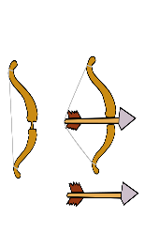
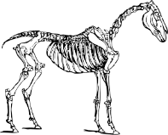
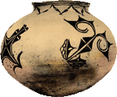
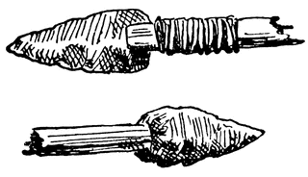
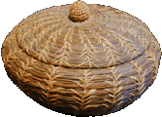
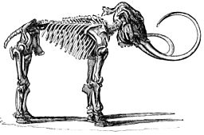

Archaeology
Process of Archaeology
Grass
Soil Layer
1
2
3
20th Century
4
5
6
European Contact
thin layer of clay
Natural event – flood?
7
Pre-European Contact
8
9
layer of ash
Natural event – volcano?
Ice Age
10
11
Archaeologists use context and inference.
Notes:
Process of Archaeology – Context and Inference
Context and inference are important ideas in archaeology. “Context” is the relationship of artifacts to each other and their location at the site. It provides the basis for the archaeologist to infer things about the site. “Inference” means to use facts, observations, logic or reasoning to form an assumption or reach a conclusion. Inference helps an archaeologist draw conclusions about the artifacts found at a site and their meaning.
In this image we see an example of a section of earth separated in layers. Archaeologists call these layers “strata,” and the study of these layers is “stratigraphy.” Strata contain artifacts and other things. Context tells us that the items within the same strata likely belong to the same period. Inference allows us to label these periods, and tell the human and natural history of this site.
An archaeologist would be very lucky to find artifacts like this. Many of the artifacts found are broken fragments. These fragments give the archaeologist only part of the story. Context and inference help the archaeologist tell a more complete story.
In this diagram, you can see that the oldest layers are at the bottom and the youngest are at the top.
Image credits:
Louisiana Division of Archaeology with various clipart
Cup: http://www.clker.com/clipart-3941.html
Television: https://openclipart.org/detail/19899/old-television-20
Bow and Arrow: https://openclipart.org/detail/202285/bow-and-arrow
Horse: https://openclipart.org/detail/896/horse-skeleton
Pot and Basket: http://www.firstpeople.us
Stone Tools: http://etc.usf.edu/clipart/49400/49412/49412_stones-paleo.htm
Spear: http://etc.usf.edu/clipart/17500/17529/arrowheads_17529.htm
Mammoth: https://commons.wikimedia.org/wiki/File:PSM_V21_D509_Skeleton_of_a_mammoth.jpg
Saber-Tooth Tiger: https://commons.wikimedia.org/wiki/File:Smilodon_head.jpg Author=Wallace 63

Slide 25
Archaeology
Process of Archaeology
Grass
Archaeology Stratigraphy Challenge
Identify the Artifact
Soil Layer
2
Word Bank
1
3
4
5
6
thin layer of clay
7
8
9
layer of ash
10
11
Notes:
Process of Archaeology – Context and Inference
Challenge: Can you identify the artifact? Use the word bank to identify the artifacts.
Image credits:
Louisiana Division of Archaeology with various clipart
Cup: http://www.clker.com/clipart-3941.html
Television: https://openclipart.org/detail/19899/old-television-20
Bow and Arrow: https://openclipart.org/detail/202285/bow-and-arrow
Horse: https://openclipart.org/detail/896/horse-skeleton
Pot and Basket: http://www.firstpeople.us
Stone Tools: http://etc.usf.edu/clipart/49400/49412/49412_stones-paleo.htm
Spear: http://etc.usf.edu/clipart/17500/17529/arrowheads_17529.htm
Mammoth: https://commons.wikimedia.org/wiki/File:PSM_V21_D509_Skeleton_of_a_mammoth.jpg
Saber-Tooth Tiger: https://commons.wikimedia.org/wiki/File:Smilodon_head.jpg Author=Wallace 63

Slide 26
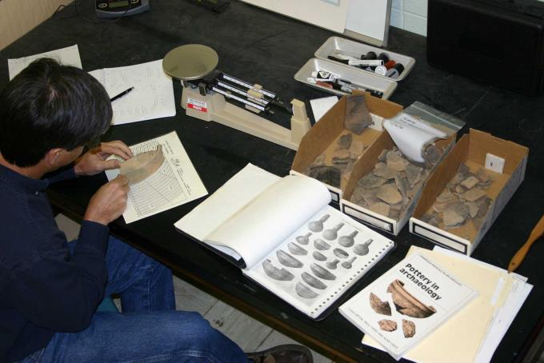
Archaeology
Process of Archaeology
Rim chart
Artifacts
from site
Pottery guides
Photograph by George Avery
Analysis is the next step in the process.
Notes:
Process of Archaeology – Analysis
Analysis is the next step in the process. Here is an archaeologist analyzing pieces of pottery. He is using a publication on pottery styles as a guide to identify the particular design of the pottery. This information helps him determine the time period. He is also using a rim chart to measure the broken piece. The rim chart gives the archaeologist an idea of the size of the pot before it was broken.
Image credits:
George Avery
Northwestern State University of Louisiana

Slide 27

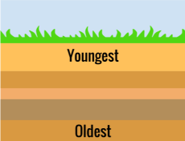
Archaeology
Process of Archaeology
Absolute Dating
Relative Dating
How does an archaeologist know how old something is?
Notes:
Process of Archaeology – How old is this?
How does an archaeologist know how old something is? Two ways to find out the age of a site or artifact are absolute dating and relative dating.
Image credits:
https://openclipart.org/detail/652/atom-model (left)
https://openclipart.org/detail/192910/superposition (right)

Slide 28

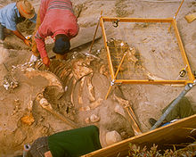
Archaeology
Process of Archaeology
Half Life of Carbon-14
© A-Z Animals
Courtesy, National Park Service
Living Carbon-14
Dead Carbon-14
Known
Known
5,730 years
Unknown
Carbon-14 dating can tell the age of things up to 50,000 years old.
Notes:
Radiocarbon Dating
Absolute Dating gives a calendar date for something found at an archaeological site. One form of absolute dating is radiocarbon, or carbon-14, dating. Archaeologists often find organic remains, like bone or wood, at a site. This method tells the age of organic remains up to 50,000 years old!
Let’s talk more about carbon-14 dating. All living things contain the element carbon. They absorb the carbon while they are alive, and they stop absorbing carbon when they die. A tiny part of that carbon, carbon-14, is naturally radioactive. The amount of carbon-14 in any living thing is the same. For example, the percent in this woolly mammoth on the left would be the same when it was alive as the percent in any other living plant or animal. After death, though, the carbon-14 starts decaying. Scientists know that it takes 5,730 years for half of carbon-14 to decay once a living thing dies, known as the half-life of carbon-14. The amount of other carbon atoms remains the same even after death.
Here is an example of the process of carbon-14 in archaeology. Archaeologists discover the remains of a woolly mammoth with a spear point in it at an archaeological site. The amount of carbon-14 that remains is determined from a small sample of the mammoth. The ratio of carbon-14 to the other carbon atoms in the sample tells the archaeologist how long ago the animal died. This information also gives the archaeologist information on the age of the site.
Image credits:
A-Z Animals, www.a-z-animals.com © 2009–2015; Tracy O; The Woolly Mammoth at Royal BC Museum, Victoria, British Columbia (left)
https://openclipart.org/detail/652/atom-model (center)
National Park Service http://www.nps.gov/chis/learn/historyculture/pygmymammoth.htm (right)

Slide 29
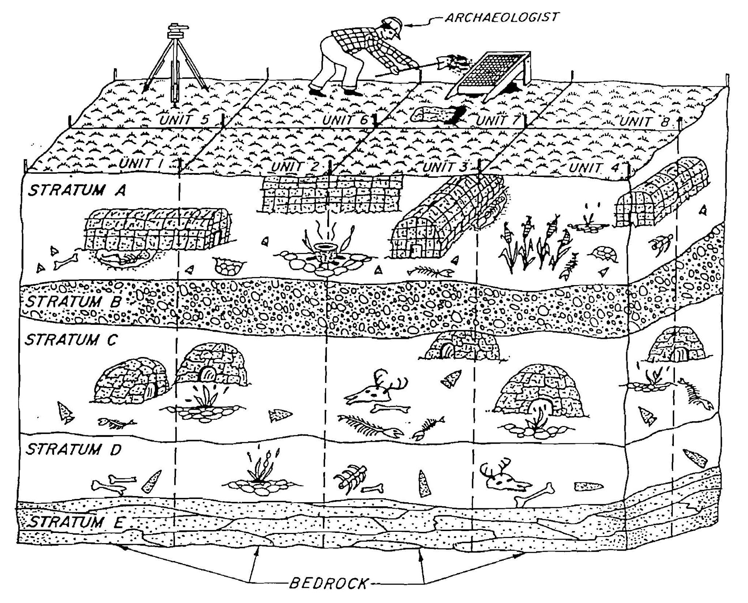
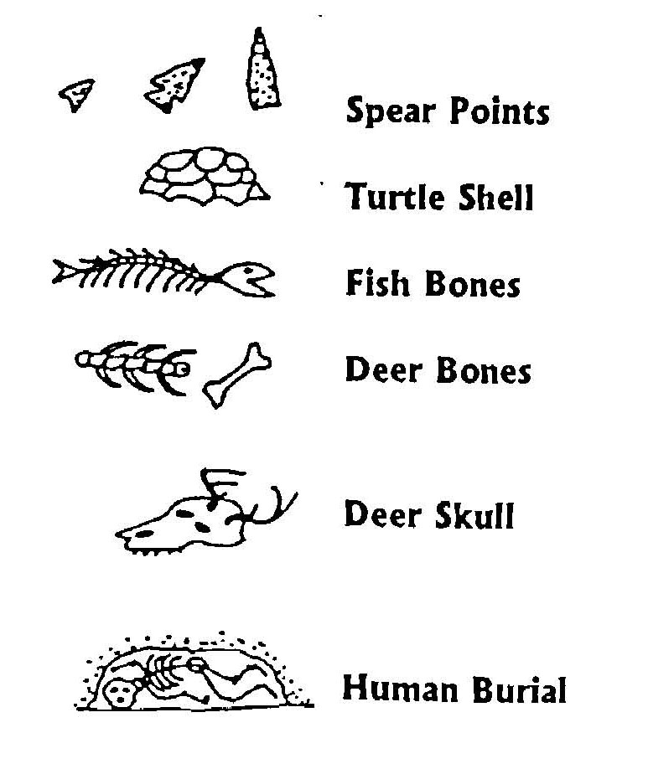
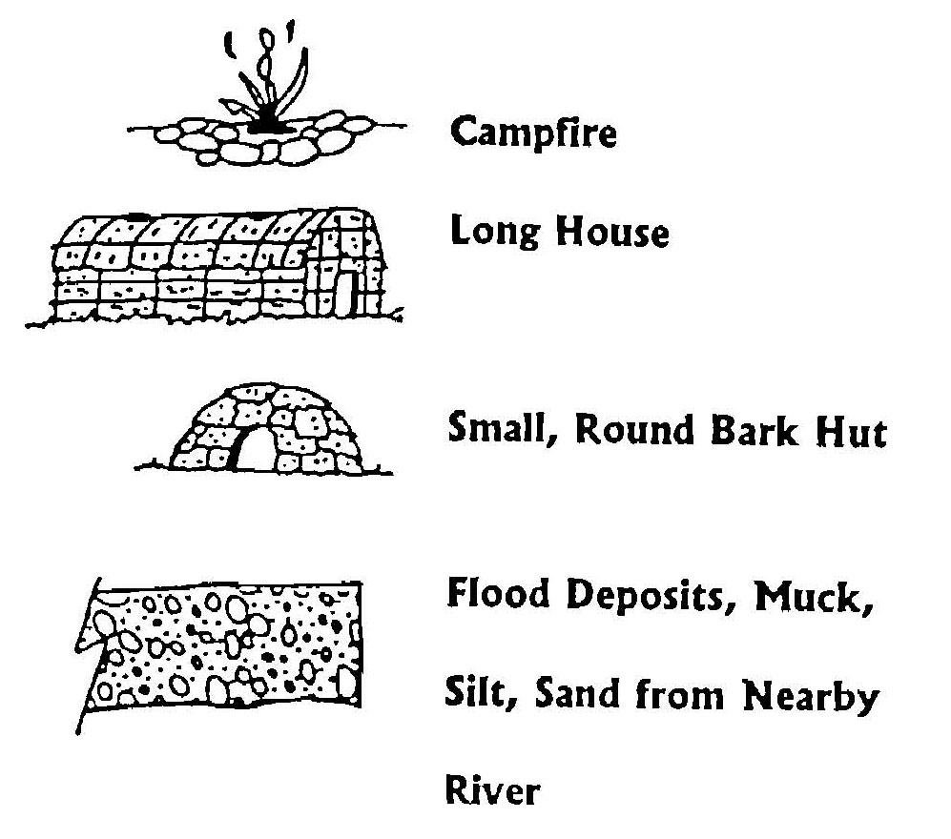

Archaeology
Process of Archaeology
Key to symbols:
Younger
Images courtesy of Delaware Dept. of Transportation
Older
Relative dating is another way an archaeologist can tell the age of something.
Notes:
Relative Dating
Relative dating gives an estimate of how old something is. One kind of relative dating comes from two geology concepts: stratigraphy and the Law of Superposition. As we learned earlier, stratigraphy is the study of the layers of earth below the surface of the ground. The Law of Superposition tells us that these layers are deposited in a time sequence. What this means is that layers on or near the surface are younger than layers buried deeper. These two concepts can help an archaeologist determine which layers are older. An archaeologist can also use this method to determine the age of specific layers and artifacts.
This image provides a visual example of relative dating. Very early people lived on Stratum D. After what may have been many years these people were no longer around. Their homes decayed or collapsed. Not long after that, soil and plants covered the area. Later, other people built their homes in the same location, as shown in Stratum C. After many more years, and what appears to be a natural event, the same thing happened to the people in Stratum C. New people made their home in the same place, as we see in Stratum A. Stratum D is older than Strata C and A, and Stratum A is the youngest or most recent activity. An archaeologist may discover these different levels during excavation. Each level will be carefully excavated, recorded and analyzed. In this diagram, there are two natural events. Stratum B is a flood event. Stratum E is sterile soil which tells the archaeologist there is no more human activity past this point.
Image credit: Delaware Department of Transportation

Slide 30
Archaeology
Process of Archaeology
?
Research
Hypotheses
Publication
Site
Interpretation
?
Excavation
Analysis
This shows what we know so far about the process of archaeology.
Notes:
Process of Archaeology
This shows what we know so far about the process of archaeology. Archaeologists excavate a site after doing some initial research and forming hypotheses. They need permission to dig, and must follow specific laws and a code of ethics. Archaeologists take detailed notes during excavation. Artifact analysis gives information about the people who built the site and the purpose of the site. Absolute dating and relative dating methods give clues to the age of the site.
We have filled in more of our diagram, but we have a few more steps to discuss in the process of archaeology. Any guesses about the remaining steps?
Image credit:
http://www.clker.com/clipart-six-6-rainbow-circular-arrows.html#

Slide 31

Archaeology
Process of Archaeology
What kind of people
lived here?
What did this site
look like?
What kinds of things
did they do here?
Interpretation means to tell the story of a site.
Notes:
Process of Archaeology – Interpretation
“Interpretation” means to tell the story of the site. This story is an explanation of what may have happened, based on the analysis. The interpretation is the best information to explain what the site looked like, who lived there, and what activities took place. The archaeologist compares the analysis and interpretations with the hypotheses to see if they are supported or not.
Image credit:
https://openclipart.org/detail/190303/woman

Slide 32
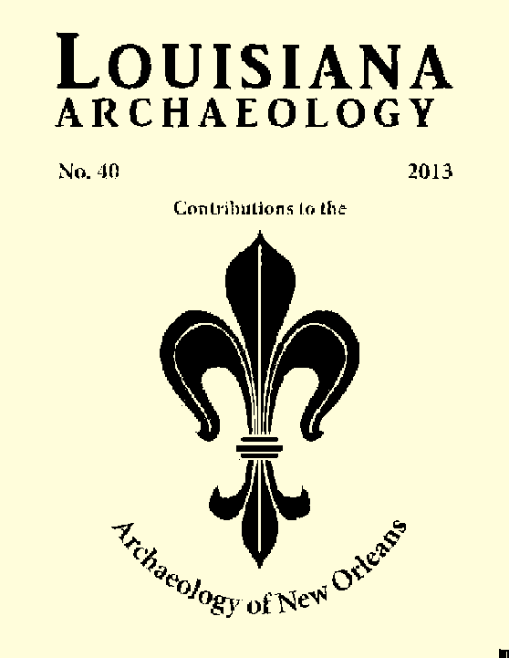


Archaeology
Process of Archaeology
Journal
Brochure
Book
Publication is the last step in the process of archaeology.
Notes:
Process of Archaeology – Publication
Publication is the last step in the process of archaeology. Archaeologists share what they learned at the site. They share this data with the general public and with other scientists. These other scientists may agree, disagree, or add to the interpretation. And sometimes other scientists give their own interpretation of what may have happened at a site.
Archaeologists share their work by writing an article in a magazine or journal. Some archaeologists write a book about what they discovered. They can also make a brochure about an archaeology site.
Image credits:
Louisiana Archaeological Society (left)
LSU Press (center)
Louisiana Division of Archaeology (right)

Slide 33
Archaeology
Process of Archaeology
Research
Publication
Hypotheses
Site
Excavation
Interpretation
Analysis
The circle is complete!
Notes:
Process of Archaeology
Our circle is now complete. We chose a circle diagram to show that the process of archaeology can continue. Archaeologists often have more questions about a site after the initial investigation. This means that the process will begin again with these new questions.
Image credit:
http://www.clker.com/clipart-six-6-rainbow-circular-arrows.html#

Slide 34
Archaeology
?
Why do we study the past?
How long ago was this built?
What did ancient people eat?
Who built this and why?
How did colonists live?
Were the people like me?
Notes:
Why do we study the past?
You may wonder why we study the past. Humans are curious by nature, and ask a lot of questions. Many of us want to know how people lived in the past. We may especially want to know if these earlier people were the same as us or if they were different.
Archaeologists study the past to understand how people lived and changed. They are curious about what may have happened to bring about those changes. We can use this information to have a better understanding of our world.

Slide 35

Archaeology
Why should we preserve the past?
Archaeological sites are one of a kind.
Notes:
Why should we preserve the past?
You may also ask why we should preserve the past. Archaeological sites are one of a kind, sort of like your fingerprints. Once these sites are gone that information is lost to us forever. Many sites are from important moments in our history. Other sites help fill in the gaps of what we know about our past. People can understand more about their history by reading about these sites or visiting them.
The past is important because it defines who we are through memory, continuity and identity. The past gives us a sense of orientation of who we are and our place in this world. Archaeology helps us see and understand changes in human society through time.
Image credit:
https://openclipart.org/detail/94687/fingerprint-search-with-slight-magnification

Slide 36
Archaeology
Compare
What I knew before
What I know now
Update your ideas about archaeology.
Notes:
Remember those three things you listed about archaeology? Take a look at the list you made and compare that information to what you now know. What is different? What is the same?

Slide 37
Introduction to
Archaeology
This presentation is one in a series of modules about Louisiana archaeology. Each module has a PowerPoint presentation and associated student activities. The series is called “Learn about Louisiana’s Past through Archaeology.”
This presentation is intended for educational use. Please use image credits where provided.
Please visit the Division of Archaeology website for additional teaching materials and educational resources at: www.crt.la.gov/DiscoverArchaeology/.
Presented by:
Louisiana Division of Archaeology
Office of Cultural Development
Department of Culture, Recreation and Tourism
Office of the Lieutenant Governor
Baton Rouge, Louisiana
This project was made possible through the Governor's Office of Homeland Security and Emergency Preparedness (GOHSEP) and the Federal Emergency Management Agency (FEMA) as part of implementing the Louisiana Hazard Mitigation Grant Program for Hurricane Katrina recovery.
© Louisiana Division of Archaeology 2016

