Slide 1




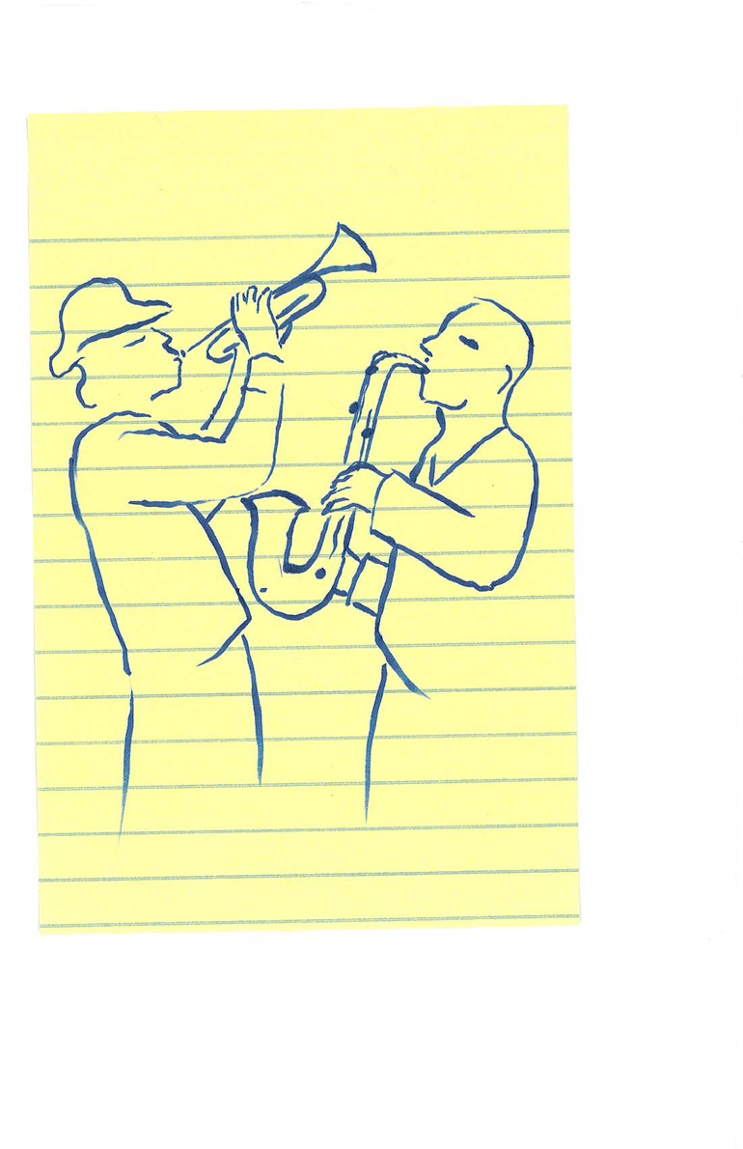



You’ve been awarded a
Louisiana Project Grant!
NOW WHAT?

Slide 2



Contents
1
4
INTRODUCTION
ACKNOWLEDGEMENT
2
5
GOALS
REPORTING
3
6
ACCESSIBILITY
THINGS TO KEEP IN MIND

Slide 3

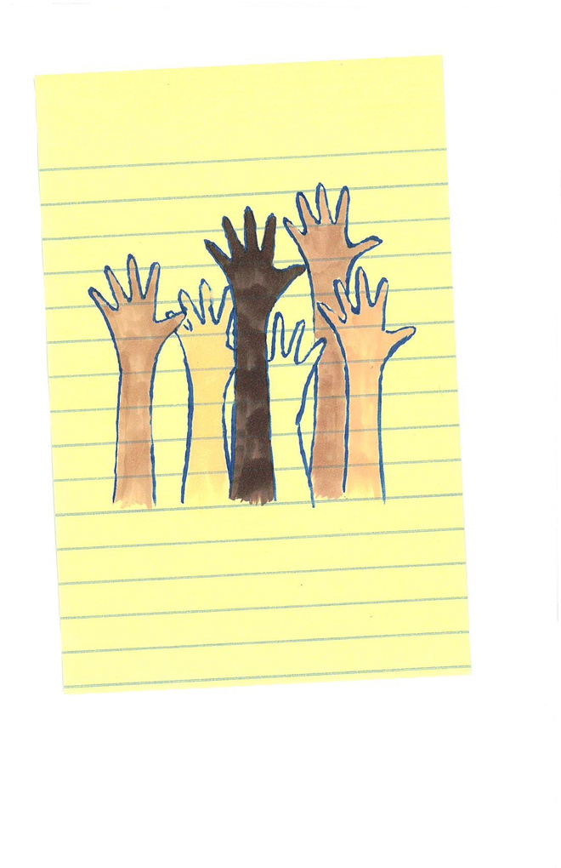
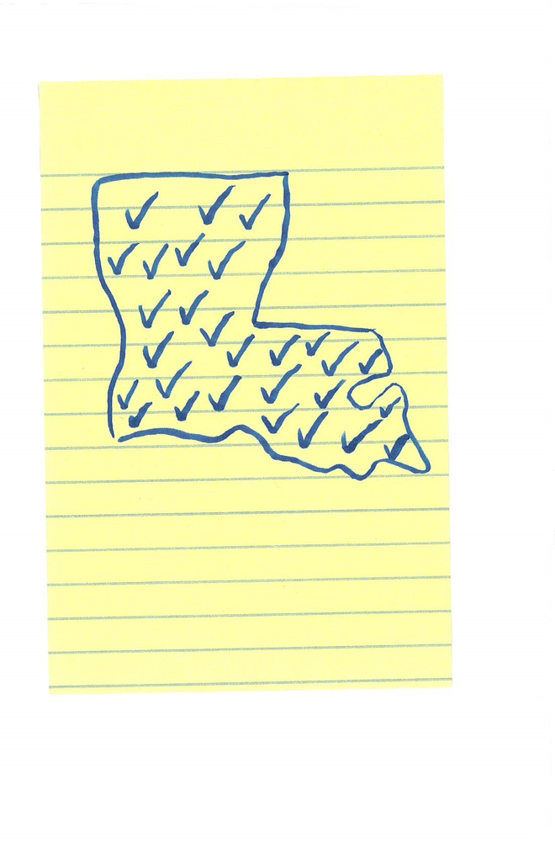
Introduction
Louisiana Project Grants are administered jointly by the Louisiana Division of the Arts (LDOA) and nine regional arts councils across the state. This program provides a system for funding arts projects in all regions of the state by giving artists, nonprofit arts organizations, nonprofit organizations, public and private schools, school boards, colleges and universities, and local government agencies in each region the opportunity to develop arts projects that meet their local needs. The purpose of the program is to cultivate innovative arts projects that have a lasting impact within each region of our state.

Slide 4




LPG goals
Benefits to your local community
Show the impact Arts funding has on our state

Slide 5



Accessibility
What you should know as a grant recipient
Americans with Disabilities Act of 1990 (ADA)
Section 504
Rehibilitation Act of 1973
Prohibits discrimination on the basis of disability in programs:
  Conducted by federal agencies
  Receiving federal financial assistance
Prohibits discrimination and ensures equal opportunity for person with disabilities
  Title II - State and local government services (State Arts Agengies, Local Arts Agencies
  Title III - Places of public accommodations & services, private organizations commerical facilities, transportation ( e.g., museums, performing arts centers, theatres, galleries, classrooms, outdoor spaces, etc.)

Slide 6

Different Laws
Same Requirements
  Architectural Access to entrances, restrooms, parking, ticket counters, etc.
  Equal Access to employment, programs, activities, goods & services
  Non-discrimination and equal opportunity and the provision of any reasonable modifications, auxiliary aids or services, necessary to achieve it, such as sign language interpretation, audio description, etc.

Slide 7
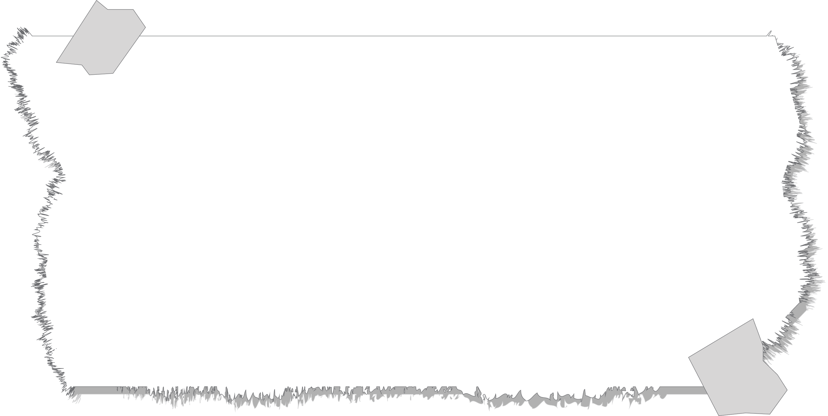
Regulations - what you sign to in your grant agreement
Grantee must comply with all state laws applicable to the grants program and to those federal laws and guidelines required by the National Endowment of the Arts including the Drug-Free Workplace Act of 1988, the Americans with Disabilities Act of 1990, and Section 504 of the Rehabilitation Act of 1973. Grantees must also comply with administrative requirements of the state and any additional requirements by the National Endowment for the Arts including those promulgated by the Office of Management and Budget (OMB): OMB Circular A-102 if the grantee is an agency of state or local government or OMB Circulars A-110 or A-133 if the grantee organization is a non-profit organization or university. Grantee is prohibited from engaging in political activity. No funds provided by a Louisiana Project Grant shall be used for any partisan political activity, or to further the election or defeat of any candidate for public office.

Slide 8


Purpose
01
Federal and State Compliance
02
Prioritize Accessibility
03
Help LDOA identify gaps in accessibility provisions in order to provide technical assistance

Slide 9

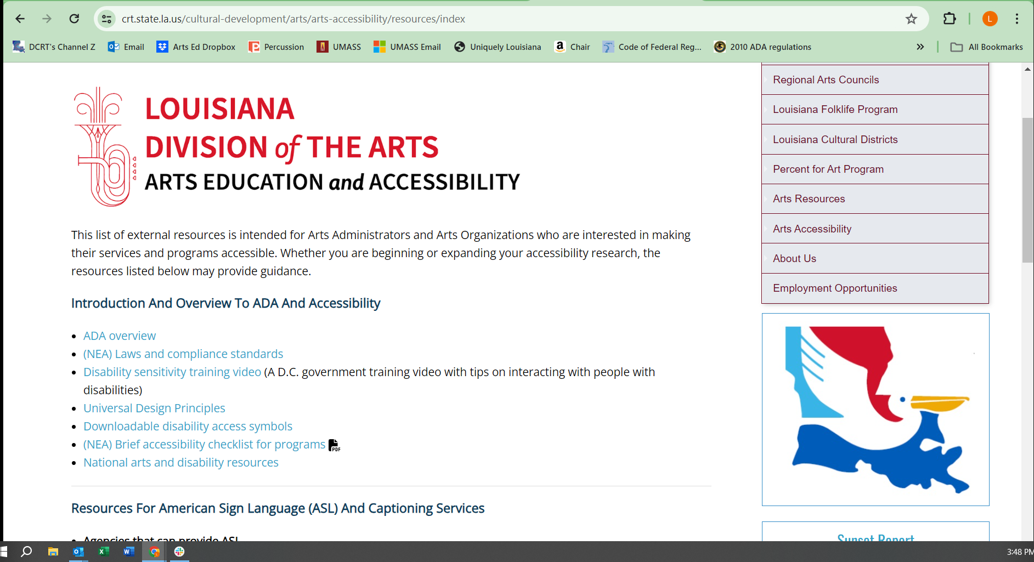


Where can I find
accessibility resources?

Slide 10






Acknowledgement
• Use the Louisiana Division of the Arts logo and the arts council logo on all printed materials
associated with your funded project (LDOA logo found on grant webpage)
• Use the following acknowledgement statement on all printed and broadcast promotion associatedwith your funded project: “Supported by a grant from the Louisiana Division of the Arts, Office ofCultural Development, Department of Culture, Recreation and Tourism, in cooperation with theLouisiana State Arts Council, as administered by the (Name of the Regional Arts Council). Funding has also been provided by the National Endowment for the Arts.”
• Recognize the LDOA and arts council during any announcements at performances, exhibits or other public activities
• Thank and inform local legislators in writing of activities funded by the LPG program. Grantees arealso encouraged to invite state legislators to grant-sponsored activities, especially events that arefree to the public. Find your legislators at www.legis.state.la.us.

Slide 11




Final Reporting
NEA Fields
Documenting Grant Expenditures $$$
Narrative and Uploads
The LDOA is funded largely by the National Endowment for the Arts (NEA), and therefore required to report specific information on each of our grantees and sub-grantees on an annual basis.
Not all required reporting fileds align perfectly to each project, please do your best to answer each required field as accurately as possible. In some instances we understand that this may require an estimation, which is acceptable.
Copies of receipts, paid invoices, cancelled checks, bank statements, etc. which show proof of expenses paid using your LPG funds.
Be sure these items are within the allowable expenses of this grant. A list of unallowable expenses is included in the Grant Guidelines.
The documentation should add up to (and may exceed) the total grant award amount.
This is your opportunity to describe the outcomes and impact of the completed Arts Project. What would you consider to be a success and why? What, if anything, was learned about the various aspects of the program such as planning, implementation and participants or audience?
Show off any images or footage in the uploads secton.

Slide 12



What was learned
How many youth were involved
NEA
REPORTING
Fields:
Where did the funded activities take place
How did the project engage special populations
How many school teachers benefitted
How many artists participated

Slide 13
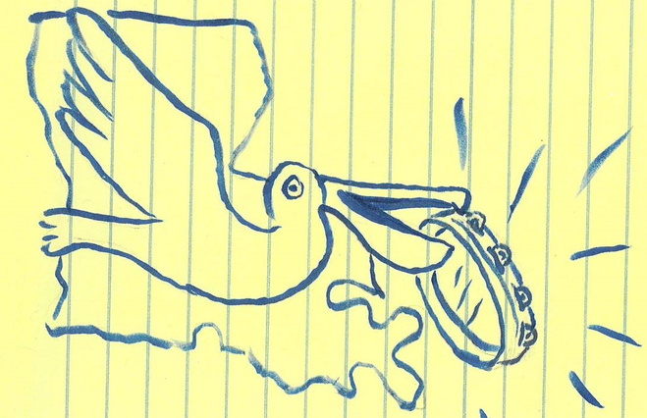
Things to Keep In Mind
New
Target Audiences
New Partnerships
Ways to build and expand
Ideas for
Improvement
Leverage the outcomes you’ve tracked
Keep in touch with your local grants administrator

Slide 14

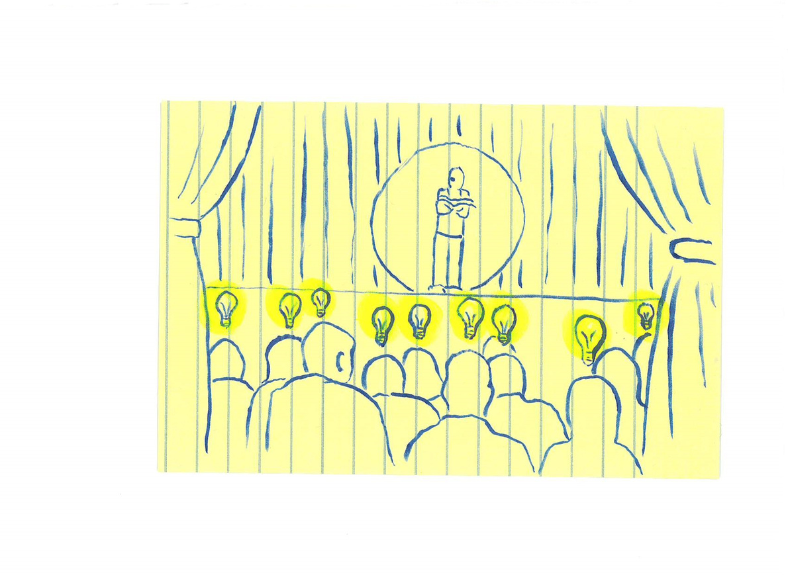
Hand Clap!
Thank You!
Take a bow!

