Slide 1

Understanding Payroll:
Policies, Process and Compliance
For DCRT/OLG Employees

Slide 2


Accessing LEO
How to log in and navigate the LEO portal
Password Assistance
Steps to reset or recover your password
Time & Leave Entry
How to accurately enter and submit time and leave requests
Supervisor/Approve E-Approve
Supervisor instructions for reviewing and approving time statements
Electronic Prior Pay Period Adjustment (Eppa)
When and how to submit corrections for previous pay periods
CATS Timeline
Key deadlines for CATS payroll processing
Questions & Answers
Supervisor/Approver Time & Leave Entry Approval or Rejection How to accurately approve or reject pending time entries
E-Certification
Certifying your timesheet as an employee
Common Payroll Errors
LEO (Louisiana Employees Online) – A web-based application which allows an employee to submit his/her bi-weekly time statement. LEO also allows an employee to view and change personnel information, including leave balances, banking information, tax information, and home/mailing addresses.

Slide 3
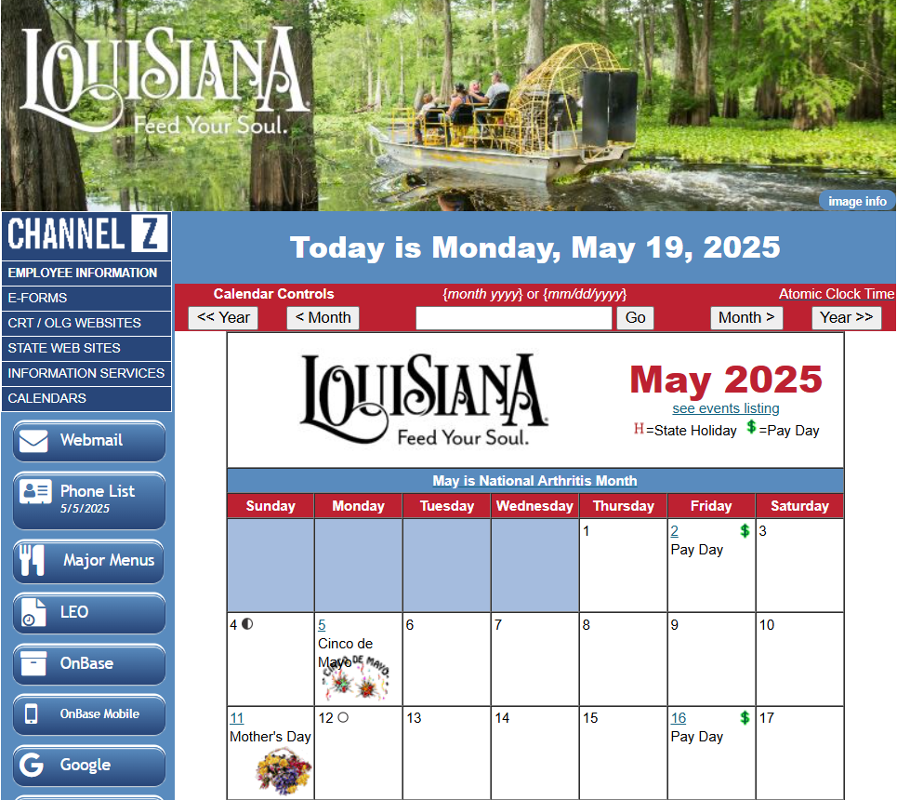
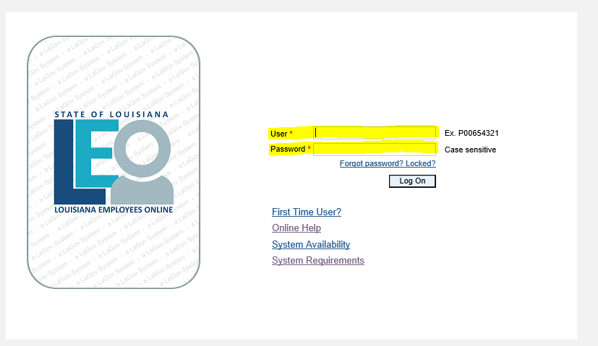
Logging into LEO
* two options are available*
Channel Z ▶ Click on LEO
https://leo.doa.louisiana.gov
Log into LEO with Username and Password

Slide 4
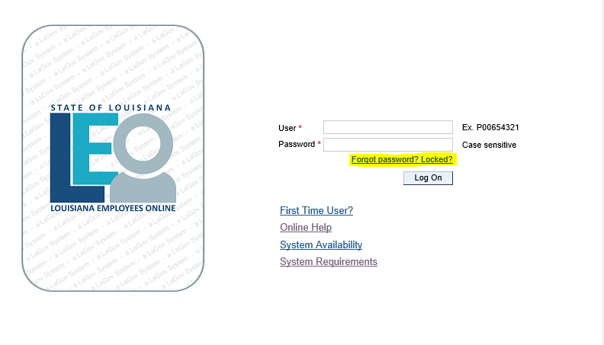
Forgot Password? Locked?
Click the highlighted link ➡ and follow the steps to reset your password
Please ensure you have access to the email address associated with your LEO account. If you no longer have access to your verification email address, kindly contact HR for assistance
For a step-by-step guide on navigating the password reset process, please refer to the attached supplemental Word document

Slide 5

Steps To Reset Password
1. Go to the LEO or LaGov ERP Login page (do not enter anything). Click “Forgot password? Locked?”
*NOTE: You cannot reset your password until you tell the system which of your email addresses to send your access code and any other notifications to.
2. If you have a verification email address saved, click “I know my verification email address” and enter that address to get an access code. If you do not have a verification email saved, click "I want to store my verification email address". You will be prompted to enter your master data and answer a security question for verification.
3. Enter an email address and press “Submit”. Make sure it is an email address that you can easily access. It can be work or personal. Click “Quit” once you get the message “Your verification email has been saved, and a confirmation email has been sent to this address“.
4. An email will be sent to your verification email address. Open it and click the “Confirm Email” link. If successful, a screen is returned that ENTERED, “Your verification email has been confirmed.” To continue, click the “Return to Password Maintenance” link.
5. Select the "I know my verification email address" link. Type in your email address. (You will have to enter your Master Data and will be asked a previously set up security question for verification.)
6. An access code will be sent to this verification email address.
*DO NOT CLOSE THE WINDOW WHERE THE ACCESS CODE NEEDS TO BE ENTERED, or you will have to start over and request another code.
7. Go to your verification email account and find the email that contains your Access Code. Type that value into the “Access Code” field.
8. Next, you may be prompted to set up two additional security questions. From this screen click “Next” to Reset Password. (If you do not wish to save a new password, instead select “Save & Quit”.)
9. Type in your new password. Be sure to read the requirements. Keep in mind that it must be different from your last 24 passwords. Must contain a special character (, !@#$%^&*()-_+{[=\|/:;}]<>) Must contain at least 1 lowercase letter
NOTE: Passwords will continue to expire every 90 days. You will not be required to change your password to the new requirements until it has expired or until you become locked out of the system.
Select “Change Password” (not Quit).
If you encounter any issues or need further assistance, call 225-342-0880.

Slide 6
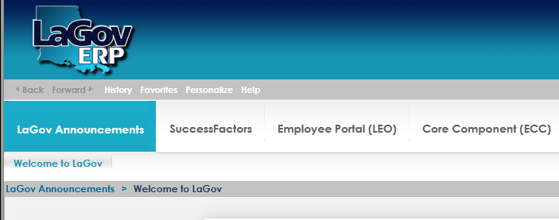
Employee Portal (LEO)
Click on Employee Portal (LEO) to access CATS Time Request

Slide 7
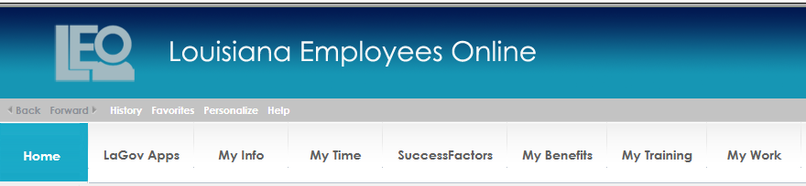
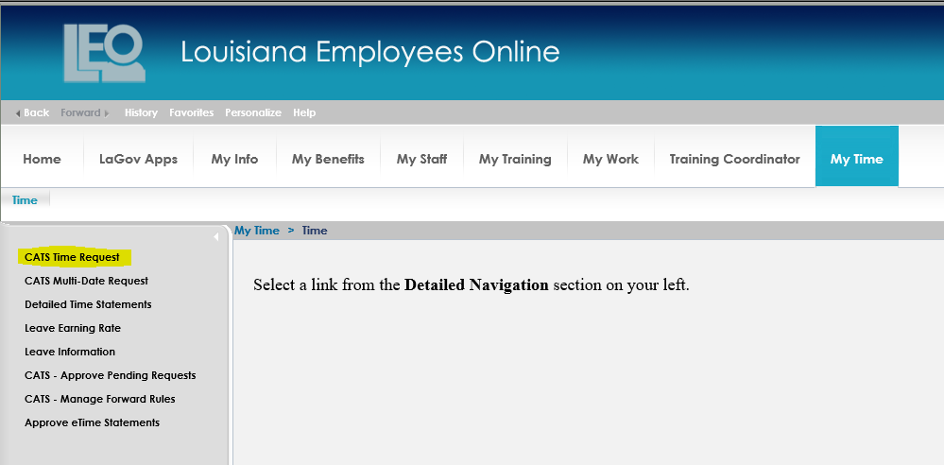
CATS Time Request(s) for all absence/attendance codes
Click on “My Time”
Click on CATS Time Request
CATS (Cross Application Time Sheet) – A computer-based application which can be accessed through LEO. CATS allows an employee to enter his/her regular attendance and absences, to view and approve his/her bi-weekly detailed time statement, to request leave, and to claim overtime. CATS also allows an employee to enter any required position costing information, if applicable.

Slide 8
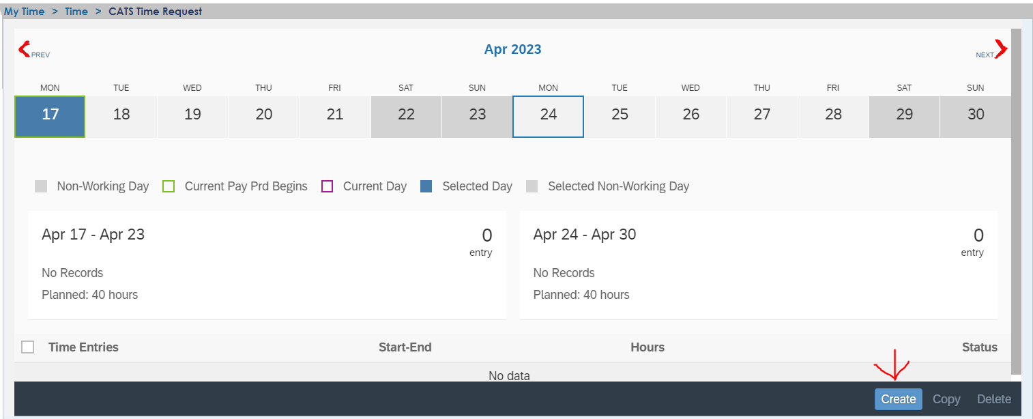
Click on the date for the entry
(note: you can click “prev” or “next” to scroll through the dates
Click on “Create”

Slide 9
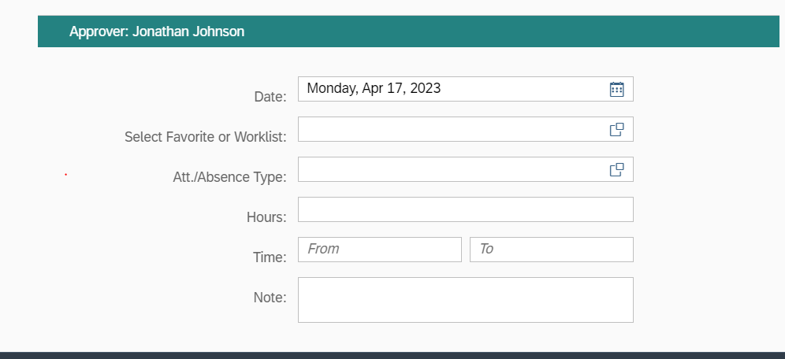
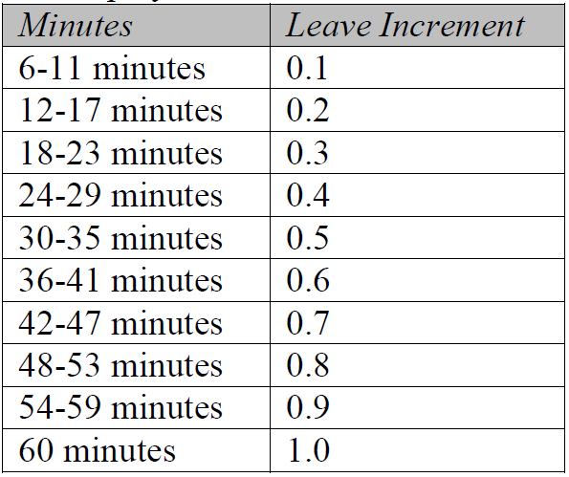
Complete the highlighted fields below
*Attendance/Absence Types are on the following slide
Once completed, click “Submit”
Use chart for increments
Justification for all K-time is required in the comment section of the CATS K-time request. PPM 42

Slide 10
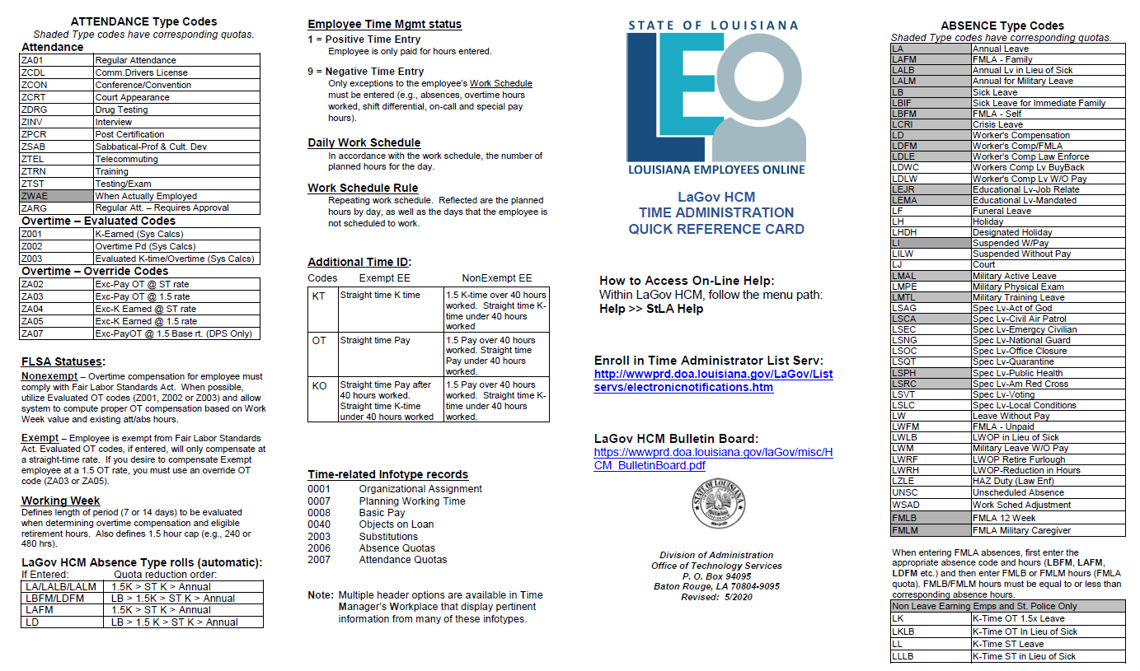
Attendance and Absence Types

Slide 11
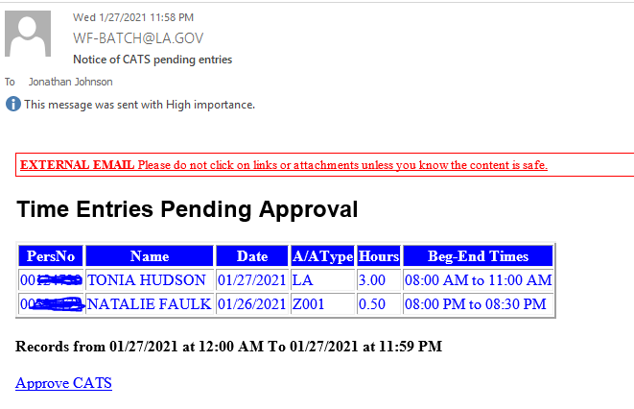
Supervisor/Approver eApprove –
Time Entries Pending
Once an employee makes a LEO entry, the supervisor will receive the following email:
Click on this link to proceed
Ensure all entries are reviewed and approved promptly.
Do not allow entries to auto-approve.

Slide 12
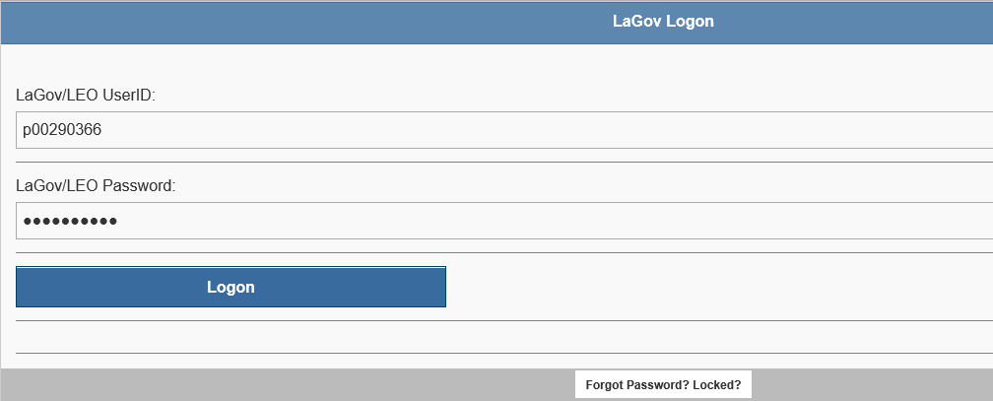
Supervisor eApprove – Pending Time Entries
After clicking the Approve CATS link, you will be directed to the LaGov Logon screen, as shown below:
Click the Logon button to proceed

Slide 13
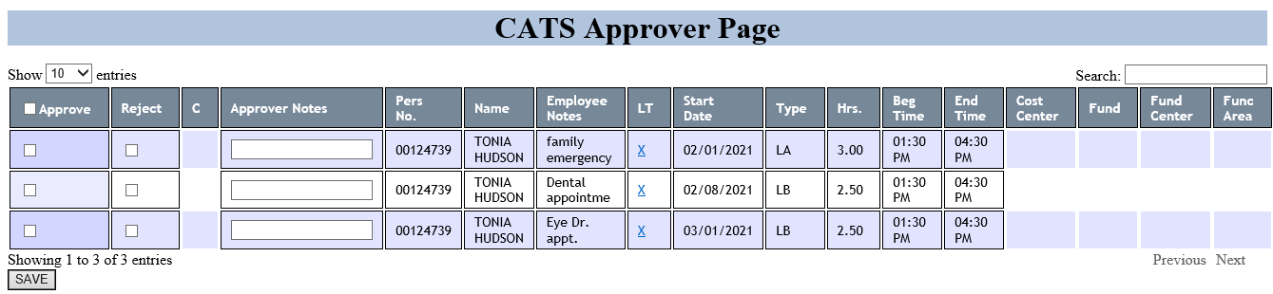
✅ Time Entry Review Checklist (Before Approval/Rejection)
Begin and End Times:
Confirm that start and end times are accurate
AM/PM Designation:
Ensure AM and PM are correctly selected
Total Hours Match:
Verify that the number of hours requested matches the time worked
(e.g., 7:00 AM – 3:30 PM with 30-minute lunch = 8 hours)
Lunch Breaks are Accounted For:
Check that lunch has been accounted for is working over 5 hours
You must also verify any notes the employee has added align with the type of leave they are requesting.

Slide 14
CATS Approver Page
Select the approve box if you are satisfied with the entry.
Select the reject box if you are not satisfied with the entry. Please be sure to also include a note as to why you are rejecting the entry. This will assist the employee in correcting the rejected entry.

Slide 15
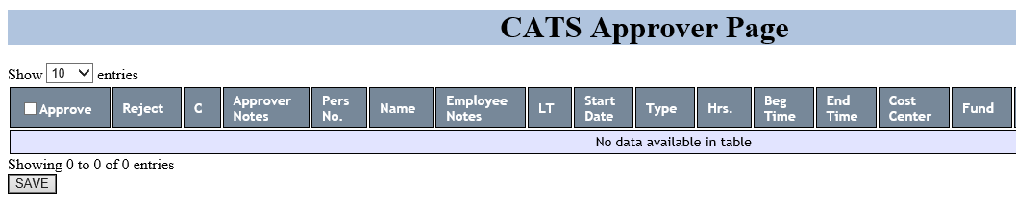
CATS Approver Page
After you approve or reject time entries, the screen will update as shown below. If there are no remaining entries to review, the message
“No data available in table” will appear.
At this point, no further action is required.

Slide 16
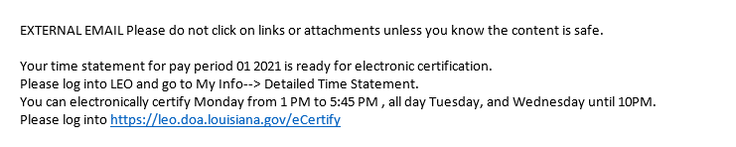
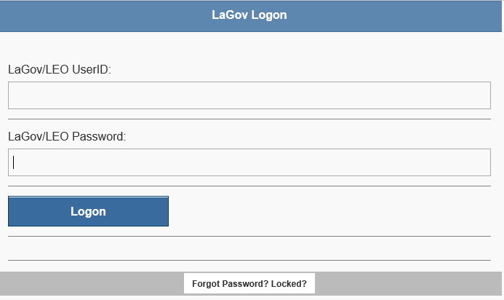
CATS E-Certification
On payroll Monday, every employee will receive the following email:
Open the email and click the link provided, see below:
Once you click on the link, you will be prompted to log into your LEO account:

Slide 17
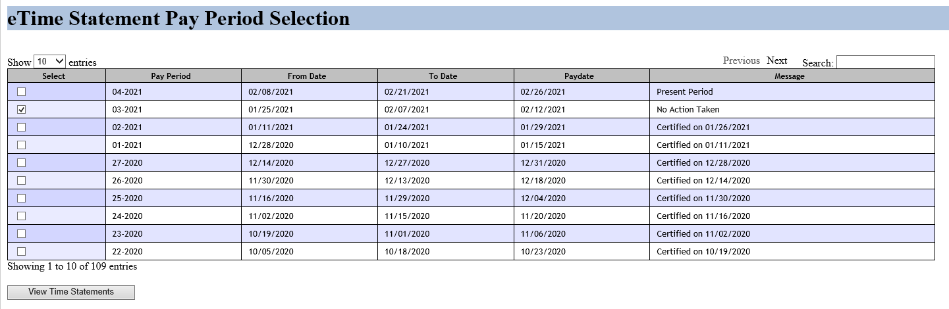
Select the pay period (should be the 2nd option down) and click “View Time Statements”
Detailed Time Statement – The bi-weekly record of an employee’s attendance and absences. The detailed time statement may also include costing information as it pertains to grants and special projects.

Slide 18
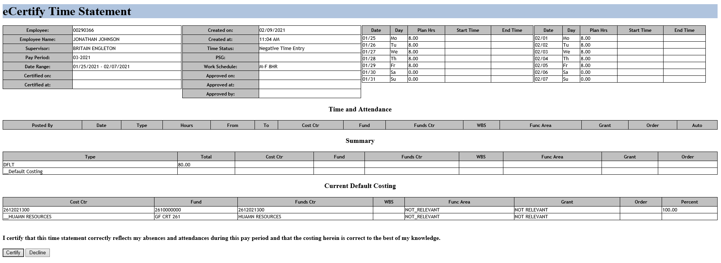
Review your time statement for accuracy and click “Certify”. Only select “certify” if entries are correct.
Certify – An employee shall certify his/her detailed time statement if no corrections need to be made.
Decline – The process by which an employee rejects his/her detailed time statement.
Employees MUST certify time statements by 12 PM on payroll Wednesday.
Employees with zero hours are required to certify statement.

Slide 19
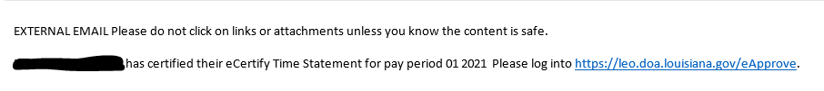
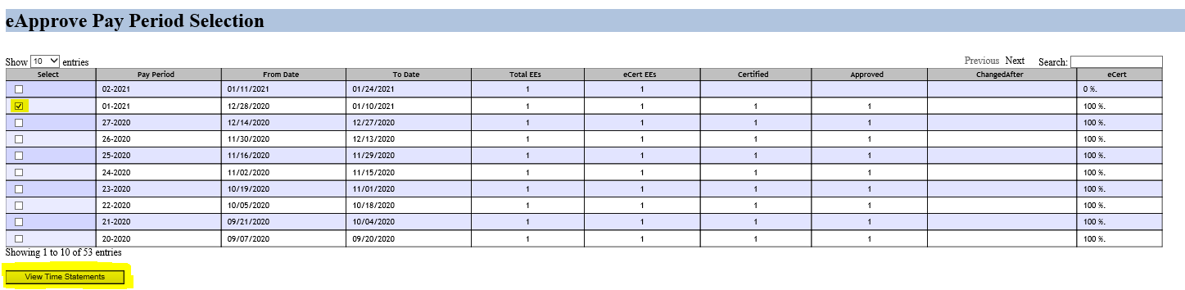
CATS E-Certification Approval for Supervisor/Approver
Once an employee certifies their time, the supervisor will receive the following email:
Open the email and click the link provided, see below:
.
Select the pay period (should be the 2nd option down) for review/approval and click “View Time Statements”

Slide 20
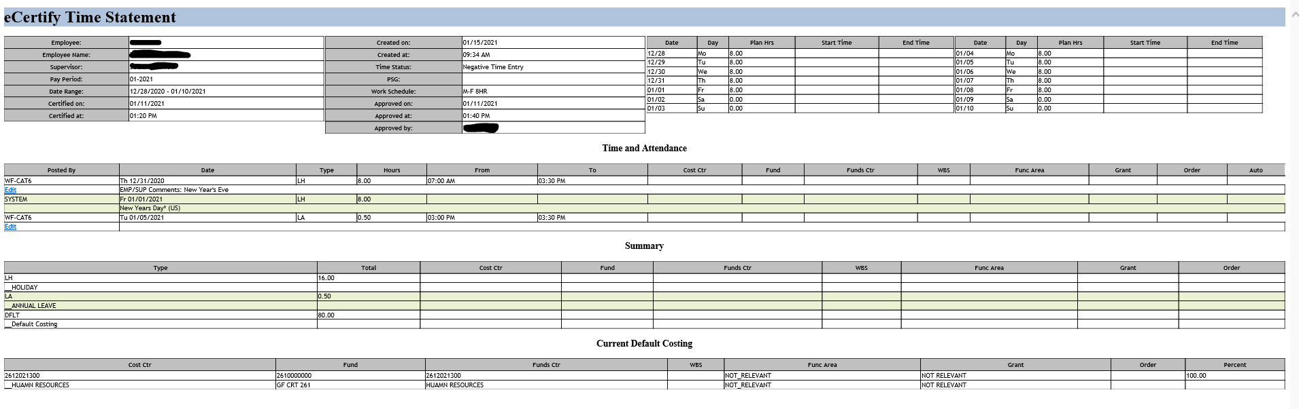
Click on the “X” to pull up the time statement for review:
Review time statement:
Supervisors MUST approve all subordinate time statements by 12 PM on payroll Wednesday

Slide 21
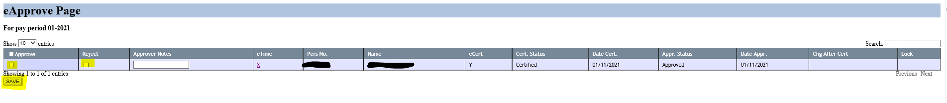
Once reviewed, return to eApprove page and select “Approve” or “Reject” and then “Save”:
If rejected, the supervisor must enter a reason for the rejection and contact the employee to correct the entry in CATS or request an Eppa if payroll has closed.
Please note:
Supervisors MUST mark all timesheets as approved or rejected by 12 PM on payroll Wednesday, even if the employee has not marked the time sheet as certified.
It is the supervisor's responsibility to ensure their employees have certified their timesheets in a timely manner.
eCertification (eCertify) – A computer-based process that allows an employee to review, edit notes, and submit for supervisory approval his/her bi-weekly detailed time statement.

Slide 22
Generating an Eppa
All Eppa’s are electrically processed. Follow the instructions below to generate an Eppa.
DCRT's Channel Z (state.la.us)
Click Employee Information
Click Human Resources
Eppa Adjustment Form
ALL fields are required, do not leave any field blank.

Slide 23
Generating an Eppa
The original data side should include EVERYTHING that is currently entered in CATS for the specified date with errors.
If an employee has several entries (i.e. ZA01 & LA, or LB, or K-time, etc.) for the date that needs an adjustment, ALL the entries should be listed, not just the one that needs to be changed.
The correct data side should include EVERYTHING that should be entered for the specified date which contained errors.
If an employee should have several entries (i.e. ZA01 & LA, or LB, or K-time, etc.) for the date that needs an adjustment, ALL the entries should be listed, not just the one that needs to be changed.
Make sure to include your correct P # along with the correct agency and agency
Submit your request once you have completed the Eppa form.
The completed Eppa form will be emailed to your time administrator (TA) along with the HR Payroll Department.
Once the request has been completed by your TA, the time approver will need to approve the pending entry.
HR will post the entry and notify the employee once this has been adjusted to their time statement.
Please refer to the next slide for an Eppa example
*** To avoid a delay in payment, all pending entries must be approved in a timely manner***

Slide 24
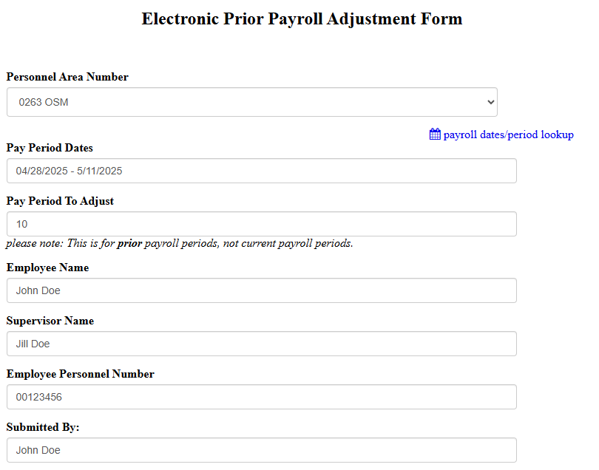
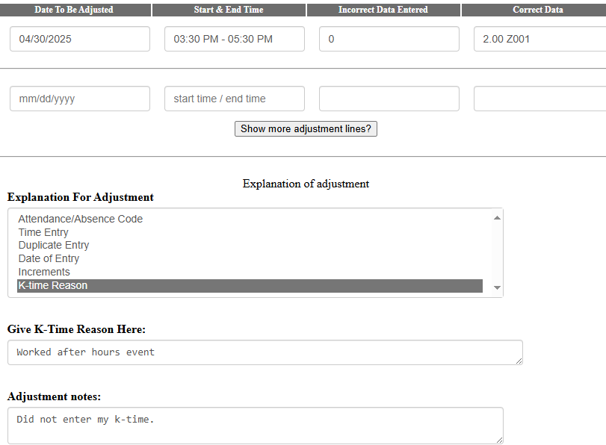
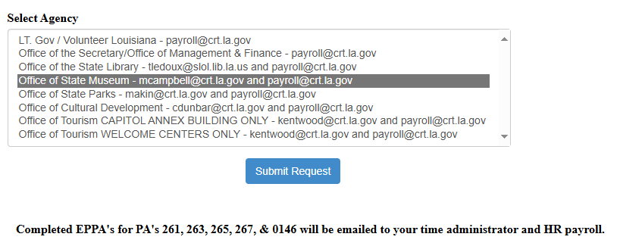

Slide 25
Common Issues to Avoid
Employees entering wrong attendance/absence codes.
Employees are frequently entering incorrect codes. Please ensure that the appropriate codes are used.
Frequently used absence codes - LA-annual leave, LB-sick leave, LF-funeral leave, LH-holiday, LHDH-designated holiday, LW-leave without pay, LJ- Jury Duty.
Frequently used attendance codes: ZA01- regular hours, ZWAE- WAE regular hours, ZARG– student regular hours, Z001-earned k-time, On-Call 0062.
Employees entering hours not in increments of “.10”.
Full-time employees on positive time entry recording less than 80 hours of payable time each pay period.
Part-time, positive time entry employees not reporting the correct numbers of hours worked.
K-time reason not added which is mandatory per PPM # 42
** Inaccurate time reporting can lead to payroll discrepancies and potential compliance issues.
** Please verify all entries before submission.

Slide 26
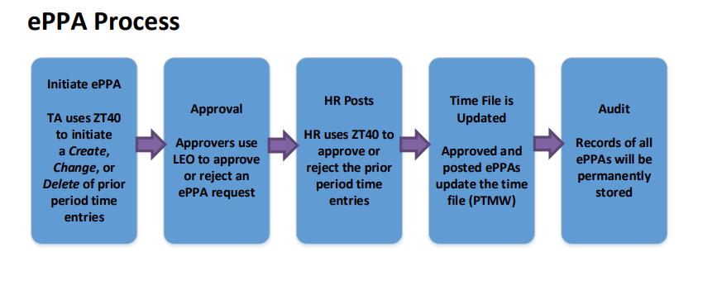
Electronic Prior Pay Adjustment

Slide 27
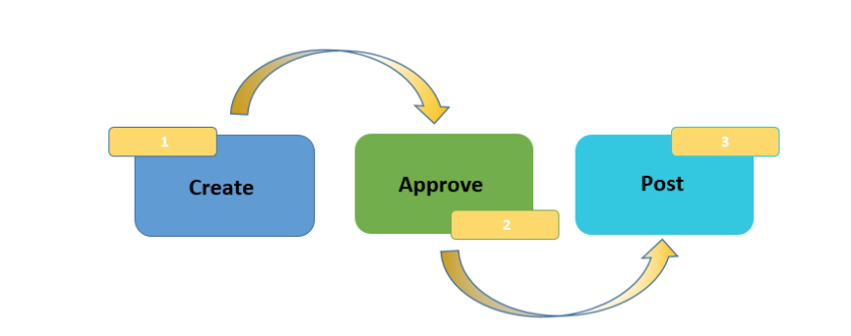
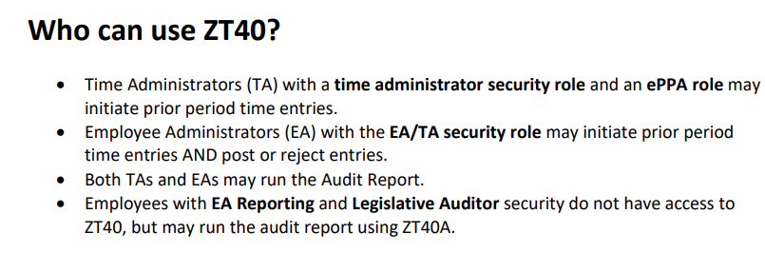
Electronic Prior Pay Adjustment

Slide 28
Payroll Monday Corrections
To assure accuracy of employee payments, all corrections should be submitted to your time administrator no later than 11:00 AM on payroll Monday.
Failure to submit corrections before the 11:00 AM deadline could result in:
Overpayment
Underpayment
Policy - out of compliance

Slide 29
CATS Timeline
11:59 PM on last Sunday of the pay period - Deadline to enter or correct CATS entries for the current pay period.
11:00 AM on Payroll Monday – Deadline for Time Administrators to enter Eppa corrections.
Noon on Payroll Monday – Deadline for supervisors to approve or reject CATS entries for the recent pay period.
1:00 PM on Payroll Monday - Employees and supervisors can view Detailed Time Statements.
3:00 PM on Payroll Monday – HR deadline for Eppa corrections to ensure proper payment.
Tuesday – Review remuneration statement in LEO to verify projected payday payment.
Wednesday at Noon - Deadline for employees to review and eCertify Detailed Time Statements. Only correct Time Statements should be Certified. Time Statements with errors should be declined and an Eppa must be submitted to your time administrator to correct CATS errors.
Wednesday at Noon - Deadline for supervisors to review and eApprove Detailed Time Statements. Only correct Time Statements should be Approved. Time Statements with errors should be rejected and an Eppa must be submitted to your time administrator to correct CATS errors.
Note: If an employee has not eCertified their time, supervisors should review, approve/reject time statements, and add a comment regarding why the approval/rejection was done without the employee’s eCertification. (ex. Employee terminated, out on leave, etc.) Supervisors/Approvers will be out of compliance if comment has not been added.

Slide 30
Best Practices
To ensure correct reporting and timeliness, supervisors should log into CATS daily to review all employees time entries.
If there are any errors or missing entries, have employees correct immediately.
WAEs and Students should not make future time entries, rather wait until the end of their shift and enter time worked daily.
If a supervisor is out for an extended period, substitutions should be created. This can be completed through LEO.
Utilize the comments/notes sections for entry and approval.
WAE’s and Students should not enter CATS entries on payroll Monday. NO EXCEPTIONS.

Slide 31
Frequently Asked Questions
Q: I can’t see the trash can to delete my leave requests even though it has already been approved by my supervisor. How can the request be deleted?
A: Employees may only delete entries for the current pay period or future pay periods. Any requests to delete entries for past pay periods must be submitted via an electronic prior pay period adjustment. Contact your Time Administrator for additional instructions.
Q: I’m trying to enter my time in CATS, but I keep getting a message stating my personnel number is locked. How can I unlock it?
A: First, ensure that you do not have a LEO page open in the background. If that's not the case, please note that neither you nor HR can unlock the personnel number immediately. This lock is a security measure: the system assumes an unauthorized attempt to modify the time file. This can happen if you've navigated extensively within LEO or tried accessing the record shortly after a Time Administrator. . You need to log out, close the browser, and wait 15 to 20 minutes before attempting to log back in.
Q: Can someone else change my time in LEO for me?
A: No. LEO contains personal information (i.e. banking information, insurance coverage, etc.) which can be changed, so you shouldn’t give your LEO login information to anyone.

Slide 32
Frequently Asked Questions
Q: How far in advance can I request time?
A: We recommend employees only enter time for the current pay period. Entering time in future pay period can create several errors for certain actions, including payroll corrections.
Q: I am negative time entry, what do I enter in CATS?
A: Negative time entry employees do not need to enter their regular work hours because it is already entered for them. The only codes negative time entry employees need to enter are leave codes, proclaimed holidays, k-time, etc.
Q: I am positive time entry; what do I enter in CATS?
A: Positive time entry employees must enter ALL their time. This included regular work hours, leave hours, holiday hours, k-time, etc.
Q: Are students and WAE’s required to take a lunch?
A: Students and WAE’s are required to take a lunch away from their duty station if they are working 5 hours or greater.
Q: When does the employee enter FMLA leave requests…before or after approval?
A: Once they have been approved for intermittent leave and the quota is set up, then they can enter the FMLA related entries of LBFM or LAFM (your leave quota) and FMLB (your FMLA quota). If they do not have a quota, they must use LB or LA until there is approval to set up the quota. An Eppa will need to be submitted to change the past pay period entries when FMLA has been approved.

Slide 33
Frequently Asked Questions
Q: I forgot to add my note to a Z001 entry, and the pay period is closed. What do I do now?
A: During the e-Certification process, you will need to select edit under "WF-CAT 6" for the date with the k-time or submit an Eppa to your time administrator.
Q:What is e-Certification and is it necessary?
A: e-Certification is a mandatory electronic process of signing your time sheets for employees and their supervisors. When you and your supervisor certify your Detailed Time Statements, you are both agreeing that what was entered in CATS is what you worked for the pay period.
Q: An employee is trying to e-Certify their time but is receiving an error stating “Email address cannot be found, contact Human Resources”.
A: The employee needs to contact HR with the correct email address. Once this has been corrected, they will be able to certify their time.

Slide 34
Frequently Asked Questions
Q: I’ve noticed an error (either with the number of hours or type of hours coded) on my time statement but CATS is not letting me go back to change it.
A: That is because no changes can be made by an employee in CATS after the close of the pay period. You will need to contact your supervisor and time administrator to take the next steps in having the time corrected.
Q: I mistyped the start and end times on my leave. How do I fix this now that the pay period is closed?
A: If the only error to your time is the time stamps, you will need to select the edit function under the entry with the wrong times and type the correct times in the additional comments section.
Q: If my time is wrong on my e-certification, should I still certify it?
A: No. When you e-certify your timesheet, you are confirming that what is entered is correct. If it is not correct, you should click decline and then contact your supervisor and time administrator for instructions.

Slide 35
Frequently Asked Questions
Q: I was unable to certify/decline my time before 12 PM on Wednesday, and my time statement is locked. What is my next step?
A: Contact your time administrator to have it unlocked. Please keep in mind that all timesheets need to be certified, even if the employee fails to act by the Wednesday deadline.
Q: Monday is a holiday, and I’m usually off on Mondays, do I still get holiday hours?
A: Yes, if you are in a position that allows for holiday pay. For employees who are normally off that Monday, your designated holiday will be either working day that touches either side of the holiday as long as it falls within the same pay period. For the designated holiday, you will use the LHDH code instead of the LH code. If you work on your designated holiday, the designated holiday hours will be coded as LHDH and the hours you work will be coded as Z001 (k-time). Designated LHDH must be within the pay period of the holiday.
Q: A WAE employee has hours coded as ZA01, not ZWAE.
A: WAEs hours will read ZA01 as result of employees not selecting ZWAE as their Attendance type in the drop-down box and instead leaving it blank. When it is left blank and they click check or save, CATS auto fills the entry with ZA01. Employees should delete this entry and re-enter their time and select ZWAE in the drop-down box. If it is after the close of a pay period, contact the supervisor and time administrator to take the next steps in having the time corrected.

