Slide 1


Welcome to The Department of Culture, Recreation & Tourism!

Slide 2





Welcome to the State of Louisiana!

Slide 3









Who is DCRT?
Louisiana State Library

Slide 4


Department of Culture,
Recreation, and Tourism (DCRT)
Vision - We will re-image Louisiana as a leader of the New South. We will create economic growth by showing that Louisiana is not just a great place to visit, but also to live, work, and play.
Mission - The Office of the Lieutenant Governor serves all citizens through activities that:
  1. Prepare the Lieutenant Governor to serve as Governor in the event of a vacancy in the Office of the Governor or the inability of the Governor to act as such;
  2. Focus and prioritize the efforts of the Department of Culture, Recreation and Tourism;
  3. Promote and market Louisiana as a preferred choice for retirement to pre-retiring and retired individuals in an effort to retain and attract retirees while enhancing communities and improving the economic climate statewide through Encore Louisiana; and,
  4. Promote civic participation and community activism through programs funded and supported by Volunteer Louisiana Commission.

Slide 5
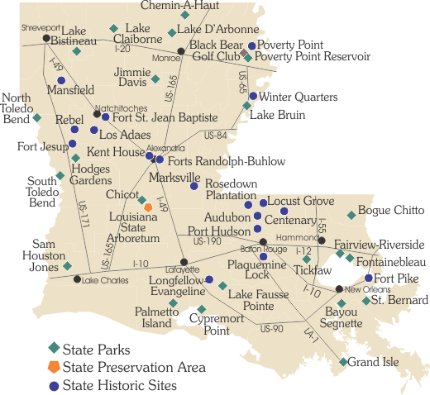

A Better Louisiana - Together
We are all one team – Culture, Recreation, and Tourism!
As one collective team, our goal is to increase economic growth throughout the state.
  That means that the actions or tasks that you perform at your specific site directly impact other sites and the state as a whole.

Slide 6
DCRT Agency Overview
Billy Nungesser – Lieutenant Governor
Julie Samson – Chief of Staff
Nancy Watkins– Undersecretary – Office of the Secretary
Margaret Placke– Assistant Secretary– Office of State Library
Susan Maclay- Interim Assistant Secretary- Office of State Museum
Brandon Burris – Assistant Secretary – Office of State Parks
Kristin Sanders– Assistant Secretary – Office of Cultural Development
Doug Bourgeois– Assistant Secretary – Office of Tourism

Slide 7
Standards of Conduct
All employees should:
Perform their job to the best of their ability
Maintain a professional demeanor at all times
Follow the dress code of your site or office
Align with their supervisor
Treat all coworkers and customers with respect
All employees are prohibited from:
Engaging in political activity
Accepting gifts and gratuities over certain values
Representing the state in media
Disclosing confidential and privileged information
Falsifying official records

Slide 8
General Safety Rules
1. Smoke only in approved areas.
2. Maintain housekeeping at all times. Keep equipment, tools, materials and work areas
clean and orderly.
3. Horseplay and fighting will not be tolerated in the workplace.
4. Possession of an un-authorized firearms, alcoholic beverages, illegal drugs, or
unauthorized medically prescribed drugs will not be tolerated in the workplace.
Inform your immediate supervisor if you are required to take medication during work
hours.
Written medical evidence stating that the medication will not adversely affect your
decision making or physical ability may be required.
5. Before beginning work, notify your supervisor of any permanent or temporary
impairment that may reduce your ability to perform in a safe manner.
6. Wear appropriate clothing and suitable work shoes for your work environment.
7. Personal protective equipment will be worn when required to protect yourself from
potential hazards that cannot be eliminated.
8. The use of assigned or available Personal Protective Equipment, when required to
perform a job, is a condition of employment.
9. Operate equipment, vehicles, etc., only if you are trained and authorized.
10. Never jump on or off moving equipment, machinery or vehicles.
11. Use proper lifting techniques. For objects exceeding 50 lbs. In weight, specific
methods for safe lifting must be determined by the immediate supervisor. Ask for
help if needed.
12. Inspect the work station for potential hazards and ensure that the equipment or
vehicle is in safe operating condition before using it.
Immediately report any recognized potentially unsafe condition or act to your supervisor.
14. If there is any doubt about the safe work method to be used, consult your supervisor
before beginning work.
15. Immediately report all accidents, near misses, and property damage to your
supervisor, regardless of severity.
16. Supervisors should obtain special safety permits when required. Examples of conditions
requiring special safety permits are work with hot objects and work in confined spaces.
17. Follow recommended work procedures outlined for the job including safe work methods
described in the job safety analysis.
18. Maintain an orderly environment and work procedure. Store all tools and equipment in a
designated place. Put scrap and waste materials in a designated refuse container.
19. Report any smoke, fire or unusual odors to your supervisor.
20. Do not throw or intentionally drop tools, equipment or materials. Never attempt to catch a
falling object.
21. Intentional misuse, neglect, or damage to tools, equipment, vehicles or property will not be
tolerated.
22. If your work creates a potential slip or trip hazard, correct the hazard immediately or use
safety tape to tag the area before leaving it unattended.
23. Obey all driver safety instructions.
24. You are required to wear seat belts where provided.
25. Safety signs are posted to remind you of safe practices. Observe and obey these instructions.
26. Comply with all traffic signs, signals, markers, and persons designated to direct traffic.
27. Safety meeting attendance is required.
28. Walk, never run, within the work premises except in emergencies.
29. Know departmental rules regarding first aid, evacuation routes, and fire/police department
notification.
30. Adhere to departmental rules and procedures specific to departmental operations.
31. Assist and cooperate with all safety investigations and inspections and assist in implementing
safety procedures as requested.
EMPLOYEES THAT FAIL TO ADHERE TO THE ABOVE SAFETY RULES MAY BE SUBJECT TO DISCIPLINARY ACTION, UP TO AND INCLUDING TERMINATION.

Slide 9
Channel Z
Channel Z can be accessed at http://www.crt.state.la.us/channelz/.
Employees can use Channel Z to access the following:
  LEO, Webmail, and the Employee Phone Directory
  E-Forms, Employee Handbook, Policies and Procedures
  Links to other OLG/CRT or State of Louisiana Websites
  Information Services Help Desk
  News, Media, and the Calendar of Events

Slide 10
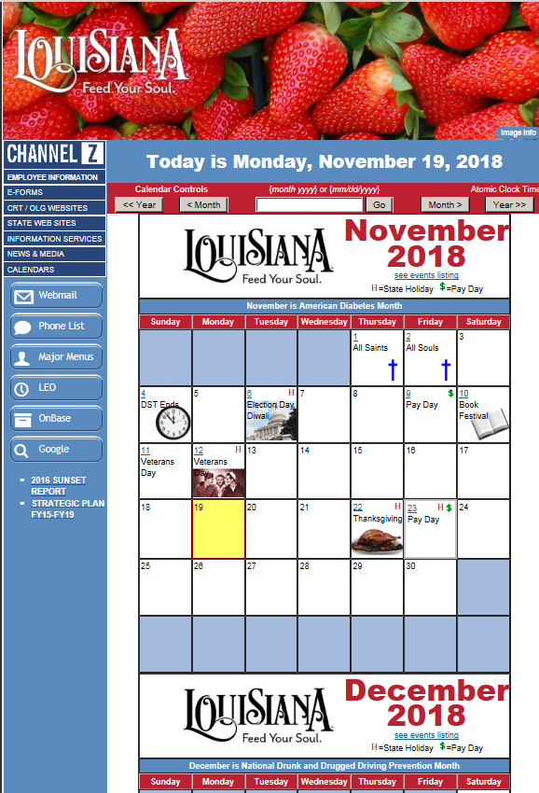
Channel Z
Employee Information
E-Forms
CRT/OLG Websites
Information Services
News & Media
Calendars
Employee Phone List
Major Menus

Slide 11
LEO
LEO can be accessed at https://leo.doa.louisiana.gov/irj/portal.
Employees can use LEO to access the following:
  Pay stubs, tax documents, and leave management
  Statewide employee directory
  Annual Learning Requirements and Supplemental Training
    Supervisor Group Training
  LEO Points of Contact, Technical Requirements

Slide 12
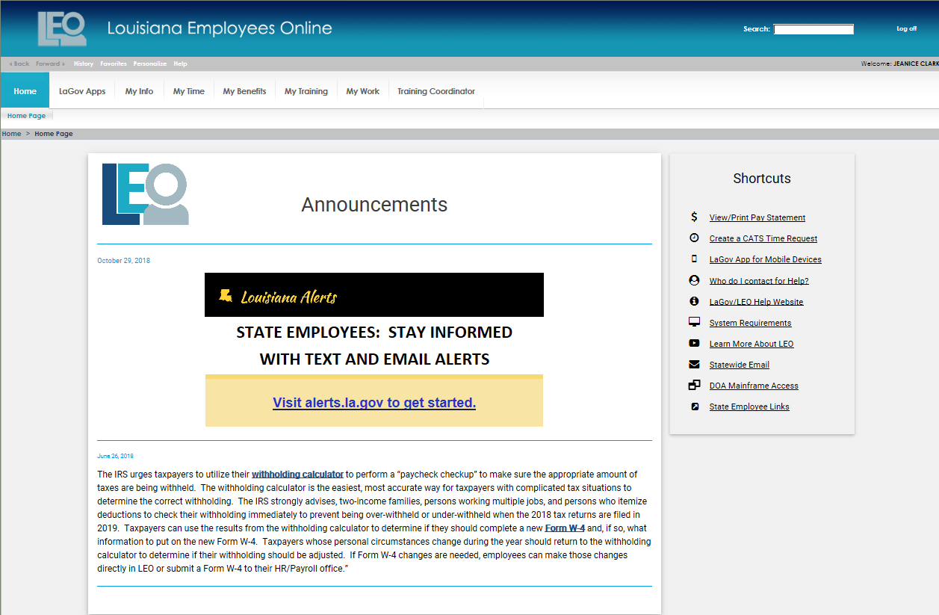
EXAMPLE OF LEO HOMEPAGE

Slide 13
Annual Learning Requirements
All Annual Learning Requirements can be accessed via SuccessFactors in LEO.
List of courses that should be completed within 30 days of hire:
Ethics
Preventing Sexual Harassment
Defensive Driving (if potentially driving a State vehicle)
Blood Borne Pathogens
Cyber Security
ADA Compliance (Supervisors Only)
If you have questions, please contact Natalie Faulk nfaulk@crt.la.gov or 225-342-0850.

Slide 14






Employee Perks
Employee Discounts
  15% off your AT&T bill.
  18% off your Sprint bill.
  Discounts on Dell, Microsoft, and Apple software, devices, and more.
  Discounts on membership to local gyms through OGB/BCBS

Slide 15


Employee Benefits
Health Insurance
  Offered to Full-time employees.
  Administered by Blue Cross Blue Shield.
  Five plans to pick from.
  Must enroll within 30 days of your hire date or during Annual Enrollment.
    May be given an exception, due to qualifying event.
Life Insurance
  Offered through Prudential.
  Choose from Basic Coverage and Supplemental.
Supplemental Benefits
  Several vendors to choose from.
  Product offerings - dental, vision, cancer, etc.
  Supplemental Vendor List
For additional information, contact Tonia Hudson in HR at 225.219.4331

Slide 16
Employee Benefits Continued..
Flexible Benefits
  Approved by the Internal Revenue Service for the tax‐free payment of eligible benefits.
  These benefits may include premiums for group health insurance, group life insurance, most payroll‐deductible benefits, and flexible spending accounts.
Deferred Compensation

Slide 17
Employee Benefits - Retirement
Louisiana State Employees Retirement System (LASERS)
What is LASERS?
  LASERS was established by the Louisiana Legislature in 1946, and administers a qualified pension and retirement plan under section 401(a) of the Internal Revenue Code. LASERS is a trust fund created to provide retirement and other benefits for state officers, employees, and their beneficiaries.
Why must I join LASERS?
  Membership in LASERS is mandatory for all state employees whose employing agencies are LASERS participants, except those exempted by state law or who meet certain or requirements. Employees with membership under other Louisiana retirement systems may be eligible to retain membership with the other system or join an earlier LASERS retirement plan.
How much do I pay?
  Any Regular Member of LASERS whose first employment began on or before June 30, 2006, pays a contribution rate of 7.5% of their salary, which is deducted from each of the employee’s paychecks and placed in a trust account that is used to pay benefits.
  Any Regular Member of LASERS whose first employment began on or after July 1, 2006, pays a contribution rate of 8% of their salary.

Slide 18
Employee Benefits - Retirement
When can I retire?
  If you are a Regular Member of LASERS, and were hired on or before June 30, 2006, you become eligible for retirement upon reaching one of the criteria below:
• 30 years of service at any age • 25 years of service at age 55
• 10 years of service at age 60 • 20 years of service at any age, actuarially reduced
  If you are a Regular Member of LASERS hired on or after July 1, 2006, and on or before June 30, 2015, you become eligible for retirement upon reaching one of the criteria below:
• 5 years of service at age 60 • 20 years of service at any age, actuarially reduced
  If you are a Regular Member of LASERS hired on or after July 1, 2015, you become eligible for retirement upon reaching one of the criteria below:
• 5 years of service at age 62 • 20 years of service at any age, actuarially reduced

Slide 19
Employee Benefits - Retirement
Where is LASERS located?
  Physical address - 8401 United Plaza Blvd, Baton Rouge, LA 70809
  Mail – PO BOX 44213, Baton Rouge, LA 70804-4213
  Phone – 1-800-256-3000 or 225-922-0600
  Website - www.lasersonline.org
  YouTube Channel - https://www.youtube.com/channel/UC0awZv9jT950-X6Ygju8IKg
For additional information, contact LASERS directly or contact Jonathan Johnson in HR at 225.342-1675.

Slide 20
Employee Benefits - Leave
Annual Leave
  Earned bi-weekly
  Use For:
    Vacation
    Personal time
    To care for sick family member
Sick Leave
  Earned bi-weekly
  Use For:
    Personal illness
    Medical/dental appointments
    To care for sick family member (if approved)
Funeral Leave
  Up to two days to attend funeral or burial rites
  Parent, step-parent, child, step-child, brother, step-brother, sister, step-sister, spouse, mother-in-law, father-in-law, grandparent, grandchild
Eligibility:
  Full time/part-time employees
    Not a classified WAE
  Begins to accrue on first day of employment
  Accrues each pay period
  Accrues each regular-duty hour
    Does not accrue for:
      Overtime
      Hours “on call”
      Travel or other activity outside regular-duty hours
      Hours for leave without pay

Slide 21
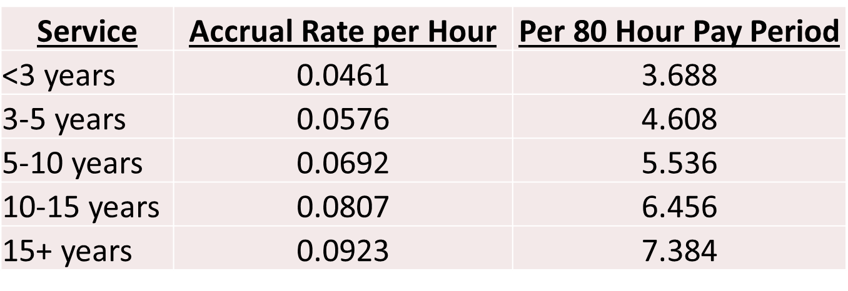
Employee Benefits - Leave
Annual and Sick Leave Accrual Rate of Hours

Slide 22
Employee Benefits - Leave
Holidays – Statutory
  New Years Day
  Mardi Gras Day
  Good Friday
  Independence Day
  Labor Day
  Veteran’s Day
  Thanksgiving Day
  Christmas Day
Holidays – Other
  General Election Day
    Every 2 years
  Gubernatorial Inauguration Day
    Every 4 years
    Only if you are domiciled in city limits of Baton Rouge
Holidays – Proclamations
  Additional holidays may be proclaimed at the discretion of the Governor

Slide 23
Performance Evaluation System (PES)
The State of Louisiana’s Performance Evaluation System (PES) is an annual process to determine and rate an employee’s overall job performance.
Three ratings:
  Exceptional – employee is eligible for market adjustment at end of fiscal year*
  Successful – employee is eligible for market adjustment at end of fiscal year*
  Unsuccessful – employee is ineligible for market adjustment at end of fiscal year
PES Planning Document will be completed for each employee within first 90 days of hire.
Rated on 3+ objectives:
  Related to Position Description
  Related to Position Description
  Related to Position Description
* - will depend on the financial status of the agency and the State of Louisiana as a whole. Eligibility is by no means a guarantee of a merit increase.

Slide 24
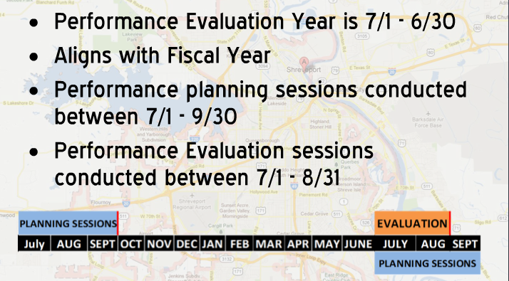
Performance Evaluation System (PES)

Slide 25
DCRT Human Resources Department Staff
Name | Program Assignment | Contact Info | Name | Program Assignment | Contact Info
Britain Engleton HR Director | Overall HR Program Employee Relations – Counsel employees, Supervisors and Managers on Civil Service Rules, Federal & State Laws, ACA, FMLA, EEOC, ADA, Leave and discipline Develops/Writes Policies Discipline/Counseling/Legal Issues Layoffs 6.5(g) - Optional Pay, Crisis Leave | 225-342-0880 bcarbins@crt.la.gov | Troi Johnson HR Analyst | Employee Administration: Recruiting and payroll (i.e., qualify applications; issue eligible list; enter 301’s, work schedule changes, etc.) Class & Pay Job Descriptions Pay Analysis TO for All Agencies Processes WAE Contract renewal – all agencies -Office of the Lieutenant Governor -Office of the Secretary/Management & Finance -Office of State Museums -OSP All regions - WAE | 22-342-9998 tjohnson@crt.la.gov
Alyson Bauer HR Supervisor | Supervision of subordinate Employee Relations staff in the duties of Recruiting, Employee Administration, Classification and Pay, and administrative programs for DCRT. Supervision of Administrative Coordinator and front office duties. Audits all sections work. Student Verification, Transcript Verification, Permanent Status/WAE Contracts – all agencies, Expired job descriptions – all agencies, Job Descriptions, Pay Analysis, Organizational Charts, 6.5(g) Audit prior to approval, COE Approval, Back-up for all EA’s duties | 225-342-0954 abauer@crt.la.gov | Melissa Thibodaux HR Analyst | Employee Administration: Recruiting and payroll (i.e., qualify applications; issue eligible list; enter 301’s, work schedule changes, etc.) Class & Pay Job Descriptions Pay Analysis TO for All Agencies Special Projects, as needed -OSP All regions – Full Time only | 225-219-9413 mthibodaux@crt.la.gov
Jonathan Johnson HR Supervisor | Supervision of subordinate staff in the duties of Benefits, Timekeeping and administrative programs for DCRT. Audits all sections work. Benefits: Family Medical Leave Act (FMLA), Health Insurance, Vendors, OGB Invoice- Back up | 225-342-1675 jjohnson@crt.la.gov | Natalie Faulk HR Specialist | Time & Attendance (CATS) Prior Pay Adjustments for all of DCRT Unemployment Student Verification Employment Verification PES | 225-342-0850 nfaulk@crt.la.gov
Tonia Hudson HR Specialist | Benefits: Retirement (Back up) Family Medical Leave Act (FMLA), Crisis Leave, Worker’s Compensation, OGB Active and Retirement Invoice | 225-219-4331 thudson@crt.la.gov | Gillis Dance Admin Coordinator | DCRT HR Reception/Front Office Drug Screens, New Hire Paperwork, E-Verify Badges, Charitable Campaign | 225-342-0880 gdance@crt.la.gov
Lance Guest Attorney | Employee discipline | 225-219-9535 lguest@crt.la.gov | Elsie Huffman– WAE Admin Coordinator | Special Projects | 225-342-0880 ehuffman@crt.la.gov
Pacee Wallace HR Analyst A | Employee Administration: Recruiting and payroll (i.e., qualify applications; issue eligible list; enter 301’s, work schedule changes, etc.) Class & Pay Job Descriptions Pay Analysis TO for All Agencies Office of State Library Office of Cultural Development Office of Tourism | 225-342-8202 pwallace@crt.la.gov | Alicia Clesi– WAE HR Specialist | Special Projects | 225-342-0880 aclesi@crt.la.gov

Slide 26

Thanks for making Louisiana a great place to visit, live, work, and play!
The End

